Slide 1
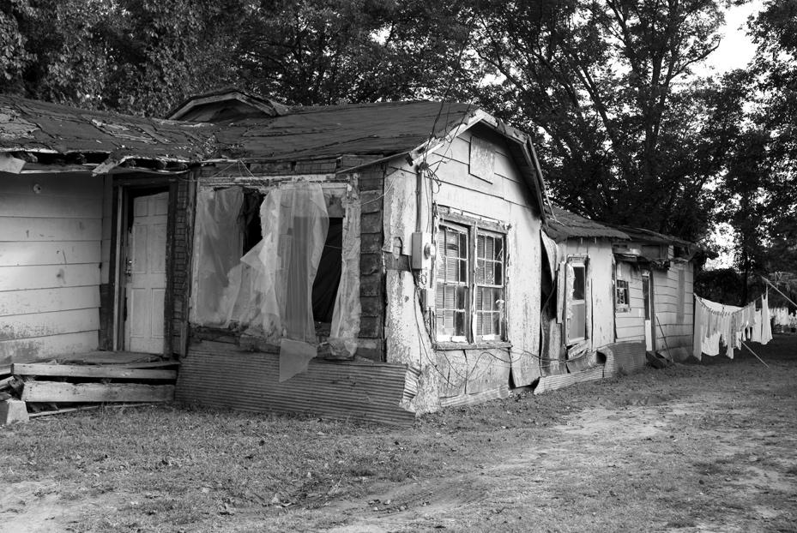
Lesson 6.3: Rural Poverty
Obj. 6.3: Examine poverty-related barriers that can hinder healthy living.
Module 6: Rural Health
Notes:
Overview: Students will calculate their estimated daily cost of living and learn about the definition of extreme poverty. They will examine how poverty is defined and listen to an audio interview from a man who works to bring strategies to the rural poor and has given politicians tours of his rural community. Then students will examine barriers to health caused by poverty through the lens of basic human rights. Finally, students will write a short story about a fictitious character who is living in poverty in a rural community.
Image source: http://www.flickr.com/photos/httpoldmaisonblogspotcom/3554602781/

Slide 2
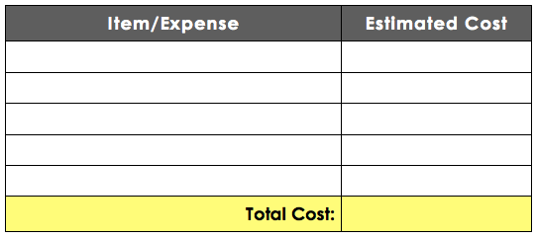
Do Now: Cost of Living Estimate
Estimate how much money you spend on an average day. Consider food, transportation, recreational spending, and any other costs you can estimate for a single day. Add every cost you can think of, no matter who pays for it (you, your parents, or someone else).
Notes:
Be aware that some students are likely to be living in poverty and this may be a sensitive issue. Establish norms and an environment of respect.
Ask students how they would spend their money if they only had half of the amount they estimated? If they only had $2 per day? $1 per day?

Slide 3
Discuss: Extreme Poverty
--Extreme poverty in the United States: households living on less than $2 per day
--1.2% of the US population in 2011 (household size of 2.55 people)
“Extreme Poverty in the United States, 1996 to 2011.” National Poverty Center, February 2012.
Was it difficult or surprising to calculate your daily expenses? What was the biggest source of expense?
If you had to live on significantly less per day, how might this impact your life and your health?
One dictionary definition of poverty is, “the state of one who lacks a usual or socially acceptable amount of money or material possessions.” Beyond this definition, how would you define poverty?
Notes:
Tell students that globally, 1 in 5 people live on less than $1 per day.

Slide 4
How is Poverty Defined?
*Any individual with total income less than an amount deemed to be sufficient to purchase basic needs of food, shelter, clothing, and other essential goods and services is classified as poor.
*The 2012 poverty line for an individual under 65 years of age is $11,945. The poverty line for a three-person family with one child and two adults is $18,480. For a family with two adults and three children the poverty line is $27,400.
Notes:
Ask students, how might the same income result in differences in lifestyle for someone living in a rural vs. urban setting.
Source: http://www.ers.usda.gov/topics/rural-economy-population/rural-poverty-well-being/geography-of-poverty.aspx#.Uu16O3ewKgk

Slide 5
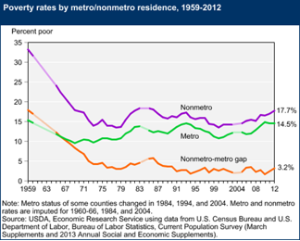
Poverty:
1. What has happened to Nonmetro (rural) poverty since 2004?
2. What overall trend do you notice about the Nonmetro-metro gap?
Notes:
Answers:
Nonmetro poverty has risen, approximately 3-4 percent, since 2004.
The nonmetro-metro gap has made small fluctuations over time, but has remained between 2-5% since the 70’s. Ultimately, this means that 2-5% more nonmetro (rural) residents are living in poverty.

Slide 6
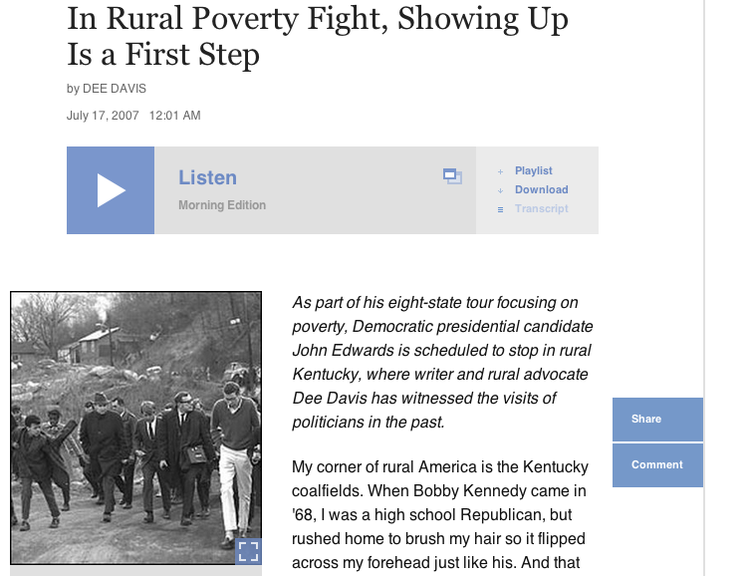
In Rural Poverty, Showing Up is the First Step.
How do you think Dee Davis would describe the effect of poverty on health?
Notes:
Play the audio of the interview for the students, as it captures the emotion, tone, and character of the narrator. Consider having students just listen the first time through, then re-read the transcript a second time in their workbook, marking it up with active reading notes as they go. Audio clip can be found at: http://www.npr.org/templates/story/story.php?storyId=12017456

Slide 7
Poverty-related Barriers to Health
Poverty as a direct cause of negative health
Ex: poor > no money to purchase food > hunger and malnutrition
Poverty as a correlate to negative health
Ex: poverty > low health literacy/poor education on healthy diet >(?)> consumption of sugary beverages
Basic rights:
shelter, sanitation, water, information, nutrition, health, and education
Notes:
Causation vs. correlation is a high level, but essential concept to teach. It will be explored more in other modules. In studying poverty and it’s relation to health, it is very important to stress the myriad ways that poverty creates health problems. Some results of poverty may be direct causes of health problems, others may be indirect or play some unknown role. All in all, there are thousands of studies of how it does indeed lead to poorer health outcomes.

Slide 8
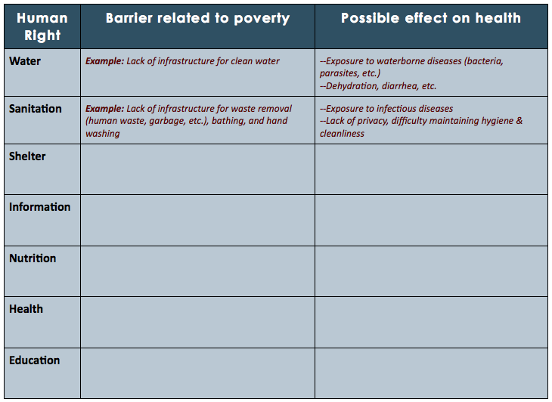
Poverty-related Barriers to Health
Notes:
Students can work in pairs or teams to fill in the chart. The barriers can be any specific effect that poverty creates. For example, in the information category, students may list the following as barriers: -Lack of computers/technology/internet in the home, -Lack of adequate education/health ed; -Lack of parental guidance in decision-making; -Lack of books in the home, etc. These barriers may be linked to many effects. Students may need more paper and can use additional sheets, or even butcher paper in groups to display on the wall.

Slide 9
Assess: Short Story
Write a short story about one day in the life of a fictitious character growing up in poverty in a rural community. In the story, include at least three poverty-related barriers and their effect on the health of your character.
Notes:
Have students peer-evaluate their stories, looking for three barriers and their effects on health. This will allow students to learn from one another and share viewpoints.

Slide 10
Homework: Representations of Poverty & Health
Find a representation of poverty and its impact on health on the Internet. This could be a news article, blog post, poem, short story, book, film, political cartoon, or work of art. You are not limited to those options, but those are examples of resources.
1. Describe your representation of poverty.
2. What barriers did it represent?
3. How does poverty impact the health of the subject?
Notes:
The purpose of this homework is to give students a chance to explore others’ stories, new perspectives, and different barriers/effects than those discussed in class.

