Slide 1
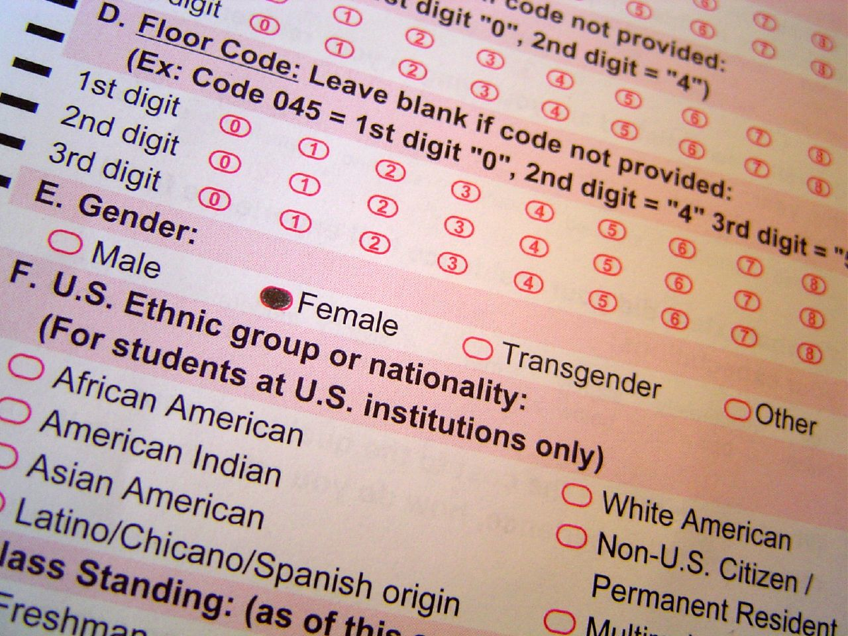
Lesson 6.11: Survey Design
Obj. 6.11: Identify potential problems in the design of survey questions.
Module 6: Rural Health
Notes:
Overview: Students will be introduced to basic survey design and have an opportunity to practice devising basic survey questions. Students will examine a survey and look for problems with its questions, review the steps to carrying out a survey, read about potential pitfalls in survey question writing, and devise a research question and two survey questions to gather data. For homework, they will translate these questions into an online survey tool which will serve as practice for the next case study.
Image source: Flickr, User Robyn Lee, http://www.flickr.com/photos/roboppy/9625780/

Slide 2
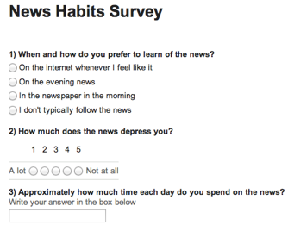
Do Now
What problems do you notice?
Notes:
Example answers:
Question is asking two things at once, answer responses are complicated (one part may be true while the other part is false, for example you may read the newspaper in the evening, not the morning)
Question is leading, perhaps the news uplifts the person but the wording of the question is biased to portray news in a negative sense. A better rewrite would be “How do you feel after watching the news?” with appropriate answers to cover the range of possible feelings.
An open-ended question may be difficult to tabulate data from; It also does not specify whether we should answer in hours, minutes, etc. or even that we should at least include units. A person who may not view the news every day (say once per week) may also have difficulty answering this (do they average that time between 7 days?)

Slide 3
Discuss: Survey Obstacles
A student wants to gather information on the obesity problem in her school. She decides to create a survey that will ask people about their height and weight (to calculate BMI), their eating habits, any health issues they have, and their self-perception of their own weight. What are some obstacles this student would face in designing and conducting her survey?
Notes:
Some possible obstacles She is gathering potentially sensitive information (need to get approval, perhaps parent approval, or if it were an academic institution, IRB approval), need to maintain confidentiality and make survey optional/no pressure, need to make it anonymous, etc.). If all this were taken care of, she would also need to determine how accurately people can estimate their height and weight if they are self-reporting these variables.

Slide 4
Steps to Conducting a Survey
1. Clarify purpose
2. Assess Resources
3. Decide on Methods
4. Write Questionnaire
5. Revise questionnaire
6. Prepare Survey
7. Collect data
8. Process data
9. Analyze the Results
10. Interpret the Results
11. Take Action
Notes:
Instill the importance of Step #1 into students. All of the time, energy and resources that go into steps 2-11 can be a complete waste if their purpose is not clear, appropriate, and aligned to the survey that results from it.

Slide 5
Discuss: Advantages & Disadvantages
What are the advantages and disadvantages of using surveys to collect data?
Notes:
Advantages: Surveys are a great way to collect information from a large group of people. More structured than interviews, allowing an objective and controlled comparison. Self-administered, meaning that the respondent of the survey fills out the survey form by him or herself. Survey respondants may be biased or self-report information that is not entirely accurate or true, for a variety of reasons
Disadvantages: May lack the depth that an interview could have (people can't usually explain their responses). Sometimes need to be read aloud to respondents, taking time.

Slide 6
Writing Surveys
1. Surveys should have a clear focus
2. Surveys should be short and questions should be concise.
3. Use closed-ended questions
4. Avoid ''double-barreled'' questions
5. Avoid ''leading questions''
Notes:
Ask students to go back the survey in the Do Now. Were any of the questions Closed-ended? Double-barreled? Leading?

Slide 7
Discuss: Response Options
Surveys can have a variety of different types of response options. Some common examples are:
Response Options
Multiple choice (Respondents only select one option)
Choose from a list (Respondents may select several options)
Scale (Respondents choose a degree of agreement with a statement)
Can you think of any other types of response options?
Notes:
Go to a Google form and show students the wide range of possible ways to set up answer responses.

Slide 8
Think:
Step 1. Clarify purpose
a. Select an issue you would like to collect information about:
b. Write a research question about that issue.
Step 4. Write Questionnaire
Devise one question and the corresponding response options for each variable. Avoid open-ended, double-barreled and leading questions.
Variable #1 Question:
Variable #2 Question:

Slide 9
Assess: ID the problems!
1. How much do you like coffee?
I love it
I like it
I dislike it
I hate it
2. How much sleep do you get, on average?
a healthy amount (8 or more hours)
a moderately unhealthy amount (6-8 hours)
an unhealthy amount (less than 6 hours)
I don’t know
Notes:
Leading, Answers do not represent a spectrum of people that might include non-coffee drinkers who have never tried it
Leading (by providing a value judgment—healthy vs. unhealthy amount, people may be led to choose one answer over another)
For a challenge, ask students to write down an example of a double-barreled question related to sleep and coffee.

Slide 10
Homework:
Assignment: Using the two questions you devised earlier in this lesson (or new ones if you prefer), create a fun, appropriate survey using any online survey tool. Be sure your questions are not open-ended, double-barreled, or leading!
Recommendation: Use a “Google Form” to create your survey. More information can be found online by searching for “How to create a google survey” on google.com
Challenge: Add more questions and try to use different types of response options
Notes:
The purpose of this homework assignment is to provide students a chance to practice using an online tool to create surveys. You may want to require that all students use the recommended Google Form type, as this mode makes sharing easy with the instructor and others, is simple & free to use, and would create consistency for grading or tracking purposes, and later simplify instruction required to get students going on the case study data collection requirement.

