Slide 1
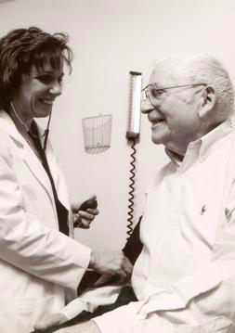
Lesson 5.8: Differential Diagnosis
Obj. 5.8: Develop an evidence-based differential diagnosis for an illness.
Module 5: Public Health
Notes:
Overview: Students will learn the thinking process behind how doctors make a diagnosis in this lesson. First, students will consider the case of a rash, a common ailment that can be difficult to diagnose. Then they will learn about differential diagnosis and read about how patients can help doctors in the process. Finally, they will practice differential diagnosis by researching and identifying the distinguishing characteristics between heartburn and heart attack and influenza and gastroenteritis (“stomach flu”).
Image source: http://en.wikipedia.org/wiki/Primary_care_physician

Slide 2
Do Now: What’s This Rash, Doc?
A patient comes in to your clinic with a bright red, streaky, bumpy rash the size of a deck of cards on his right forearm. The patient reports that the rash itches intensely. He just got back from vacation in the Upper Peninsula of Michigan, where he spent time fishing, hiking, and hunting.
1. What possible diseases might this patient have?
2. How would you, as a physician, determine the right diagnosis?
3. You have narrowed down the possibilities to poison ivy, shingles, or an allergic reaction. Which diagnosis do you think is correct? Why?
4. What additional data would you need to be more certain?
Notes:
Some possibilities: poison ivy (correct diagnosis), allergic reaction, shingles, poison oak or sumac, psoriasis, contact dermatitis, etc.
Answers will vary. Encourage students to explain their thinking step-wise.
Answers will vary.
Students should discuss possible tests they could run, or additional symptomatic/history of illness information they could gather.

Slide 3
Avoiding Medical Error
1. How certain does a physician need to be before making a diagnosis?
2. What are the potential consequences in the case of misdiagnosis?
Notes:
1. A physician would ideally like to be 100% certain, but this is not always possible. There are still a great deal of unknowns about medicine and the body. While we have come a long way in our ability to diagnose, especially with the aid of new diagnostic technologies and computers, errors still occur due to incomplete information, physician negligence and other causes.
2. Medical errors can lead to complications, injury/illness, and even death. Ask students if they have heard about any of these types of cases in the news. Many medical errors are not necessarily the result of misdiagnosis (ex: amputating the wrong limb (extreme), medication errors, etc.) but some errors certainly are.

Slide 4
What is Differential Diagnosis?
Differential diagnosis: A systematic method of information gathering used by clinical health professionals to determine the cause of illness when multiple alternatives are possible; the process focuses on eliminating diseases that are suspected in order to arrive at the correct diagnosis with as much objective evidence as possible.
Notes:
The differential diagnosis is the main portion of the Assessment process/documentation in the SOAP note. If students have already tried out this process in prior cases (from previous modules) ask them what was challenging or difficult about this step?

Slide 5
Horses or Zebras?
A common adage, Occam’s razor, is taught in medical school. It states that:
“When you hear hoofbeats, look for horses, not zebras.”
How do you think this relates to differential diagnoses?
Notes:
The idea is that even though med students learn about rare diseases, they should not always assume it’s something less likely (statistically) than the obvious diagnosis. It is good to be prudent and rule out the dangerous/urgent (even though rare) diseases, but not always practical when the cost vastly outweighs the likelihood. A good example of this is brain tumors and headaches. Occasionally patients will come in and ask for/demand a brain scan (MRI) for a headache they have had. In some cases this is the right call, but in most cases it is not. And the cost of this diagnostic test (both in money and in actual possibility for unnecessary and potentially harmful intervention) usually outweighs the infinitesimal chance it is a tumor.

Slide 6
How to do a Differential Diagnosis:
Step 1. Review the symptoms reported in the Subjective patient interview and the data already collected in the Objective portion of the patient visit (or from medical records).
Step 2. Create a list of all possible causes of the symptoms and objective data.
Step 3. Prioritize the list based on the most urgently dangerous conditions first
Step 4. Rule out (if possible) the most dangerous conditions first by conducting tests. If not possible to rule out and safe treatment can be given, treat the patient for the most urgent conditions first.
Notes:
This is not necessarily the “gold standard” method of how a DD is done in practice, but it is a good approximation. In fact, many doctors have so much experience that they will conduct many of these steps in their head. But for students who have VERY limited medical knowledge and no experience, it is important to be more systematic and write everything out.

Slide 7
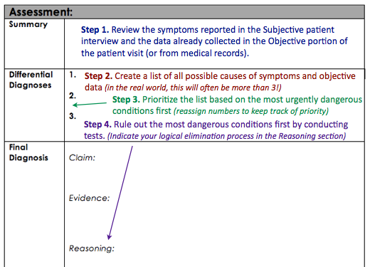
How to do a Differential Diagnosis:

Slide 8
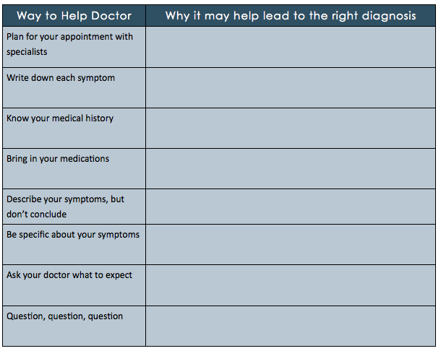
Read:
Read “8 ways to help your doctor make the right diagnosis” then fill in the table:
Notes:
The article can be found as a PDF file in the lesson resources folder. Make a class set of copies for students to read during this part of the lesson.

Slide 9
How do Patients stack up?
Which one of the tips do you think the average patient is most likely already doing when visiting the doctor?
Which tip is the average patient least likely to be already doing?

Slide 10
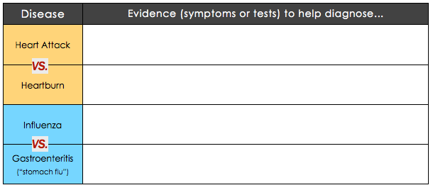
Which Disease?
Notes:
Heart attack vs. Heartburn: http://www.mayoclinic.org/diseases-conditions/heartburn-gerd/in-depth/heartburn-gerd/art-20046483
Influenza vs. Gastroenteritis: http://www.webmd.com/cold-and-flu/flu-guide/stomach-flu-not-influenza

Slide 11
Assess: Do You Know Your DD?
What is a differential diagnosis?
How does a clinical healthcare provider conduct a differential diagnosis?

Slide 12
Homework: DD the Disease!
Choose any disease, syndrome, condition, or illness you are interested in.
Research the disease carefully so you know the symptoms, tests, and other similar illnesses
Describe the illness including it’s symptoms and tests to diagnose
List at least 3 (or more) diseases that would be most likely to appear on a differential diagnosis list, in order or priority from most urgent or dangerous to least urgent or dangerous.
For each differential diagnosis option, write at least one way you could “rule it out” based on a symptom or, more preferably, a test.
Notes:
The purpose of this homework assignment is to get students to continue practicing the differential diagnosis thinking process with an illness they are interested in.

