Slide 1
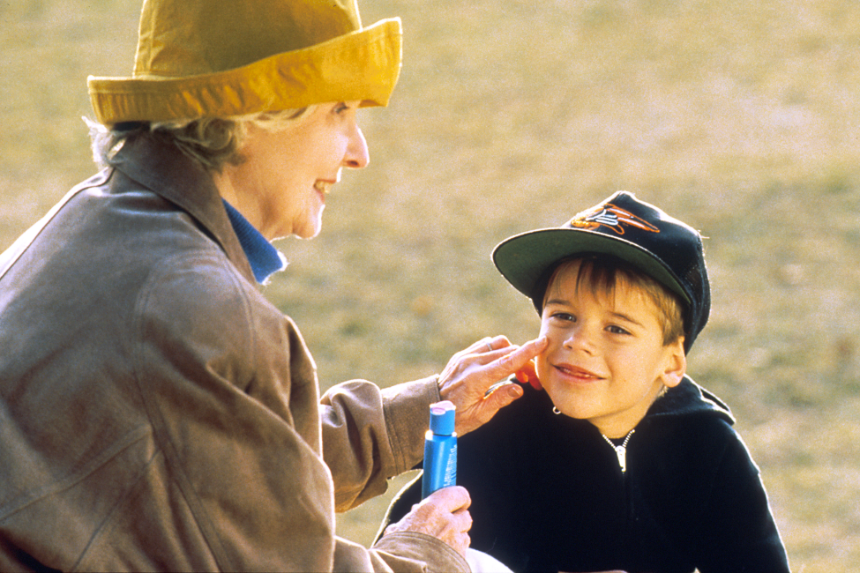
Lesson 5.6: Prevention
Obj. 5.6: Distinguish between primary, secondary, and tertiary prevention.
Module 5: Public Health
Notes:
Overview: Students will explore prevention on all levels in a variety of contexts--from lung cancer, skin cancer, and lyme disease to a disease of their own interest. In this lesson, students will reflect upon a quote, defend which treatments work best, read about different types of treatment, and ultimately present a new disease and explain its prevention methods.
Image source: http://commons.wikimedia.org/wiki/File:Applying_sunscreen.jpg

Slide 2
Do Now: An Ounce of Prevention
Benjamin Franklin once said, “An ounce of prevention is worth a pound of care.”
1. Do you think the average American follows Mr. Franklin’s advice? Why or why not?
2. Do you think most health care providers follow Mr. Franklin’s advice? Why or why not?
Notes:
Ask students to name examples of how they see healthcare professionals in their community engaging in prevention vs. care/treatment

Slide 3
Discuss: Which type of prevention?
With a partner, determine which of the following would be the BEST way to fight a community’s problem with lung cancer? Circle your choice, then justify your answer.
1. Run a campaign in schools to encourage youth not to smoke
2. Hold classes to educate smokers how to stop smoking
3. Increase funding to lung cancer treatment centers
Why did you choose this answer?
Notes:
Encourage debate as students respond to this question!

Slide 4
Prevention Methods
Notes:
Ask students WHY these types of prevention are named the way they are—primary, secondary, and tertiary? Ask students which type of prevention they use or receive most in their own lives?

Slide 5
Skin Cancer Prevention
Emily is a naturally fair-skinned Caucasian teenager (age 16) who loves to spend time at the beach. She often goes with her friends in the summertime 3-4 times per week. Emily burns quite a bit at the beginning of the summer, but develops what she considers a “pretty nice tan” by the end of the summer. Her friends never use sunscreen, so she has never considered using it herself, even though her mother reminds her to take it every time she leaves the house. Next year, Emily is hoping to save up some money to visit a local tanning place in the Spring so that she can have a good “base tan” for the summer months and won’t have to burn as much at the beginning of the summer.

Slide 6
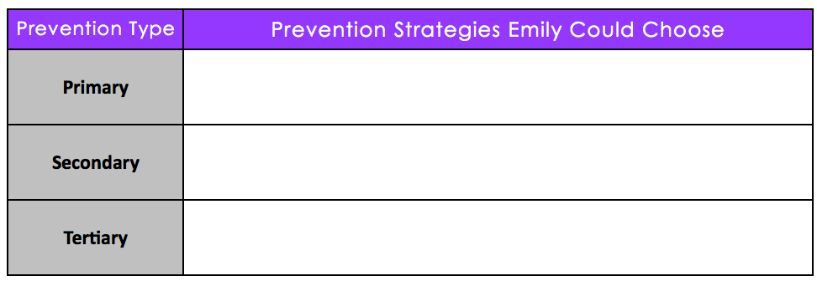
Skin Cancer Prevention
Notes:
Answers:
Modifiable—spends a lot of time in sun, not using sunscreen, parental support to use sunscreen, tanning
Unmodifiable—fair-skinned, Caucasian, teenager
Predisposing—(lack of knowledge of harmful effects of sun exposure/burns and skin cancer can be inferred, but not explicitly mentioned)
Reinforcing—friends do not use sunscreen, mother encourages sunscreen use
Enabling—access to tanning beds as a teen
Primary Prevention—use sunscreen/shade/hat, avoid high peak sun times, avoid tanning beds, learn about skin cancer & risks
Secondary Prevention—check for the signs of skin cancer (ABCDs), regularly visit dermatologist for skin cancer checks
Tertiary Prevention—obtain treatment for skin cancer if detected

Slide 7
Discuss: Barriers to Prevention
1. Which type of risk factor seems most influential on Emily’s risk for skin cancer?
2. Which type of prevention will be most useful for Emily? Why?
3. What factors may prevent Emily from using the prevention strategies you suggested?
Notes:
Ask students why Emily may not be worried about her sun exposure & burns. Pose a hypothetical, maybe she IS worried, but she still chooses the same behavior. What could account for this?

Slide 8
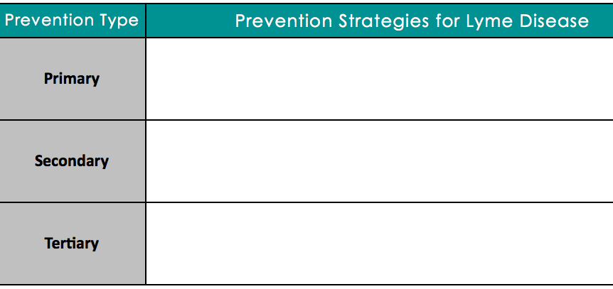
Lyme Disease Prevention
Lyme disease is a chronic disease caused by bites from deer ticks. Luckily, there are many ways one can prevent Lyme disease, get it treated quickly, or reduce its impact. Document the variety of prevention measures in the table below. To find information, go to the CDC Lyme Disease website, at: www.cdc.gov/lyme
Notes:
Possible Answers:
Primary—avoid deep woods areas where ticks may be common, wear tall socks, inspect socks, feet, legs & body for ticks after hikes
Secondary--remove ticks with tweezers carefully if bitten, seek medical attention quickly, depending on factors, follow doctor’s plan, often including taking antibiotics
Tertiary—Continue medications and treatment plan if diagnosed w/ Lyme disease

Slide 9
Team Up for Disease Prevention
YOU choose the disease.
Research, using any credible website. (e.g., CDC)
Notes:
Encourage students to select diseases with more preventable causes. For example, brain cancer might not be a good option for this exercise because it is primarily genetic and studies demonstrating other risk factors (i.e, cell phone use) have not documented any consistent findings showing other risk factors.

Slide 10
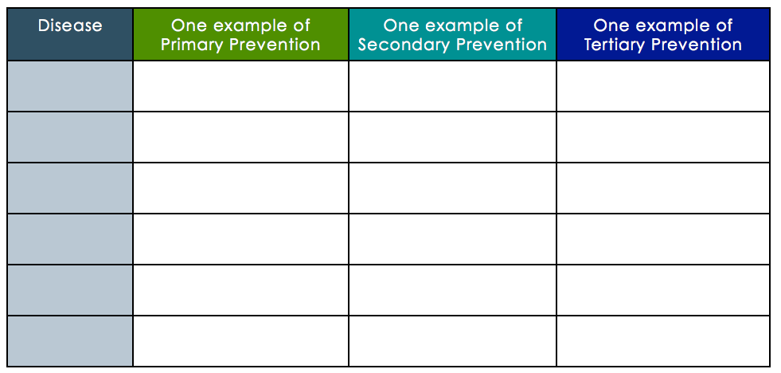
Present
Notes:
Recommend that students in the audience write down the one example that they think is most essential or effective for each type of prevention.

Slide 11
Primary, Secondary, or Tertiary Prevention?
1. Miguel is worried about getting Athlete’s Foot. He always wears sandals in the shower because he’s scared.
2. Jane has a two-year old daughter in daycare. Her daughter woke up sick and began vomiting and having diarrhea immediately. Jane decided to keep her home from daycare and give her oral rehydration fluids to prevent dehydration.
Notes:
Answers:
1. Primary;2. Tertiary

Slide 12
Homework: Prevention Analysis
Find an example of prevention in your community.
Describe the example of prevention.
What type of prevention is it--primary, secondary, or tertiary--and why?
What characteristics seem to make it effective or ineffective?
How might you improve it to make it even more effective?
Notes:
The purpose of this homework assignment is for students to investigate prevention efforts that exist in their own community and practice identifying them by type. If desired, the instructor could also allow students to focus on prevention efforts on the statewide, national, or international health setting.

