Slide 1
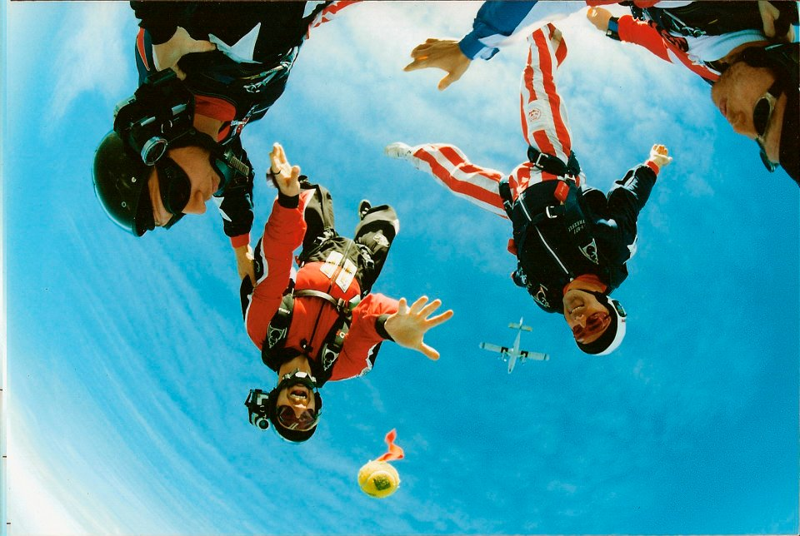
Lesson 5.5: Risk Factors
Obj. 5.5: Differentiate between modifiable, unmodifiable, predisposing, enabling, and reinforcing risk factors.
Module 5: Public Health
Notes:
Overview: Students will analyze the various types of risk factors by brainstorming with a familiar topic (obesity), classifying based on choice or lack of choice, and taking a list of risk factors and trying to determine common characteristics. Along the way, they will define and review examples of the five types of risk factors and ultimately practice applying their knowledge in two vignettes.
Image source: http://en.wikipedia.org/wiki/Freeflying

Slide 2
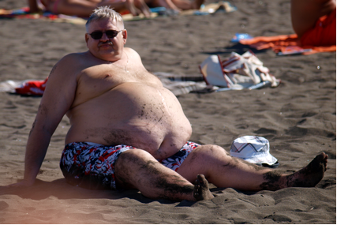
Do Now: Obesity Risk Factors
Name 5 (or more) risk factors for obesity. Think about what makes you more likely to be obese.
Notes:
If students need additional ideas, or if time permits for a supplemental article, the resource reading entitled, “Obesity Risk Factors Vary for Boys, Girls” has a variety of additional risk factors that can be used for this exercise.
Image source: http://commons.wikimedia.org/wiki/File:At_the_beach_-_male_abdominal_obesity.JPG

Slide 3
Do You Have A Choice?
With a partner, combine your risk factors for obesity into two lists below: 1) Risk factors that you have a choice about; and 2) Risk factors that you have no choice about.
Notes:
If students find that all of their risk factors would go into one column or the other, challenge them to think of additional factors that would fit in the other column.

Slide 4
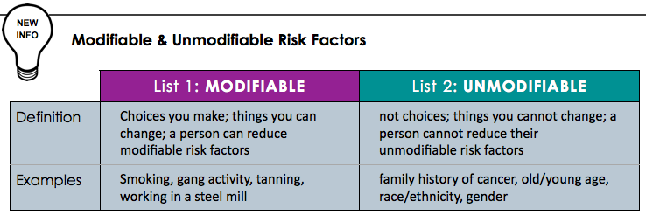
Modifiable vs. Unmodifiable

Slide 5
RF Classification
Read through the following risk factors. Then try to come up with three categories you could classify them within, based on their common characteristics.
a. Hanging around people who are constantly stressed
b. Not having access to a place that sells nicotine patches
c. Not knowing how to exercise
d. Not having access to gyms
e. Living with someone who smokes
f. Not knowing the effects of smoking
g. Living with people who don’t sleep a lot
h. Not knowing athlete’s foot is communicable
i. Not having access to hospitals/clinics
j. Can’t take time off of work to go to the hospital
k. Hanging around people who don’t exercise
l. Having friends who are involved with gang activity
Notes:
Answers:
Predisposing (individual knowledge or skills) – c,f, h
Reinforcing (relationships & culture) – a, e, g, k, l
Enabling (access to resources) – b.d,I, j

Slide 6
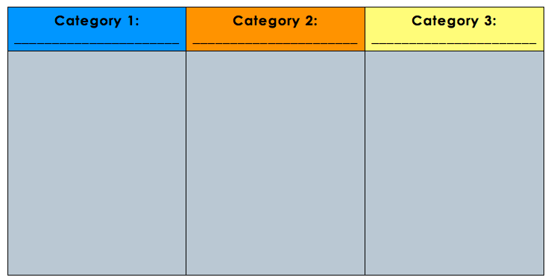
RF Classification
Challenge examples: Can you add the following risk factors to your lists?
m. Family doesn’t have enough money to pay medical bills
n. Living in a third world country
o. Using a wheelchair
p. Living in a fraternity house where drinking is a big part of the culture
Notes:
Answers:
Predisposing (individual knowledge or skills) – c,f, h
Reinforcing (relationships & culture) – a, e, g, k, l, p
Enabling (access to resources) – b.d,I, j, m, n, o

Slide 7
Discuss:
Was this exercise challenge? Explain your answer.
Notes:
Some students may get frustrated with trying to figure this out; reassure them that it is a good mental workout and the process is what counts!
Image source: http://www.flickr.com/photos/zachklein/54389823/

Slide 9
Name that Risk Factor:
For each of the risk factors below, identify the types (predisposing, enabling, reinforcing, modifiable, and/or unmodifiable). Note: More than one may apply!
1. David doesn’t know who to go to for help with his chronic (constant) cough.
2. Cornisha can’t take time off of work to go to the doctor.
3. Leonard is trying to quit smoking. Everyone else in his family smokes.
4. Susan can’t afford to go to a specialist for her allergy problem.
Notes:
ANSWERS:
Predisposing (knowledge) & possibly modifiable
Enabling & possibly unmodifiable
Reinforcing & modifiable
Enabling & unmodifiable

Slide 10
Assess: Vignette #1
Vignette #1: Tabitha is from China and recently found out that she has Osteoporosis. She is 67 years old and has been inactive for several years. She eats mostly energy dense foods and said dairy products make her stomach hurt. She was shocked when she found out that she has Osteoporosis because she had no idea what caused it in the first place. Her general practitioner advised her to see a specialist, but she said she couldn’t find the time to go. She lives with her husband who also dislikes dairy, doesn’t exercise, and eats a fatty diet.
Notes:
ANSWERS:
Unmodifiable: 67, female, Chinese
Modifiable: no calcium, no exercise
Predisposing: Didn’t know what caused osteoporosis
Reinforcing: Husband eats a poor diet and is inactive
Enabling: Didn’t have time to go

Slide 11
Assess: Vignette #2
Vignette #2: Jason is a 40 year old Caucasian male farmer who just found out that he has skin cancer. He didn’t realize that getting sunburned multiple times and being exposed to environmental chemicals can cause skin cancer. He also didn’t realize that he should see anyone about this problem, he thought he could treat it on his own. He lives far from any hospitals and can’t take time away from tending to his crops. When he told his wife about the problem, his wife seemed unconcerned and said, just get outside and keep tending to the crops -- we need this money!
Notes:
Unmodifiable: 40, male, Caucasian
Modifiable: Farmer (partially modifiable, depending on circumstances) –also, exposed to sun & environmental chemicals
Predisposing: Didn’t know about sunburn & cancer or how to get it diagnosed/treated
Reinforcing: Wife not supportive of seeking care
Enabling: Lives far from hospitals; cannot take time off

Slide 12
Homework:
1) PERSONAL Risk Factors: Think about your own personal health. On a separate sheet of paper list at least one risk factor that fits within each of the categories.
2) COMMUNITY Risk Factors: Think about your community. On a separate sheet of paper list at least one risk factor that fits within each of the categories.
Notes:
The purpose of this homework assignment is to provide an application to students lives. As they focus on risk factors in their lives and in their communities they will practice classifying these factors and the learning will become more cemented in their minds.

