Slide 1
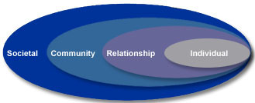
Lesson 5.3: Social-Ecological Model
Obj. 5.3: Analyze a problem to identify factors on various levels of the social-ecological model
Module 5: Public Health
Notes:
Overview: Students will consider the scale and the variety of factors that contribute to a problem. First, they will brainstorm the causes of violence and write a “tweet” summarizing them and reflect upon the impact of violence in their lives at various levels. As they learn about the social-ecological model, students will read about how it applies to violence and then consider a problem within their own school that they can analyze using the framework.
Image source: http://www.cdc.gov/violenceprevention/overview/social-ecologicalmodel.html

Slide 2
Do Now
In 140 characters (letters) or less, write your own “tweet” about the causes of violence.
Notes:
Have students take turns sharing their “tweets” with the class. Consider having them write the Tweets on strips of paper and posting them up in the classroom. Explain to students that violence is considered a public health problem and an epidemic and is responsible for massive numbers of deaths and injuries in the U.S. and worldwide.

Slide 3
Discuss
Have you personally been affected by violence? (Have you or someone you are close to been a victim? Has it affected you in some other way?)
Has anyone in your social network (friend or family) ever been affected by violence? (Has someone close to you been a victim or known someone who was a victim?)
How has violence impacted your school? Your community? Your nation?
Notes:
This is a great time to introduce (or review) the concepts of micro to macro. By assessing a problem from various levels of scale, we can see important interrelationships in factors and patterns may start to emerge.
If gun violence or other forms of violence are endemic in students communities, they will be able to relate personally. Others may not have this situation but will quickly turn to school shootings and other recent public headline violence events. Either way, all students can make some connections to the issue.

Slide 4
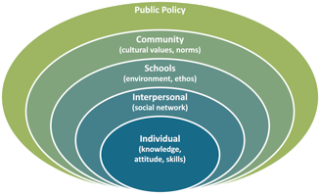
The Social-Ecological Model
Examine the diagram below: What is its purpose? What does it show? How does it relate to violence?
Notes:
Ask students what the definitions of Social and Ecological are?
Society: the aggregate of people living together in a more or less ordered community
Ecological: relating to or concerned with the relation of living organisms to one another and to their physical surroundings
So, the social-ecological model is a way to think about how people living together relate to each other and their surroundings.
This particular model substitutes the word “interpersonal” in the place of “relationships” and adds an additional layer, “schools.” It also calls the top level “public policy” rather than “societal”

Slide 5
S-E Model: Individual Level
Individual: The first level identifies biological and personal history factors that increase the likelihood of becoming a victim or perpetrator of violence. Some of these factors are age, education, income, substance use, or history of abuse. Prevention strategies at this level are often designed to promote attitudes, beliefs, and behaviors that ultimately prevent violence. Specific approaches may include education and life skills training.
Notes:
See resource document entitled, “Examples Eco Model” for a table with definitions, examples, and how each of these levels might apply to violence.
Source of text: http://www.cdc.gov/violenceprevention/overview/social-ecologicalmodel.html

Slide 6
S-E Model: Relationship Level
Relationship: The second level examines close relationships that may increase the risk of experiencing violence as a victim or perpetrator. A person's closest social circle-peers, partners and family members-influences their behavior and contributes to their range of experience. Prevention strategies at this level may include mentoring and peer programs designed to reduce conflict, foster problem solving skills, and promote healthy relationships.

Slide 7
S-E Model: Community Level
Community: The third level explores the settings, such as schools, workplaces, and neighborhoods, in which social relationships occur and seeks to identify the characteristics of these settings that are associated with becoming victims or perpetrators of violence. Prevention strategies at this level are typically designed to impact the climate, processes, and policies in a given system. Social norm and social marketing campaigns are often used to foster community climates that promote healthy relationships.

Slide 8
S-E Model: Societal Level
Societal: The fourth level looks at the broad societal factors that help create a climate in which violence is encouraged or inhibited. These factors include social and cultural norms. Other large societal factors include the health, economic, educational and social policies that help to maintain economic or social inequalities between groups in society.

Slide 9
Discuss
The social-ecological model is a framework used to think about the interrelationship of various factors that contribute to health problems and their possible solutions.
Choose one of the following problems and discuss how it can be thought of at each level of the model.
Childhood obesity
Substance abuse
Depression
Teen pregnancy
Notes:
Consider splitting the group into four sections so that each topic is addressed in more depth by one cohort. Alternatively, students could think individually then “jigsaw” by grouping into fours with one from each topic area to share.

Slide 10
Social-Ecological Model in School
Think about issues within our school.
What types of problems need to be solved in our school environment?
With a small group, brainstorm some problems, select one, and examine it on each level of the social-ecological model, considering both causes and solutions.
Notes:
Remind students that no school is perfect, but that excellent schools are ones that identify their weaknesses and work to come up with solutions to improve. Implore them to consider themselves a key agent of change and a group of talented, smart, thoughtful young people who can actually make a difference in the school. If possible, offer the opportunity for the “best” eco models/ideas to be presented to the administration.

Slide 11
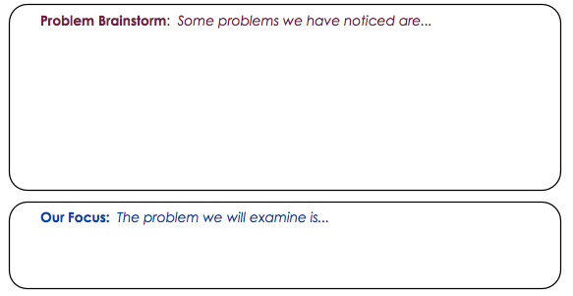
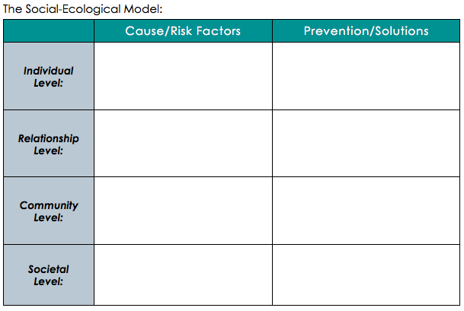
Notes:
Some examples of the types of problems students might consider could include: 1) High rates of absences among students and/or teachers; 2) A poorly followed dress code; 3) Bullying; 4) Lack of spirit; 5) Needing more variety/options for after-school activities; 6) Technology use in hallways/classrooms; 7) Poor health/; 8) Sedentary method of learning; 9) School lunch options; 10) Lack of academic rigor/challenge, in some classes or in overall courses offered.

Slide 12
Reflect
1. Which level that seems to be the source of the most causes or risk factors related to your problem? Why do you think this is?
2. Which level would you focus on in order to improve this problem? Why?

Slide 13
Assess:
For each of the examples below, identify which level of the social-ecological model is represented: individual, relationship, community, or societal:
1. Zeke consumes several candy bars each day; he blames it on his “sweet tooth.”
2. New laws make it mandatory for employers and insurance providers to provide health benefits for partners in same-sex unions.
3. A school district decides to adopt a comprehensive sexual health curriculum, which includes instruction on abstinence and contraception.
4. A family enjoys sharing television shows and movies as its primary form of social entertainment and interaction; limits on screen time are not considered for the children.
Notes:
Answers:
Individual
Societal (or public policy)
Community (or school)
Relationships (or interpersonal)

Slide 14
Homework:
Binge drinking is the most common pattern of excessive alcohol us in the United States. NIDA defines binge drinking as a pattern of drinking that brings a person’s blood alcohol concentration (BAC) to 0.08 grams percent or above. This typically happens when men consume 5 or more drinks, and when women consume 4 or more drinks, in about 2 hours. About 90% of the alcohol consumed by youth under the age of 21 in the U.S. is in the form of binge drinks (Office of Juvenile Justice and Delinquency Prevention).
Source: CDC Fact Sheet “Binge Drinking”
Notes:
Source: http://www.cdc.gov/alcohol/fact-sheets/binge-drinking.htm

Slide 15
Homework:
Challenge: You have been elected president of a new organization on your college campus focused on reducing binge drinking. You are charged with leading a committee to creating a campus-wide strategy to prevent binge drinking. Because you are so resourceful, you remember learning about the social-ecological model and you realize that it is a great tool for starting out in this task.
Directions: On a separate sheet of paper, create a chart like the one on the previous page, listing each level of the social-ecological model down the left-hand column (Individual, Relationships, Community, Societal), and the titles “Causes/ Risk Factors” and “Prevention/Solutions” as the column headers. Then brainstorm factors to fill in the table related to binge drinking. Make your table as complete as possible!
Notes:
The homework assignment will challenge students to consider how the social-ecological model is relevant to a real-world health issue they face (or may face in college)—the pressure or norm of binge drinking. It will provide another opportunity to practice the process of analyzing a problem on multiple levels.

