Slide 1
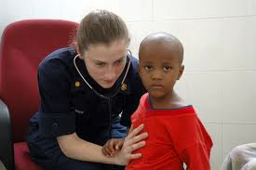
Lesson 5.2: Public Health
Obj. 5.2: Identify examples of the ten essential functions of public health
Module 5: Public Health
Notes:
Overview: Students will explore the incredible realm of public health, as they examine various tasks that would be considered work of public health, contrast it with the traditional roles of medicine, and read about 10 great public health achievements of the 20th Century. Students will reflect upon careers in public health and learn the 10 essential functions of public health. By identifying these functions in real examples, students will begin to master an understanding of the scope of public health.
Image source: Wikimedia Commons, http://commons.wikimedia.org/wiki/File:US_Navy_070903-N-6020F-287_U.S._Public_Health_Service_Lt._Cmdr._Sandra_Bender,_attached_to_Military_Sealift_Command_hospital_ship_USNS_Comfort_(T-AH_20),_listens_to_the_lungs_of_a_patient_at_Centre_Hospitalier_Eliazar_Germain_i.jpg

Slide 2
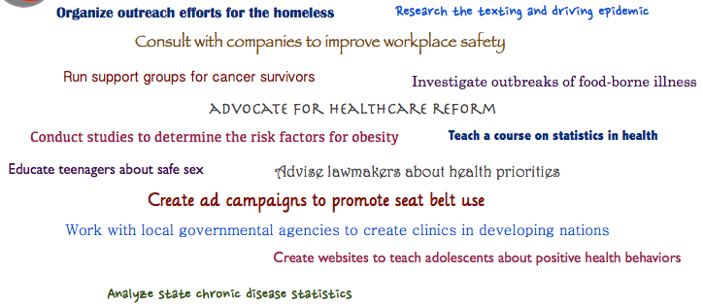
Do Now
Circle the items that could be part of the work of a public health professional.
Notes:
The correct answer is that ALL of these items could be part of the work of public health. Ask students if any of them ever considered a career in public health (a show of hands would work here), and if they were surprised by at least one or more of the items being part of this career.

Slide 3
Discuss: Public Health vs. Medicine
How is the role of a public health professional different from the traditional role of a physician?
Notes:
A physician diagnoses and treats individuals while public health focuses on improving health and preventing health problems among a population.
Image source: http://ruralsouthphtc.phhp.ufl.edu/certificate-program/certficate-courses-in-public-health-foundations-current-public-health-workers/

Slide 4
Defining Public Health
Public health professionals focus on populations (also sometimes referred to as communities) rather than individuals. Public health also works to prevent problems before they occur.
“As opposed to medicine which concentrates on the treatment of disease once it has occurred, public health focuses on the prevention of disease and optimizing the physical and psychosocial status of populations” (UIC School of Public Health)
“Public Health is the science and art of protecting and improving the health of communities through education, promotion of healthy lifestyles, and research for disease and injury prevention.” (ASPH)
Notes:
The work of public health is often thankless and difficult to quantify the value of, this is due to the nature of the field: PREVENTING problems before they even happen. Ask students, “Why could we consider the work of public health sometime like an invisible force in our world?”

Slide 5
Video: The Power of Public Health
http://www.youtube.com/watch?v=M72DdaEYGuk
Notes:
Optional: Show video which connects with some of the health problems that people DON’T have as a result of public health efforts.

Slide 6
Video: This is Public Health!
http://www.thisispublichealth.org/video_lowres.html
Notes:
Optional: Show video to highlight how public health can be made more visible. (the “This is Public Health” sticker campaign will also be featured in students’ homework for this lesson)

Slide 7
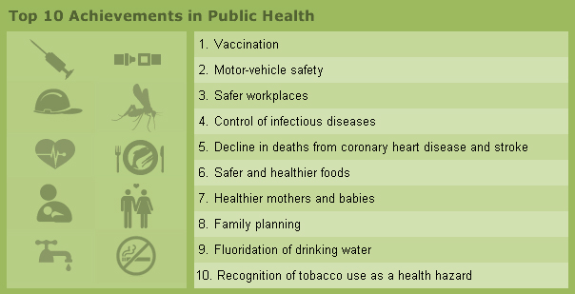
Top 10 Achievements in Public Health
Notes:
Ask students, “Which of these was most surprising to you? What might you expect to be on this list that is NOT included? Why?”
Source: http://www.whatispublichealth.org/impact/achievements.html

Slide 8
Discuss: Public Health Careers
Many kids decide they want to become a doctor from a very young age, however it is less common to say “I want to be a public health professional” among youngsters and even high-schoolers. Many people don’t discover public health until college or even later! Why do you think this is the case?
Notes:
Ask students for a show of hands of how many want to work in the healthcare field? Ask those who raise hands what professions they are interested in. Contrast this with the question asked at the beginning of the lesson (How many are interested in a public health career?)

Slide 9
10 Essential Functions of Public Health
Source: http://www.cdc.gov/nphpsp/essentialservices.html
Notes:
Ask students to name some examples of specific institutions and organizations within these categories.
Source: http://www.cdc.gov/nphpsp/essentialservices.html

Slide 10
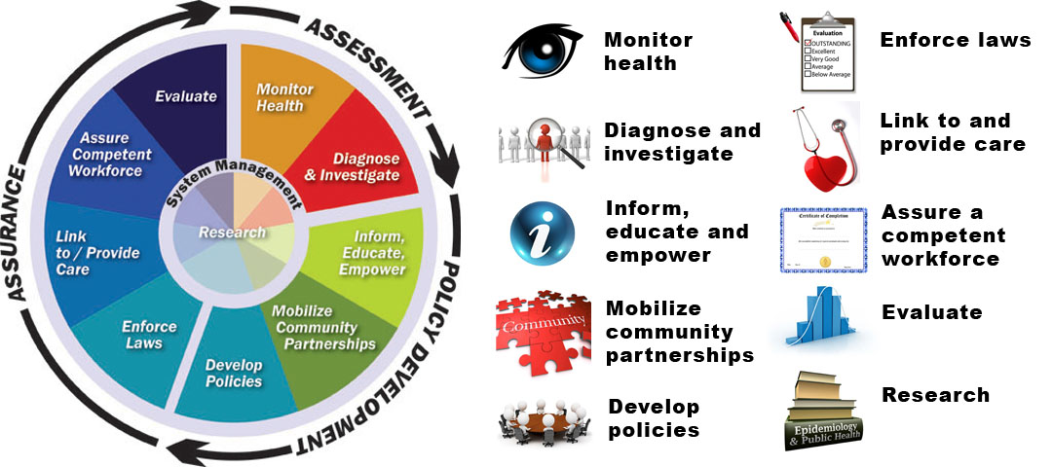
10 Essential Functions of Public Health
Notes:
Emphasize with students that public health is really a field that draws together many fields: medicine, science, research, law, policy, consulting, activism, community organizing, etc.
Image source: http://ldchealth.org/information/resources-and-information/the-public-health-system/

Slide 11
10 Essential Functions of Public Health
Notes:
Source: http://www.cdc.gov/nphpsp/essentialservices.html

Slide 12
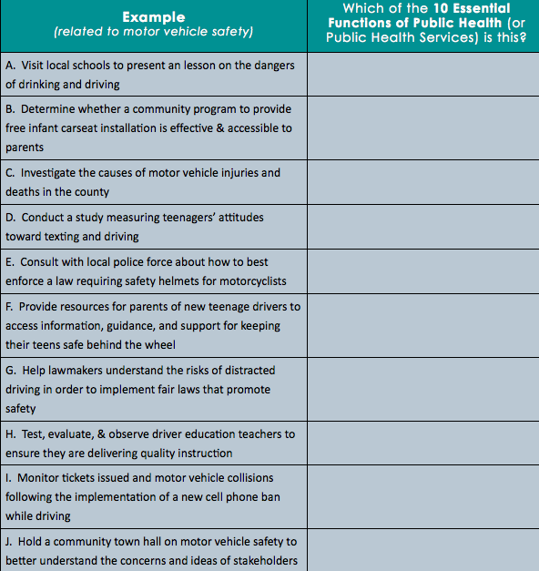
Identifying Functions of Public Health
Notes:
Answer Key:
A - 3. Inform, educate, empower
B - 9. Evaluate
C - 2. Diagnose & investigate
D - 10. Research
E - 6. Enforce laws
F - 7. Link to/Provide care
G - 5. Develop policies
H - 8. Assure competent workforce
I - 1. Monitor health
J - 4. Mobilize community partnerships

Slide 13
Discuss:
Which of these examples were most challenging to identify? Why?

Slide 14
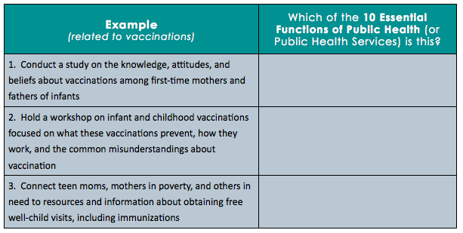
Assess:
Notes:
Answers:
1. Research
2. Inform, educate, empower
3. Link to / Provide care

Slide 15
Homework: This is Public Health
Public Health is Your Health. Most people don't understand what public health is or how it impacts their daily lives. The “This Is Public Health” campaign was created by Association of Schools of Public Health (ASPH) to let people know that public health affects them on a daily basis and that we are only as healthy as the world we live in. The campaign utilizes stickers with the slogan “This is Public Health” placed in strategic locations around communities to build awareness of the many ways in which public health impacts our well being.
Challenge: Join this global effort to promote public health awareness in your community. Visit http://www.thisispublichealth.org/
Assignment: Think about your community. What is public health in your community? List five or more places where you would place a sticker in your community and explain each
Notes:
The purpose of this assignment is to get students to connect with what public health looks like in their own community. Stickers can be obtained for students for a more authentic challenge assignment.
Source: http://www.thisispublichealth.org/AboutCampaign.html

