Slide 1
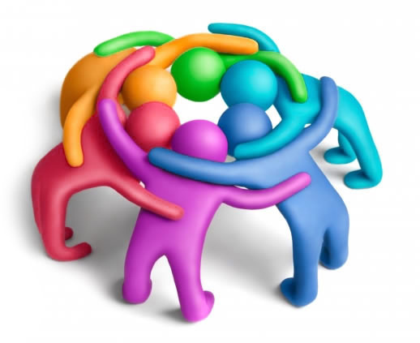
Lesson 5.1: What is a Community?
Obj. 5.1: Identify communities and the factors that shape their health.
Module 5: Public Health
Notes:
Overview: Students will examine the concept of community from a variety of angles in this lesson. First, they will describe their vision of an ideal community and compare it with another student’s vision. Then they will review what communities means and create a Venn Diagram comparing and contrasting two communities that they are a part of. Next they will read an article on the role and impact of community health workers. Finally, they will identify factors that contribute to making communities healthy.
Image source: Flickr, http://www.flickr.com/photos/nooku/5170154324/

Slide 2
Do Now: Vision of a Community
Describe your vision of an ideal community. Consider questions such as the following:
What characteristics would the community have?
What kind of structures (i.e. buildings, organizations, etc.) would the community have?
How would roles in the community be divided?
How would people treat each other?
What would make this community different from other communities?
Notes:
Create a safe space by reminding students of the norms: all viewpoints and diverse perspectives will be respected and valued in this classroom. This will encourage students to feel open about sharing various communities they may be a part of (i.e. LGBT, Latino, disabled, etc.) as long as they are comfortable.

Slide 3
Discuss
Share your vision with a partner. Discuss what was similar and different about your visions.
Notes:
Challenge students to find similarities, even if they aren’t immediately visible.

Slide 4
What is a Community?
Community: A group of people who have common characteristics.
Communities can be defined by location, race, ethnicity, age, occupation, social network, shared values, relationships, interests, a focus on particular problems or outcomes, or any other common bond.
What other common characteristics can you think of?
Notes:
Conduct a Google search on the projector, if technology is available. Search in Google Images for the word “Community” Scroll through the results of the search and ask students: What do these images about community, which are the most commonly “clicked on” say about what community means to us as humans? What images do you think SHOULD be in the Google image search result for the word “community that do not appear here?

Slide 5
Discuss: Examples of Communities
With a partner, list examples of communities. Come up with as many as you can!
Notes:
School, sports, clubs, extra-curriculars, city/town, county, race/ethnicity, age group, hairstyle, those who have piercing/tattoos, handicapped, professional or business organizations, networking organizations, online social media groups, support groups, those who have or have survived a type of illness groups (ex: cancer), faith communities and churches, etc. etc.!

Slide 6
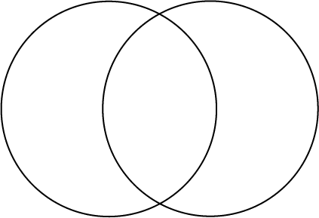
My Communities Venn Diagram:
Identify two communities that you belong to. In the Venn diagram, list similarities and differences between each community.
Community #1:
Community #2:

Slide 7
Community Health Workers
Read the article, “How Community Health Workers Dramatically Improve Healthcare” from The Atlantic. After you read, answer the questions below:
1. What were some of the particular communities identified in the article?
2. Why are community health workers important in achieving better health outcomes in communities?
3. Do you think you would enjoy a job as a community health worker? Why or why not?
Notes:
The article can be found as a PDF in the “5.1 – Communities folder of the module.” Be sure to prepare a class set of copies before class and have students pass them back in after reading.
Possible Answers for #1: What were some of the particular communities identified in the article?
Urban families in Ethiopia
A rural coal mining town
Diabetics
Community health workers, themselves
Female high school graduates in Ethiopia
Underserved men in Denver
Children of addicted parents,
Obese
Big Creek People in Action, an organization focused on education and health

Slide 8
A Healthy Community Has…
Choose one community that you belong to. Identify any of the factors required to keep this community healthy. List as many as you can!
Notes:
Example: schools—people must wash hands, safety inspections and regulations followed in cafeteria, absence policies for sick students, availability of hand sanitizer and other sanitary supplies, health education and PE classes, amount of time sedentary vs. active, existence of role models in school, values/beliefs about health and learning conveyed, opportunities for student involvement, after-school activities, and positive reinforcement, policies on bullying, availability of counseling and mental health support, etc.

Slide 9
Assess:
List two examples of communities you are a part of and what makes them a community.

Slide 10
Homework: Communities Collage
Create a collage representing the communities you have been a part of, are currently a part of, and would like to become a part of in the future.
You may use any media to create your collage.
Be prepared to share and explain different elements in your collage that represent your unique combination of communities, and describe how each of your communities impacts your overall health.
Notes:
The purpose of this homework is to get students to continue to reflect upon the communities they are a part of, with the goal of realizing new ones as they think more about this in a creative way. The secondary purpose is to provide an opportunity to practice their communication skills and demonstrate their understanding of communities and factors that impact health within their communities. Carve out time in the next class period for brief presentations, if possible.

