Slide 1
Lesson 5.10: Scholarly JourNal Articles
Obj. 5.10: Identify the purpose and conclusion of a scholarly journal article.
Module 5: Public Health
Notes:
Overview: Students will grapple with a challenging text in this lesson, gaining a sense of what a peer-reviewed scholarly journal article is, the level of rigor to expect, and practicing some strategies to tackle them.
Image source: http://en.wikipedia.org/wiki/File:Paris_2010_-_Le_Penseur.jpg

Slide 2
Do Now
Notes:
Ask students, what title would you give these graphs? That is another way to think about the purpose. [Be specific! Ex: Brain Activity (shown by spindles) over time for Night 1 (no noise) & Sound levels over time for nights 2-3 (noise)]
Encourage students to ask questions. [E.g., What is a spindle? How is brain activity measured? Is brain activity the DV? How does sound change brain activity? Why did they measure at night? Were subjects asleep? How was sound different on nights 2 & 3? How long did it last?)

Slide 3
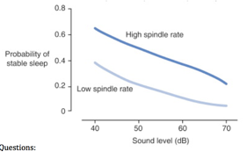
Do Now
Purpose? Conclusion?
Notes:
E.g. Purpose: Determine probability of stable sleep for increasing sound levels for high vs. Low spindle rate groups (The overall purpose would be something like: Determine how spindle rate affects sleep stability across a range of sound intensities.)
Good questions to ask: Why are you more able to have stable sleep with high spindle rate? Does sound volume influence spindle rate? How were high/low spindle rate determined? How many in each?

Slide 4
Discuss: Two Heads…
Two heads are better than one. The previous exercise was probably a challenge. Work with a partner to discuss what you could make of the data and together work to refine your Purpose and Conclusion.
Notes:
Expect students to struggle, and encourage it. Remind them they are doing college and even graduate level work by trying to analyze and interpret scholarly journal articles.

Slide 5
What is a Scholarly Journal Article?
In academic publishing, the goal of peer review is to assess the quality of articles submitted for publication in a scholarly journal. Before an article is deemed appropriate to be published in a peer-reviewed journal, it must undergo the following process:
Submission
Review/Evaluation
Suggested revisions
Acceptance or Rejection
Source: http://guides.lib.jjay.cuny.edu/content.php?pid=209679&sid=1746812

Slide 6
New Info:
Scholarly journal articles in science will typically have the following sections (or similar):
Abstract (a short summary of the entire study)
Introduction/Background
Literature Review
Methods
Results
Conclusions
Source: http://guides.lib.jjay.cuny.edu/content.php?pid=209679&sid=1746812

Slide 7
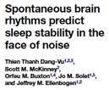
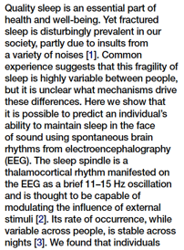
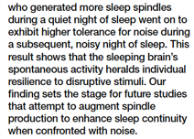
The Abstract
Notes:
Possible Answers:
Purpose: How does brain activity (high or low spindle rate) affect tolerance to waking up during the night due to noise?
Results: People with lower spindle rates are more likely than people with higher spindle rate to wake up to noise.
Conclusion: People with more brain spindle activity are less likely to wake up to loud noises.

Slide 8
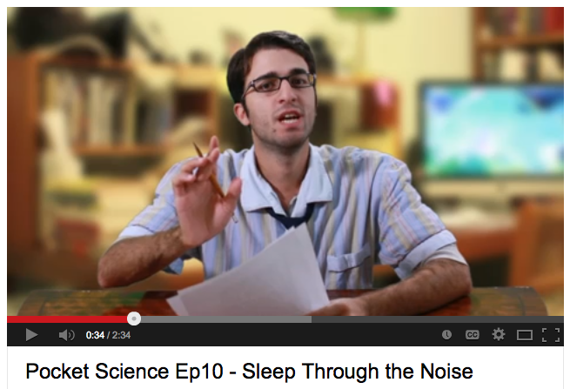
George Zaidan on Pocket Science!
Jot down anything new you learn as he explains:
Video Link: http://www.youtube.com/watch?v=Trn2E63_9Bw
Notes:
Have students watch the 2.5 minute overview of this study by George Zaidan on Pocket Science. Link: http://www.youtube.com/watch?v=Trn2E63_9Bw

Slide 9
Analyze the Study
1. According to the study, the ( more / less ) spindles you have per minute, the ( better / worse ) you are at sleeping through noise.
2. Predict: Write a sentence predicting the relationship between about spindles and sleep through light.
3. In this study, people who probably had poor quality of sleep were most likely those with ( high / low ) spindle rates. Explain!
4. According to the study, which group of people would be most likely to wake up in the middle of the night if the neighbors in the apartment next door started blasting music at 50 dB?
Notes:
Answers:
More; Better
Those with higher spindle rates are less likely to wake up in the presence of light than those with lower spindle rates.
Low; Poor quality of sleep is the lower end of the y-axis (low probability of stable sleep)
People with lower spindle rates

Slide 10
Analyze the Study
5. Based on the information in the graph, which person is most likely wake up? (Circle one.)
Suzie has a high spindle rate and at 6:30am her brother runs in to wake her up in the morning, screaming at a 70dB level
Pablo has a low spindle rate and at 6:00am a bird flies into the window, hitting it with a crash at a 40dB level
6. Based on results from the study:
How likely is it that Mr. Smith (who has high spindle rates) would wake up if exposed to his wife’s 50 dB scream when she goes into labor in the middle of the night? ______% likely
How likely is it that Mr. Taylor (who has low spindle rates) would wake up from his lunchtime nap if exposed to the passing period bell at 40 dB? ______% likely
Notes:
5. Suzie (find each point on the graph in Do Now and Suzie will be lower on the y-axis, indicating she is more likely to wake up)
6. 50%; 40%
Challenge: Ask students, “The scientists concluded their abstract saying that more studies should be conducted. What other variables could they test?” (Possible answer: How the patterns of sleep stability change when the other senses (sight (light), smell, touch, taste?) are varied.)

Slide 11
Assess:
Summarize the purpose & conclusion of the article in your own words.
Purpose:
Conclusion:
Notes:
Possible Answers:
Purpose: How does brain activity (high or low spindle rate) affect tolerance to waking up during the night due to noise?
Conclusion: People with more brain spindle activity are less likely to wake up to loud noises.

Slide 12
Homework: Scholarly Study
Use Google Scholar to find an abstract for a scholarly journal article focused one risk factor for influenza (you choose!). Summarize the Purpose, Methods, Results, & Conclusions on a separate sheet of paper.
Notes:
The purpose of this homework assignment is to challenge students to “get their feet wet” using Google Scholar. They may struggle a bit, but it will be a good way to get exposed to the process of searching for a scholarly journal, even before learning how to do this in a later lesson. Once students find an article, they’ll also gain more practice analyzing complex scholarly texts. If they are successful, they may even be prepared to start the following case study (on influenza) with some of their research already done.

