Slide 1
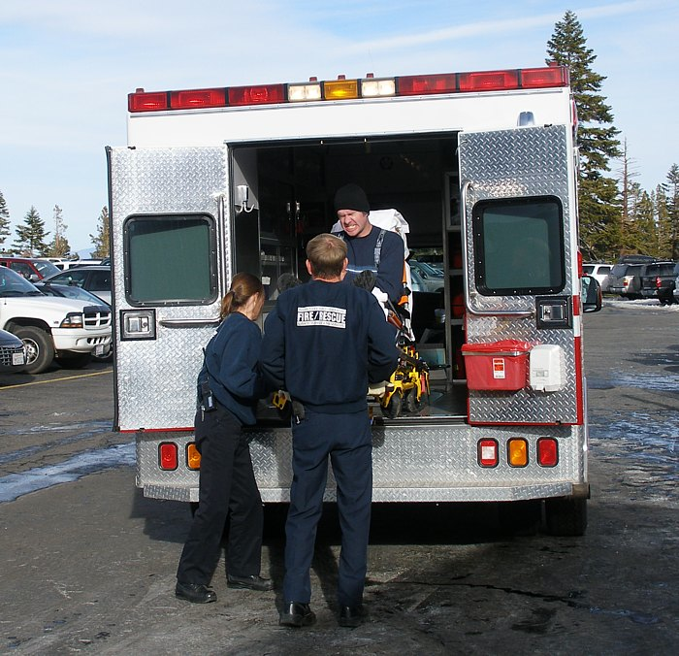
Lesson 4.8: SAMPLE HISTORY
Obj. 4.8: Identify essential subjective information through a SAMPLE history
Module 4: Sexual Health
Notes:
This lesson will provide more background and practice for the SAMPLE history component of the Subjective section of the SOAP note. Students will briefly review the sections of the SOAP note. Then they will engage in a hypothetical situation to brainstorm questions that would be asked in a medical emergency. Next they will read more about the SAMPLE history and partner up to practice asking questions to obtain essential information. Finally, they will be assessed with examples of statement in the SAMPLE history.
Image source: http://en.wikipedia.org/wiki/Emergency_medical_technician

Slide 2
Do Now: S, O, A, or P?
1. WT = 210 lbs, HT = 60, BW = 115 lbs, Chol = 255, BP = 140/95
2. Obese at 183% BMI, hypercholesterolemia, hypertension.
3. Long Term Goal: Change lifestyle habits to lose at least 70 pounds over a 12 month period. Short Term Goal: Client to begin a 1500 Calorie diet with walking 20 minutes per day. Instructed Pt on lower fat food choices and smaller food portions. Client will keep a daily food and mood record to review next session. Follow-up in one week.
4. Pt. states that she has always been overweight. She is very frustrated with trying to diet. Her 20-year class reunion is next year and she would like to begin working toward a weight loss goal that is realistic.
Notes:
Answers: 1. Objective; 2. Assessment; 3. Plan; 4. Subjective

Slide 3
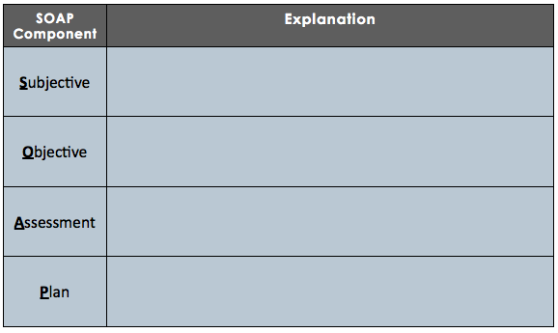
Discuss:
Notes:
SUBJECTIVE: Chief Complaint, or CC, a brief statement of the patient as to the purpose of the office visit or hospitalization.
OBJECTIVE: Vital signs (pulse, respiration, blood pressure) and measurements, such as weight and height; Findings from physical examinations, Results from laboratory and other diagnostic tests
ASSESSMENT: A medical diagnosis for the purpose of the medical visit on the given date of the note written is a quick summary of the patient with main symptoms/diagnosis including a differential diagnosis, a list of other possible diagnoses usually in order of most likely to least likely. It is the patient's progress since the last visit, and overall progress towards the patient's goal from the physician's perspective.
PLAN: This is what the health care provider will do to treat the patient's concerns - such as ordering further labs, radiological work up, referrals given, procedures performed, medications given and education provided. This should address each item of the differential diagnosis.

Slide 4
Think:
You walk over to your grandmother’s house and find her on the ground in the hallway, moaning in pain. You assess the situation and decide that calling 9-1-1 is the best precaution to take. While you are waiting with her for the ambulance, list the questions you would ask her.
Notes:
Ask students whether the questions they asked would be different if it were a stranger instead of your grandmother. This should elicit responses that help them consider the background knowledge they already have about their grandmother that a health care provider would need to ask.

Slide 5
SAMPLE history
Mnemonic tool
Used in patient assessment
Taken at beginning of the patient’s visit (with vitals)
Emergency medicine health practitioners
Person must be alert to answer the questions for themselves
Family member or a friend can also answer if needed

Slide 6
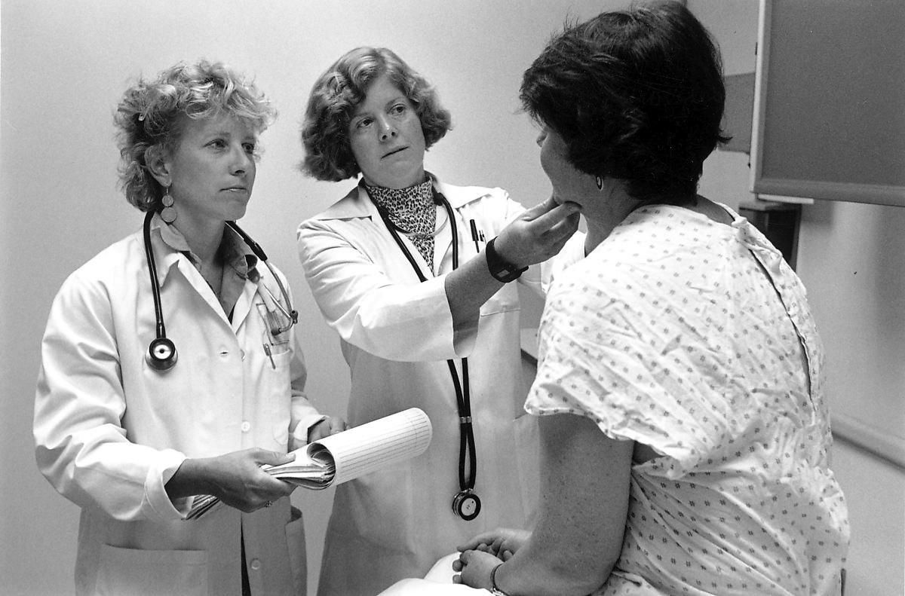
SAMPLE history:
Symptoms (and Signs)
Allergies
Medications
Past medical history
Last oral intake (and sometimes Last menstrual cycle)
Events leading to injury or illness
Notes:
For more information, see the following sites:
Basic overview of sample: http://en.wikipedia.org/wiki/SAMPLE_history
Questions to consider in drug abuse situations: http://www.webmd.com/mental-health/medical-history-for-drug-use
Excellent comprehensive take on the SAMPLE from emergency medicine professional: http://theemtspot.com/2012/03/08/understanding-the-sample-history/
Image source: http://en.wikipedia.org/wiki/Patient_participation

Slide 7
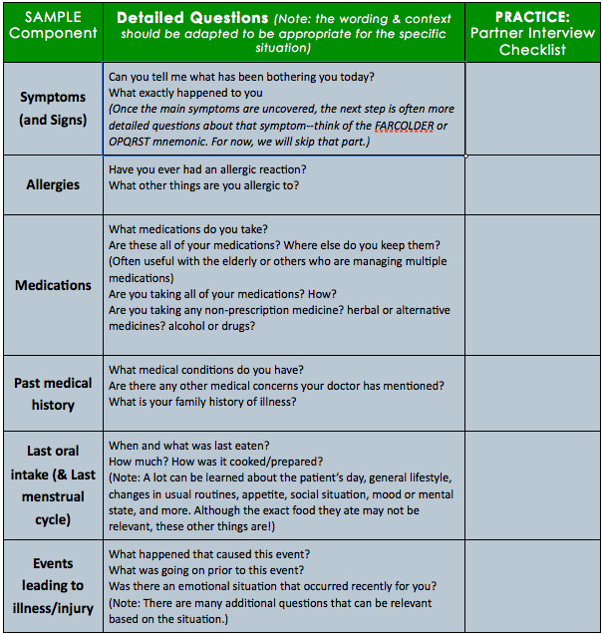
Notes:
The partner SAMPLE interview activity could be more structured (assign partner, provide disease assignments for each student, etc.) or it can be an informal semi-unstructured activity.
This chart was prepared as a loose summary of the following web page: http://theemtspot.com/2012/03/08/understanding-the-sample-history/

Slide 8
Assess: Which part of SAMPLE?
1. “I had a bag of pretzels and a Diet Coke about an hour ago.”
2. “I got stung by a bee five years ago and broke out in terrible hives.”
3. “I feel a stabbing pain in my chest & my jaw has been aching for days.”
4. “I was running in the 800 meter dash and I got dizzy at the finish line.”
5. “I take one Aspirin per day, along with Echinacea and Fish oil tablets.”
6. “I was diagnosed with Type II diabetes six months ago.”
Notes:
Answers:
Last oral intake
Allergies
Symptoms & signs
Events leading to injury/illness
Medications
Past Medical history

Slide 9
Homework:
Imagine you are a paramedic called to a scene. Create all the fictional details of the situation by writing a script of the interview with the patient that happens after you arrive. Be sure to include components to clearly and thoroughly cover all aspects of the SAMPLE history.
Notes:
The purpose of this homework assignment is for students to practice the ask/response involved in SAMPLE history taking to prepare for the case study. This will boost familiarity with the components of information that must be gathered to gain a complete picture of the patient’s situation.

