Slide 1
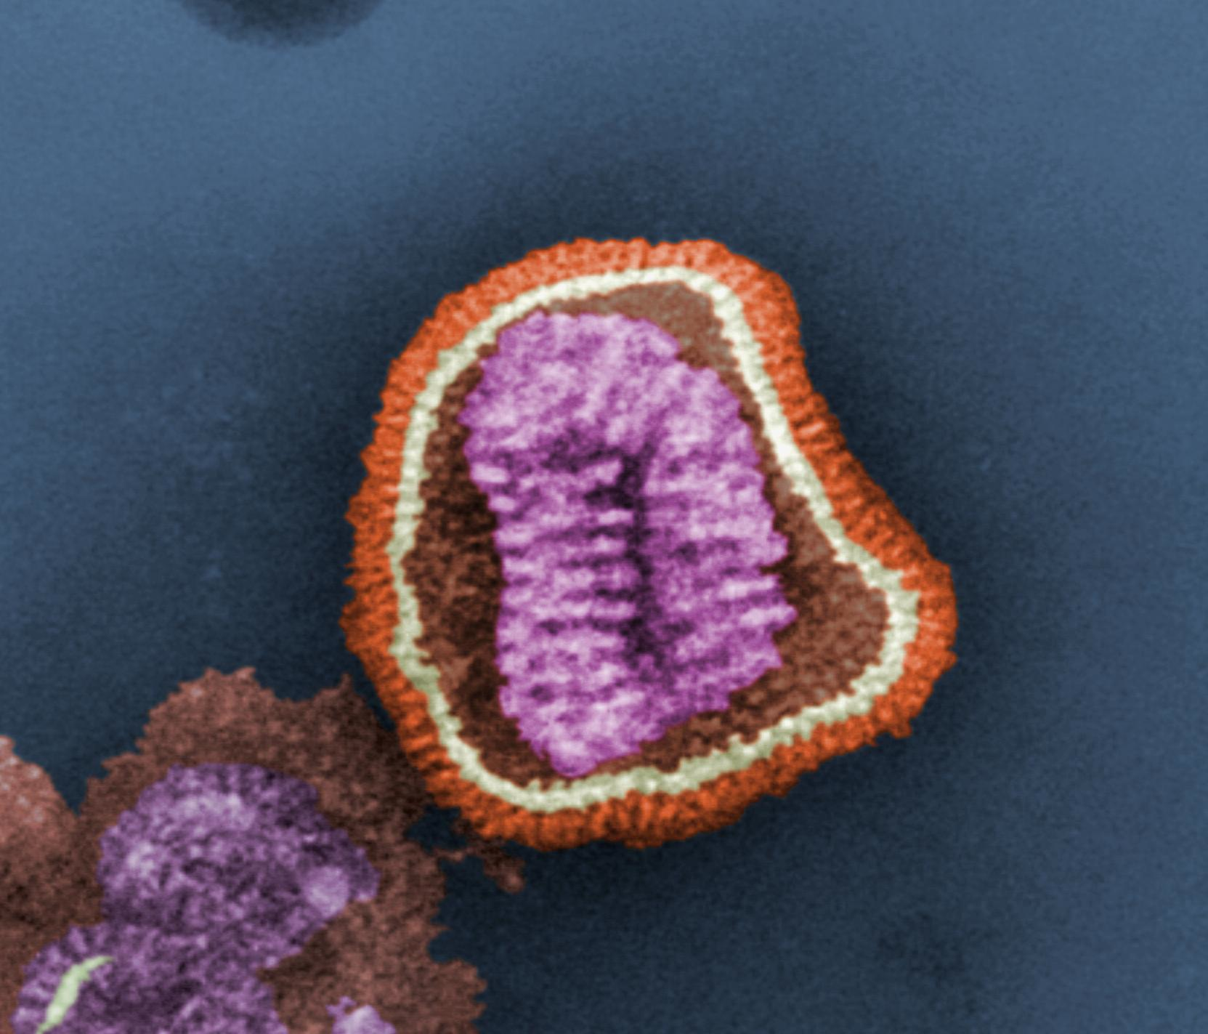
Lesson 4.7: Sexually transmitted infections (Stis)
Obj. 4.7: Identify the symptoms of STIs and their impact on physical, mental, and social health.
Module 4: Sexual Health
Notes:
Overview: This lesson will challenge students to increase their awareness of STIs. Students will begin with a Truth vs. Myth exercise, then they will discuss the causes and effects of STIs. After that, students will learn some basic terms and background information on STIs, followed by a chance to do their own research on STIs, focusing especially on physical, mental, and social effects (both short-term symptoms and long-term risks). Finally, students will complete a homework assignment with clinical scenarios. This lesson could also be flipped, so that the research is done outside of class for homework in preparation of the lesson and the scenarios are completed in class.
Image source: http://simple.wikipedia.org/wiki/Virus

Slide 2
Truth or Myth?
1. It can take only one sexual contact with an infected person to get a STI.
2. If you’ve been infected with an STI before, you can’t get the same infection again.
3. You can have more than one STI at a time.
4. You can get a STI from sharing needles.
5. All people infected with STIs know they have something.
Notes:
Answers:
Truth
Myth
Myth
Truth
Myth

Slide 3
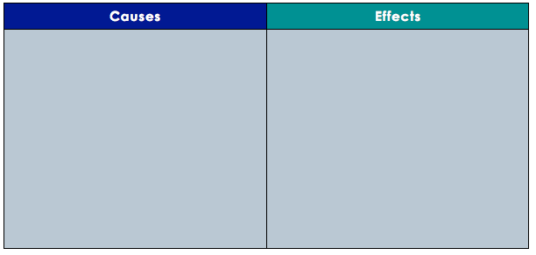
Discuss
There are an estimated 19 million new cases of STIs every year. With a partner, brainstorm and list causes and effects of this problem in the table below.
Notes:
Example causes and effects:
Causes: Lack of education/awareness, not getting tested, lack of safe sex, drugs/alcohol influencing sexual behaviors, etc.
Effects: Psychological distress from having STIs (mental health), damaged relationships, burden on healthcare system, lost work/school days and/or productivity, long-term reproductive problems, especially with child-bearing, etc.

Slide 4
Transmitting STIs:
Sexually transmitted infections (STIs) can be passed from one person to another in the following ways, which vary based on the STI:
Oral sex, anal sex and vaginal sex
Contact with blood, semen and vaginal discharge
Skin-to-skin contact
Occasionally, contact with breast milk and fecal matter

Slide 5
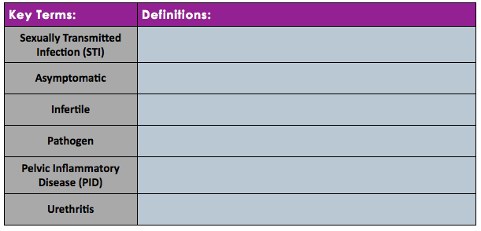
Transmitting STIs:
Any pathogen that spreads from one person to another during sexual contact
experiencing no symptoms (silent STI)
Not able to reproduce
any agent that causes disease (ex: bacteria, virus, parasite, etc.)
an infection & inflammation of the female uterus, fallopian tubes, and ovaries
Infection/inflammation of the urethra in males and females
Notes:
STI: Any pathogen that spreads from one person to another during sexual contact
Asymptomatic: experiencing no symptoms (silent STI)
Infertile: Not able to reproduce
Pathogen: any agent that causes disease (ex: bacteria, virus, parasite, etc.)
Pelvic Inflammatory Disease (PID): an infection & inflammation of the female uterus, fallopian tubes, and ovaries
Urethritis: Infection/inflammation of the urethra in males and females

Slide 6
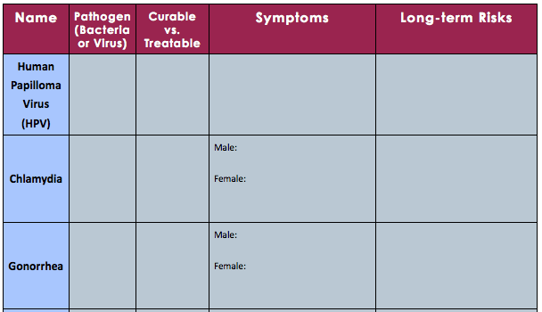
Think:
Notes:
For information that can be used to fill in this chart, see STI Factsheet PDF file (can also be found at: http://www.womenshealth.gov/publications/our-publications/fact-sheet/sexually-transmitted-infections.pdf). Another good site to direct students to is: http://www.cdc.gov/std/healthcomm/fact_sheets.htm

Slide 7
Clinical Scenarios:
1. Your patient has been experiencing no physical symptoms other than raised, painless bumps on his penis. His girlfriend is currently undergoing treatment for cervical cancer. What STI does he most likely have?
2. Your patient has never had sexual intercourse. She has had a few recent outbreaks of painful, raised bumps around her lips and mouth. She has no other visible symptoms. Does she have an STI? If yes, which one?
3. Your patient has developed a painless open sore on his finger after touching his partner’s genitals, who had a similar sore on his penis. Does your patient have an STI? What STI does your patient most likely have?
4. Your patient is having frequent yellowish discharge from his penis, and experiences pain when urinating. What STIs should you test him for?
Notes:
Answers:
1. HPV
2. Herpes
3. Syphilis
4. Gonorrhea, Chlamydia

Slide 8
Think:
1. After reviewing the information, what characteristic of a disease has a direct impact on whether or not the infection is curable? (Think about which infections can be cured; what do they have in common?)
2. Which STIs can be asymptomatic?
3. Which STIs can be fatal (deadly), if left untreated?
4. Which STIs can lead to infertility?
Notes:
ANSWERS:
1. VIRAL STIs are not curable (only treatable), bacterial STIs are curable
2. Chlamydia, Gonorrhea, Genital herpes, HIV, Syphilis, HPV
3. HIV, HPV, Syphilis
4. Chlamydia, Gonorrhea, HIV

Slide 9
Assess:
1. Which of the following STIs can be totally cured with medicine?
a. Genital Warts
b. Gonorrhea
c. HIV
d. HPV
2. Which of the following is untrue about STIs?
a. A person cannot have more than 1 STI
b. Condoms protect a person from getting an STI 100% of the time
c. A person cannot get an STI the first time they have sex
d. All of the above are false statements about STIs
3. Which of the following is not a long-term risk of human papilloma virus?
a. Weakened immune system
b. Cervical cancer
c. Genital warts
d. Urethral cancer
Notes:
Answers:
B
D
A

Slide 10
Homework:
1. When should a person start to get tested for STIs? How often should they be tested?
2. If a person tests positively for an STI, what sort of action should they take to treat themselves physically, socially, and mentally? What should they do/say to their current partner and previous partners?
3. What should a person do if a previous sex partner informs them they have tested positive for an STI?
4. What is one way to be sure that your partner does not have an STI?
5. What conversations should sex partners have before engaging in sexual behaviors?
6. How might a person feel, psychologically, after testing positive for an STI? What sort of treatment should they seek in a addition to physical treatment?
Notes:
The purpose of this homework assignment is to get students thinking about how to apply the information they learned in the real world. All of these should be able to be answered based on logic and understanding of basic information on STIs, however students may look up information online if they prefer.

