Slide 1
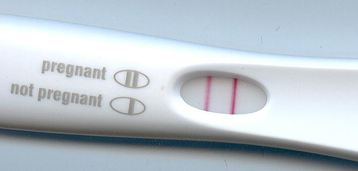
Lesson 4.4: Pregnancy
Obj. 4.4: Describe the events of pregnancy.
Module 4: Sexual Health
Notes:
This lesson will prepare students with some basic background on the initial stages of pregnancy, some key events in the three trimesters, common pregnancy complications, and support structures for the growing fetus. Students will engage in readings and discussion questions, along with data analysis during the Do Now and Homework portions of the lesson.
Image source: http://en.wikipedia.org/wiki/HCG_pregnancy_strip_test

Slide 2
Do Now

Slide 3
Do Now
1. How many babies were born to teens in Illinois in 2010?
2. How many babies were born to girls under 15 years old in the US in 2010?
3. How many babies were born to Black and Hispanic teens in Illinois during 2010, respectively?
4. How many babies were born to Asian and American Indian teens in Illinois is 2010, combined?
5. What age group produced the fewest babies in 2010? What age group produced the most babies?
6. Approximately what percentage of teen births occurred in Illinois in 2010 (yes, you may use a calculator if you have one, or make a great estimate)
7. Which race/ethnicity produced the highest number of babies in Illinois and the United States in 2010, respectively? Why do you think there is this difference between our state and the nation?
Notes:
Answers:
1.14,988
2. 190
3. 5457, 4532
4. 97
5. Under 15, 15-19
6. Approx. 4%
7. Non-Hispanic black, Non-Hispanic white, Answers will vary.

Slide 4
Discuss
What do you think is impacting the pregnancy numbers?
What is one strength and one limitation with the way the data is presented in the table?
Notes:
One possible strength: showing totals gives a sense of the extent of the problem; One possible weakness: we don’t know the total populations at each age and race/ethnicity, so showing whole numbers may be misleading if we don’t know what percentage of the whole those make up

Slide 5
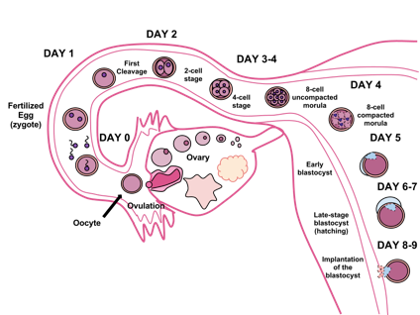
Fertilization, Cell Division, & Implantation
Notes:
For more background on this process, numerous websites can be visited. Here are a few good ones:
Complex: http://php.med.unsw.edu.au/embryology/index.php?title=Embryonic_Development
Simple: http://www.mayoclinic.org/prenatal-care/art-20045302
Video: http://www.babycenter.com/2_inside-pregnancy-early-fetal-development_10354436.bc
Visual: http://www.visembryo.com/baby/

Slide 6
Terms for the Stages of Development
ZYGOTE: When a single sperm enters the mother's egg cell, the resulting cell is called a zygote.
BLASTOCYST: The zygote continues to divide, creating an inner group of cells with an outer shell. This stage is called a blastocyst. The inner group of cells will become the embryo, while the outer group of cells will become the membranes that nourish and protect it
EMBRYO: The cells of the embryo now multiply and begin to take on specific functions. This process is called differentiation
FETUS: Term for the developing life form, beginning at the 11th week in gestational age, which is the 9th week after fertilization.
Source: http://www.nlm.nih.gov/medlineplus/ency/article/002398.htm

Slide 7
Discuss
At what stage would you consider the developing life form an actual life?
Do you base your answer on scientific evidence or personal beliefs?
Why is this such a controversial question?
Notes:
This question obviously hints at the abortion debate. While that debate is an important one, it would take much more time than this lesson will allow. It is also a very sensitive issue and should be approached with caution in the classroom. A takeaway of this question for students should be that we can form opinions based on evidence and our own beliefs, but that often there is a lot of “gray area” imbedded in these complex questions.

Slide 8
The Trimesters of Pregnancy
Pregnancy: 40 weeks
First Trimester (Week 1 to Week 12)
Second Trimester (Week 13 to Week 28)
16 weeks: find out the sex
20 weeks: begin to feel movement.
24 weeks: fetus sleeps and wakes regularly.
Survival rate for babies born at 28 weeks was 92% (NICHD Neonatal Research Network)
Third Trimester (Week 29 to Week 40)
Notes:
One interesting visual on the growing baby inside the mother’s womb can be found here: http://www.msichicago.org/whats-here/exhibits/you/the-exhibit/your-beginning/make-room-for-baby/interactive/

Slide 9
Discuss:
Could a baby develop outside of a human? Why or why not?

Slide 10
Support Structures for the Fetus
PLACENTA:
pancake-shaped organ that attaches to the inside of the uterus and is connected to the fetus by the umbilical cord
works as a trading post between the mother’s and the baby’s blood supply.
UMBILICAL CORD:
life-line that attaches the placenta to the fetus.
made up of three blood vessels: two smaller arteries which carry blood to the placenta and a larger vein which returns blood to the fetus.
AMNIOTIC SAC:
baby’s home, gymnasium, and protection from outside knocks, bumps, and other external pressures.
allows the fetus ample room to swim and move around which helps build muscle tone
Source: http://americanpregnancy.org/duringpregnancy/fetallifesupportsystem.html
Notes:
Ask students if they have heard of any problems relating to these support structures? (Examples: Placenta previa, premature rupture of the amniotic sac, umbilical cord prolapse, umbilical cord being wrapped around babies neck, meconium aspiration syndrome, etc.)

Slide 11
Common Pregnancy Complications:
Miscarriage:
Spontaneous loss of a fetus before the 20th week of pregnanc
Ectopic Pregnancy:
The embryo implants outside the uterus, causing heavy bleeding, severe pelvic pain, dizziness and may result in death, if untreated
Preterm Labor:
When the mother’s body is trying to deliver the baby before she has reached full-term (37 weeks).
Gestational Diabetes:
Develops during pregnancy (usually 2nd trimester), when a woman’s body is not making enough insulin.
Notes:
Ask students if they know of other complications. There are many more than can be added to this list (some common, others not so common) : (Molar pregnancy, Rh Negative disease, Group B strep, Low birth weight, etc.)

Slide 12
Assess:
Describe the following terms in three sentences of less:
zygote,
second trimester
amniotic sac
ectopic pregnancy

Slide 13
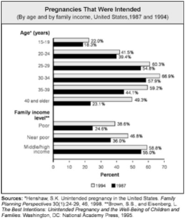
Homework:
Answer the homework questions as you analyze the data in this graph on intended pregnancies among different groups.
Notes:
The purpose of this homework is to provide students with a useful data set (this may be helpful data to draw from in their upcoming case study) to use in more data analysis practice. It may also surprise and shock students to learn how many pregnancies are actually unintended, even among older women.

