Slide 1
Lesson 4.3: Female Reproductive System
Obj. 4.3: Explain the anatomy and physiology of the female reproductive system.
Module 4: Sexual Health
Notes:
This lesson will provide a basic background of the male reproductive system, focusing on the structures and functions of the main reproductive organs. Students will complete a labeling exercise, a short reading, note-taking, and discussion.
Image source: http://commons.wikimedia.org/wiki/File:2Silhouette_Female.svg

Slide 2
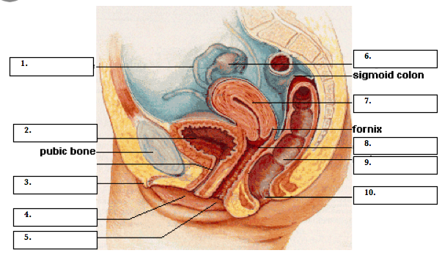
Do Now
Fallopian tube
ovary
uterus
bladder
cervix
rectum
clitoris
anus
urethra
vagina
Notes:
Show students a frontal image on the next slide to help them understand how the reproductive system is organized from both angles.

Slide 3
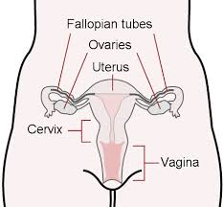
Frontal view of the reproductive system

Slide 4
Female System Parts
Part | Description
1. Fallopian tube | Carry eggs to the uterus, fertilization happens here
2. Pubic bone | Front bony portion of pelvis
3. clitoris | Nerve center for female genitals, can produce pleasure during sex
4. urethra | Tube carrying urine from bladder to outside (separate from vagina)
5. vagina | 1. birth canal; 2. route for menstruation; 3. route for sexual intercourse
6. ovary | Two walnut-sized structures, store eggs and nurture them prior to ovulation
7. uterus | Pear-shaped (upside down) structure; home for developing embryo/fetus
8. cervix | Opening of the mouth of the uterus into the vagina
9. rectum | Last segment of large intestine (colon)
10. anus | Opening of colon; closed by anal sphincter
Notes:
Ask students what diseases, illnesses, or problem they have heard about pertaining to parts of the female reproductive system? (Ex: ectopic pregnancy in fallopian tubes, female genital mutilation of the clitoris in some cultures, ovarian cancer or ovarian cysts, endometriosis, cervical cancer, etc.)

Slide 5
Read
Sex cells = gametes
male gamete = sperm
female gamete = egg or ovum
Genes: the special carriers of human traits
Female reproductive system is entirely in pelvis
External: vulva
Internal: vagina, uterus, fallopian tubes, & ovaries
Notes:
Remind students of the importance of using the appropriate medical/scientific terms, not common nicknames.

Slide 6
Think:
1. What is the function of the human reproductive systems?
2. What are the major differences between the female and male reproductive system?
3. What questions do you have about the female reproductive system? (List at least one).
Notes:
Provide students an opportunity to write questions anonymously on notecards. Explain that the instructor will read these outside of class to ensure the answers provided are medically accurate, however remind them that some questions dealing with personal health issues should be addressed with their health care practitioner. This can be a norm that is carried out throughout the entire module.

Slide 7
Functions, Sex Cells, Puberty…
1. FUNCTIONS: What are the 3 main functions of the female reproductive system?
1. Produce sex hormones (estrogen, progesterone)
2. Produce eggs
3. Provide a nourishing environment for a fertilized egg
2. SEX CELLS: What are the female sex cells and how are they protected and nurtured?
ovum: Carry female genetic material; typically one released per month
ovaries: Select and nurture ova each month in a follicle, which ruptures release ovum into fallopian tube at ovulation
Uterus: Develops a blood-rich, nutrient-rich lining to help grow a fertilized egg
PUBERTY: What are some changes females undergo during puberty? Breasts grow, increase of body/pubic hair, increased body oils, menstruation begins, hips widen, voice deepens, weight gain

Slide 8
Phases of Menstrual Cycle:
Menstruation (having a period): The uterine lining and blood sheds, usually lasts 4-7 days
Follicular Phase: ovaries are being stimulated to produce a mature egg, uterine lining is growing, preparing for possible egg implantation if pregnancy would occur
Ovulation: ovaries release a mature egg, triggered by a surge of hormones
Luteal Phase: (average: 14 days). uterine lining continues to grow, preparing for embryo implantation
Notes:
Have students draw a timeline of the menstrual cycle to better understand these phases. The next slide contains a useful diagram. Also, remind students that these timeframes are only averages and that it can take much longer or shorter for phases to happen, especially among adolescent females whose menstrual cycles may not be regulated yet.

Slide 9
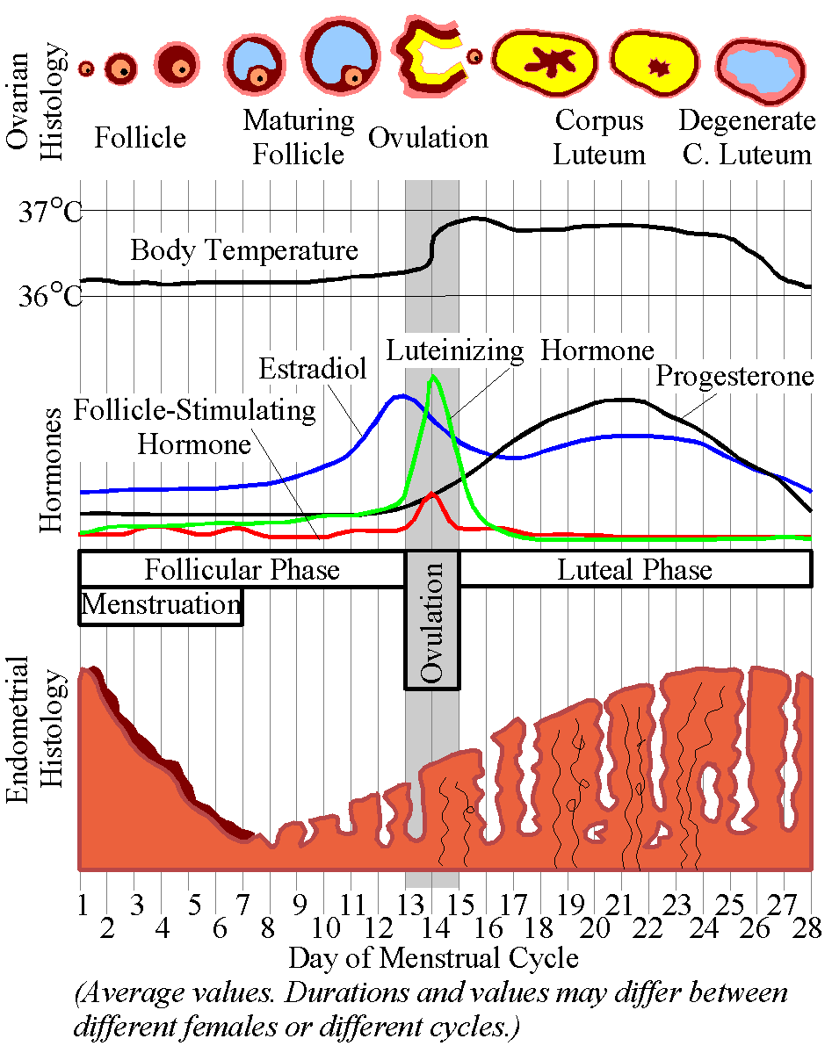
Phases of Menstrual Cycle:
Notes:
Image source: http://commons.wikimedia.org/wiki/File:MenstrualCycle.png

Slide 10
Discuss:
What might happen if the egg is fertilized (meets a sperm)?
How would this interrupt the menstrual cycle?
How might twins be formed?
What may cause this?
Notes:
Twins can either be monozygotic ("identical"), meaning that they develop from one zygote that splits and forms two embryos, or dizygotic ("fraternal"), meaning that they develop from two eggs, each fertilized by separate sperm cells.

Slide 11
Assess:
Describe how the female reproductive system accomplishes it’s function of providing a nourishing environment for a growing egg. Use at least 4 new reproductive system terms in your description.

Slide 12
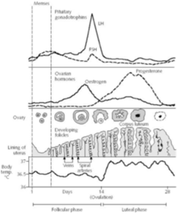
Homework:
1. During approximately which days of the cycle might a woman have her menses (bleeding)?
2. At approximately what day (#) during the cycle is there a surge (big increase) in LH?
3. According to Figure 1, on what approximate day (#) does ovulation occur?
7. Describe what is happening on Day 14 of the menstrual cycle.
8. At what range of days is the lining of the uterus the thickest?
9. When do the follicular phase and luteal phase take place, respectively?
10. Describe the journey of an unfertilized ovum.
Figure 1: Changes of hormone concentrations in the blood during a 28-day menstrual cycle.
Notes:
The purpose of this homework assignment is for students to spend more time internalizing the events of menstruation, a fairly complex process. They will also practice the skill of analyzing a diagram/graph as they answer the questions.

