Slide 1
Lesson 4.1: Sex, Gender, & Sexuality
Obj. 4.1: Distinguish between the terms sex, gender, and sexuality
Module 4: Sexual Health
Notes:
This lesson will provide an introduction to sexual health for students, by focusing on terminology of the paradigm of sexuality. Students will engage in exercises in note-taking, discussion, and brainstorming to begin the module with a clear understanding of sex, gender, sexuality, sexual orientation, sexual behaviors and much more.

Slide 2
Do Now
What type of sexual health education have you had in the past?
Was it informative?
Why/why not?
When did it occur?
What would you have changed or improved about it?
Notes:
Additionally, a separate questionnaire could be anonymously distributed with questions similar to the following: (this would provide the instructor with more data)
How are you feeling about beginning our sexual health module? Why?
What sexual health topics do you feel you already know a lot about?
Which sexual health topics do you know the least about?
What are you most interested in learning about?
What type of sexual health education have you had in the past? Was it informative? Why/why not? When did it occur?
What questions do you have that you hope are answered during this unit? Think of as many questions as possible.

Slide 3
Discuss: NORMS?
Ask questions.
Listen.
Avoid Judging Comments.
Keep comments/stories general; no names.
Avoid personal questions in a group setting.
Use appropriate, medical language.
Respectfully disagree and question.
Notes:
Norming is VERY important in this module. Allow students to brainstorm in groups to determine whether any other norms should be added.
It may also be useful to have a “repeat-after-me” session to get students accustomed to the normalcy of using the appropriate terms (ex: penis, vagina, etc.). Explain that it is natural reaction to want to giggle (and perhaps give them one opportunity to “get it out of their system”), but that the tendency to do so occurs because we feel uncomfortable, and we want to strive to create an environment where we feel as comfortable as possible so we will try to refrain from giggling/laughing.

Slide 4
Sex, Gender & Sexuality:
(1) Biologically male or female, determined by chromosomes. XX = female, XY = male. (2) Sexual Intercourse
Expression of masculinity or femininity. Most people identify as man, woman, or transgender.
Total capacity for sexual feelings; Influenced by: biological sex, gender roles, sexual orientation, behaviors relationships, society, body image, etc.
Notes:
Sex = (1) Biologically male or female, determined by chromosomes. XX = female, XY = male. (2) Sexual Intercourse
Gender = Expression of masculinity or femininity. Most people identify as man, woman, or transgender.
Sexuality = Total capacity for sexual feelings.
Influenced by: biological sex, gender roles, sexual orientation, behaviors relationships, society, body image, etc.

Slide 5
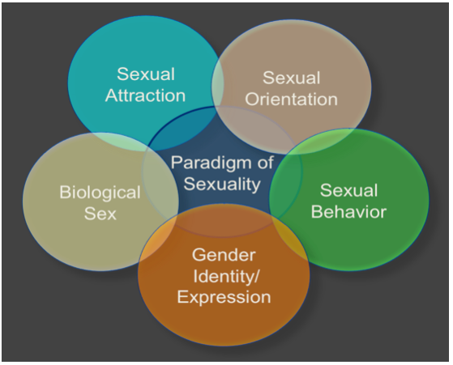
Paradigm of Sexuality:
Paradigm: a typical example or pattern of something; a model.

Slide 6
Paradigm of Sexuality:
Term: | Description:
Sexual Attraction | Romantic or physical interest in another. (Looks; Personality; What else?)
Sexual Orientation | people’s physical and romantic attractions (LGBTQQIA) Lesbian: Woman attracted to women Gay: Man attracted to men Bisexual: Person attracted to men and women Transsexual/Transgender: Person whose gender does not align with biological sex Queer: Person who identifies as LGBT, reclaiming an offensive term Questioning: Person exploring sexuality Intersex: Biologically not fully female or male Ally: Person supportive of all identities/orientations

Slide 7
Paradigm of Sexuality:
Term: | Description:
Sexual Behavior: | Acts that result from sexual attraction or arousal Kissing: mouth/tongue to mouth/tongue contact Touching/Masturbation: hand contact to one’s own genitals or to another’s genitals Sexual rubbing with clothes on: genital-to-genital contact through clothes Genital-to-genital contact: same, but while naked Vaginal sex: insertion of penis into vagina Oral sex: mouth/tongue to genital (penis/vagina) contact Anal sex: insertion of penis into anus
Gender Identity/Expression: | Expression of femininity or masculinity. People identify as: Man; Woman; Transgender; None
Biological Sex: | Male or female anatomy: penis or vagina; Intersex: Unclear biological sex, extra/missing chromosome

Slide 8
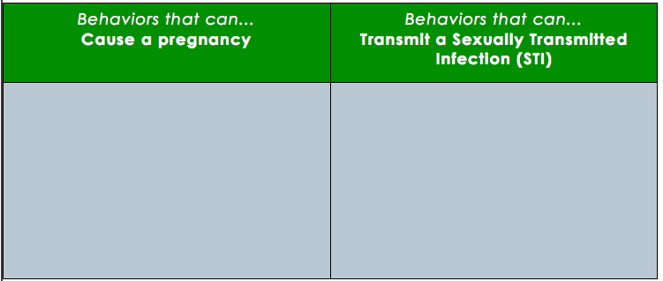
Why do we SPECIFICALLY define sexual behaviors?....
Unprotected vaginal sex
Protected vaginal sex
Ejaculation of semen on or near the opening to the vagina
Ejaculation of semen while pulling out of the vagina
Unprotected oral, anal or vaginal sex with an infected partner
Protected oral, anal or vaginal sex with an infected partner
Skin-to-skin contact of the genital or mouth area with an infected partner
Exposure to infected sexual fluids such as blood, semen, vaginal fluids or pre-ejaculate
…because the details make the difference!

Slide 9
Discuss:
1. Do you think most adolescents have an accurate understanding of the two lists above (behaviors that can cause pregnancy or STIs?). If not, what do you think the most common misconceptions are?
2. For teens who do have an accurate understanding of what behaviors can cause pregnancy or STIs, what are some of the other reasons they may still end up making risky decisions that involve these sexual behaviors?
Notes:
There are numerous studies on how knowledge and awareness influence teen sexual health outcomes. A supplementary journal source or data set could be used if time permits.

Slide 10
Assess:
In your own words, explain the difference between gender, sex, and sexuality (without referring back to your notes).

Slide 11
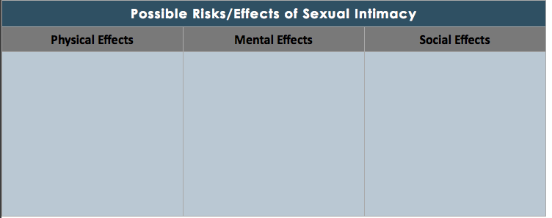
Homework:
Which of the effects (mental, physical, social) of engagement in sexual activity would you consider to be most lasting? Why?
When should a person decide to become sexually active? What factors should he/she consider?
How does the media influence teens’ choices regarding sex?
Notes:
The purpose of this homework assignment is to consider the possible effects of being sexually intimate. By framing it around the three components of health (mental, social, & physical) students will likely think of possible outcomes that they had not thought of before.

