Slide 1
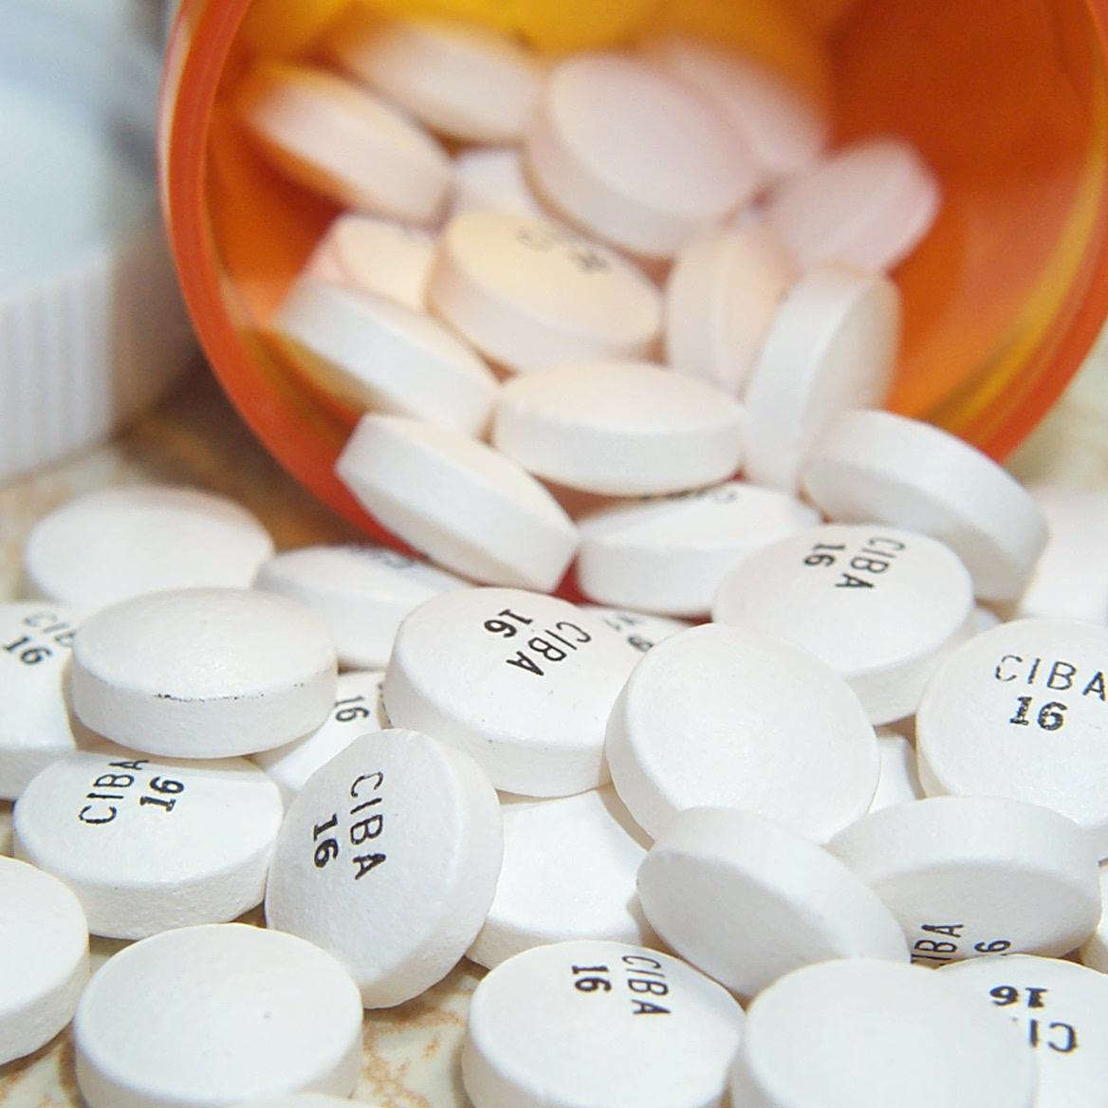
Lesson 3.8: Prescription Drug Abuse
Obj. 3.8: Use data to provide evidence for the prescription drug abuse epidemic.
Module 3: Drugs & Addiction
Notes:
This lesson will challenge students to compile evidence from graphs and charts to build evidence for the prescription drug abuse epidemic. Students will examine 4 graphical data presentations on various aspects of the prescription drug abuse problem, answering questions to analyze them, discussing related questions, and reading some background information along the way. At the end of the lesson they will provide an explanation of the problem in paragraph form, citing four pieces of evidence from the lesson.
Image source: http://en.wikipedia.org/wiki/Prescription_drug

Slide 2
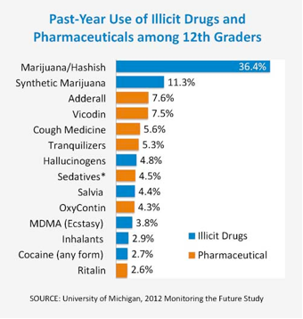
Do Now
Notes:
ANSWERS:
Which 3 pharmaceutical drugs did 12th graders use most in the past year? Adderall, vicodin, and cough medicine
2. What pharmaceutical drug most closely matches the rate of use among 12th graders for each of the following illicit drugs: a. Cocaine (any form): Ritalin; b. MDMA (Ecstasy): OxyContin; c. Synthetic marijuana: Adderall
3. Why do you think pharmaceutical drugs (prescription drugs) are being abused at these levels among 12th graders? Answers will vary.

Slide 3
What is Prescription Drug Abuse?
If you take a medicine in a way that is different from what the doctor prescribed, it is called prescription drug abuse. It could be:
Taking a medicine that was prescribed for someone else
Taking a larger dose than you are supposed to
Taking the medicine in a different way than you are supposed to. This might be crushing tablets and then snorting or injecting them.
Using the medicine for another purpose, such as getting high
Notes:
Ask students why they believe many people think prescription drug abuse is less dangerous than the abuse of other illicit drugs?

Slide 4
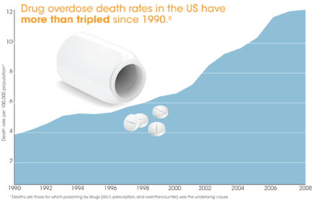
Drug Overdose Death Rates:
Source: http://www.cdc.gov/homeandrecreationalsafety/rxbrief/
Notes:
ANSWERS:
1. In what year did drug overdose deaths double the number of deaths in the year 1990? In approximately 2002
2. Why do you think drug overdose deaths have been rising in the past few decades? Answers will vary.

Slide 5
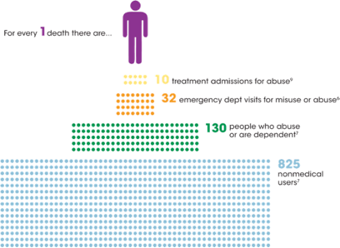
Prescription Drug Abuse Numbers
Source: http://www.cdc.gov/homeandrecreationalsafety/rxbrief/
Notes:
Possible problems that this infographic reveals or alludes to may include: overloaded clinics and emergency departments, resources used in the care of drug abuse cases cannot be used for other patients, strain on medical professionals, loss of work or income, strain on relationships with family/friends, etc.

Slide 6
How Prescription Painkiller Deaths Occur
bind to receptors in the brain to decrease the perception of pain
create a feeling of euphoria, cause physical dependence, and, in some people, lead to addiction
cause sedation and slow down a person’s breathing.
larger doses can cause breathing to slow down so much that breathing stops, resulting in a fatal overdose.
Notes:
According to WebMD, According to the National Institute on Drug Abuse, the three classes of prescription drugs that are often abused include: 1) Opioids used to treat pain; 2) Central nervous system (CNS) depressants, such as benzodiazepines (e.g., Xanax, Valium, Ativan, Klonopin), used to treat anxiety and sleep disorder; 3) Stimulants, such as Adderall or Ritalin, used to treat attention deficit disorder and narcolepsy (a sleep disorder)

Slide 7
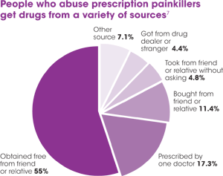
Where the Drugs Come From
Source: http://www.cdc.gov/homeandrecreationalsafety/rxbrief/

Slide 8
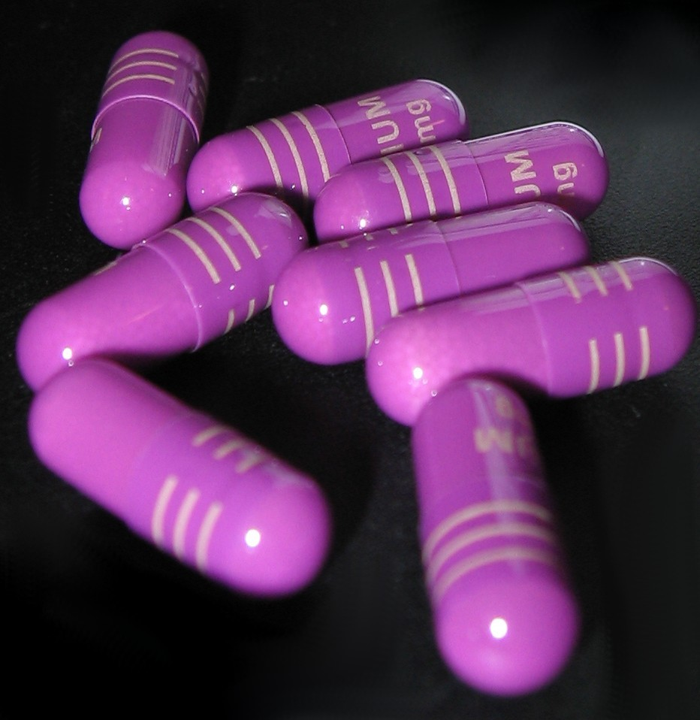
Assess:
Use the data presented in this lesson to describe the prescription drug abuse problem, in a clear and compelling paragraph.
Use at least 4 pieces of evidence in your explanation.
Notes:
Image source: http://en.wikipedia.org/wiki/Drug

Slide 9
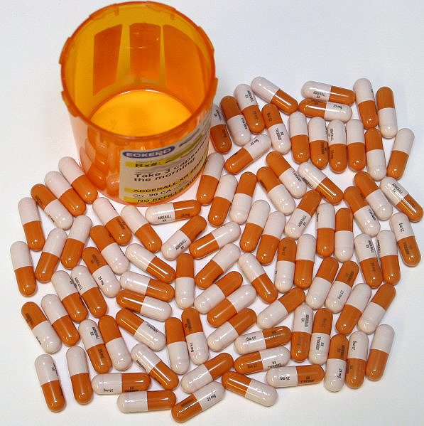
Homework:
Find two additional data sets (in graph, chart, table form) on the prescription drug abuse problem.
Add an additional short paragraph using the new data to continue your explanation of the prescription drug abuse problem.
Notes:
The purpose of this homework is to give students a chance to practice finding reliable data in the form of graphs, charts and tables. Then they must interpret and use the data independently to continue to build the case for why prescription drug abuse is a problem.
Image source: http://en.wikipedia.org/wiki/Attention_deficit_hyperactivity_disorder_management

