Slide 1
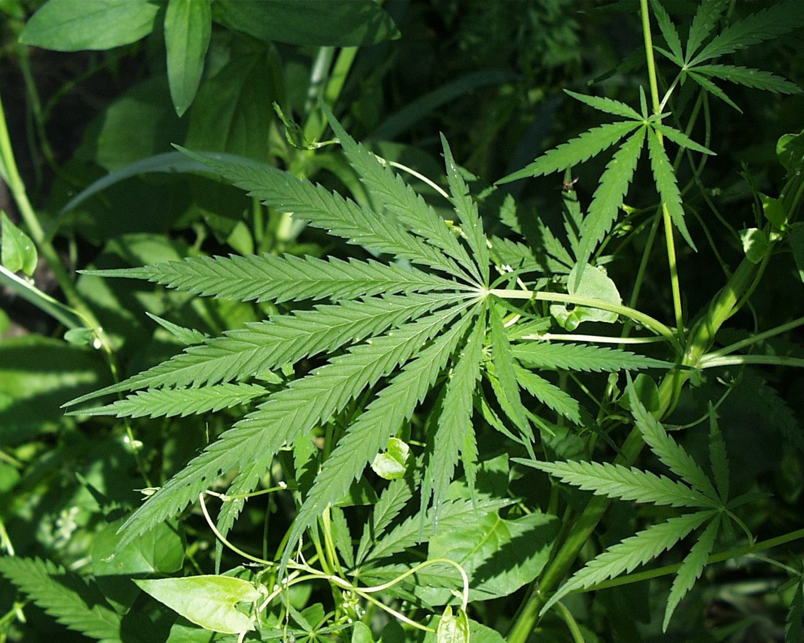
Lesson 3.1: Marijuana
Obj. 3.7: Identify factors that contribute to the use of marijuana among teenagers
Module 3: Drugs & Addiction
Notes:
This lesson will provide students with an opportunity to practice the skill of creating mind maps to identify factors that contribute to the use of marijuana among teenagers. First students will answer questions about a graph comparing the effects of smoking with that of marijuana. Then students will brainstorm factors that influence marijuana. Next they will read a handout summarizing notes on marijuana, answering questions to focus on key information. Finally, students will create a mind map in any method they choose, listing all the factors that influence marijuana use they can uncover through their brainstorming and research.
Image source: http://commons.wikimedia.org/wiki/File:Marijuana.jpg

Slide 2
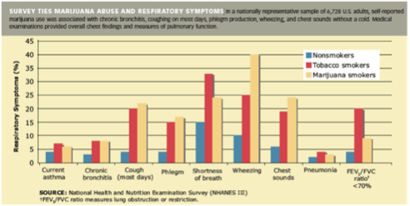
Do Now
Notes:
ANSWERS:
1. What story does this data tell? (Hint: Write out the purpose of collecting this data and the conclusions you take away after analyzing the data). This data tells the story of marijuana abuse and respiratory symptoms, in comparison with tobacco smoking and not smoking at all. By compiling data from self-reported surveys on symptoms along with clinical data on respiratory function, researchers determined that most respiratory symptoms and respiratory function markers (all except two) are actually nearly equivalent or even slightly worse among marijuana users as compared to tobacco users. This provides evidence that marijuana use may be worse than most people think for your health.
2. Which symptoms are worse for marijuana smokers than tobacco smokers? Why might this be? Cough (most days), Phlegm, Wheezing, and Chest sounds are worse for marijuana users. There could be many possible explanations: perhaps something about marijuana smoke irritates the lining of the respiratory tract more than tobacco smoke. It also could be the way the marijuana smokers inhale smoke (more deeply perhaps, or in some different way) that impacts these symptoms.

Slide 3
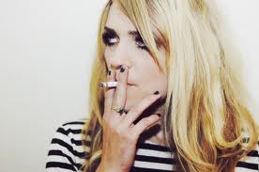
Discuss
With a partner, brainstorm reasons why teens might try or use marijuana.
Notes:
Reasons could actual rationale for why they use marijuana (ex: curiosity, wanting to fit in/peer pressure, or wanting to escape from problems or stress) AND/OR they can be actual risk factors that influence its use (ex: poor grades in school, having a friend or sibling who is smoking, accessibility to the drug, lack of parental supervision, etc.)
Image source: http://en.wikipedia.org/wiki/Partnership_at_Drugfree.org

Slide 4
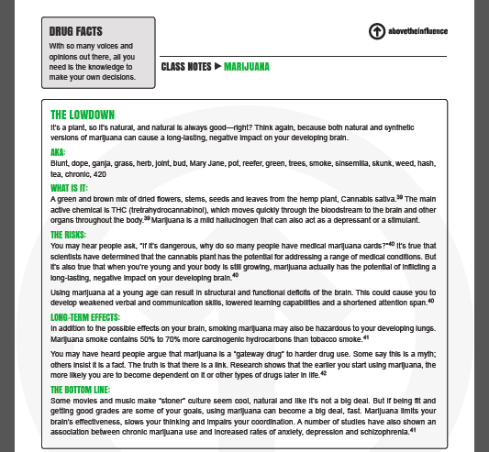
Above the Influence Reading
Read the “Class Notes” on Marijuana from Above the Influence (PDF).
Source: http://www.abovetheinfluence.com/_pdfs/drugfacts/ATI_DrugFacts_MARIJUANA.pdf
Notes:
The PDF provides a brief summary of information on the drug. It can be read individually, in partners/groups, or whole class.

Slide 5
Above the Influence Questions
1. How does marijuana work in the body?
2. What are some possible long-term effects of marijuana on a young person’s lungs and brains?
3. Has marijuana use among teenagers increasing or decreasing in the past decade?
4. What are the short-term effects of marijuana use?
5. How does smoking marijuana compare to smoking tobacco, in terms of health and potential to cause cancer?
Notes:
ANSWERS:
THC in marijuana moves quickly through the bloodstream and reaches the brain (and other organs), where it acts as a mild hallucinogen and a stimulant or depressant
Possible structural and functional deficits in the brain (resulting in weakened verbal and communication skills, reduced learning capacity, and shorter attention span), hazards to developing lungs because of the carcinogens, and increased likelihood for dependency
It has been decreasing (since 2000)
Memory loss, trouble with thinking, decrease in muscle strength, anxiety and increased heart rate
It is difficult to compare the two directly, but based on the graph in the beginning showing symptoms, as well as the facts that marijuana contains over 400 chemicals (many of which are found in tobacco), and studies show that smoking 5 joints a week may pose similar risks to smoking a pack a day, ti can be concluded that marijuana smoking may be as harmful as tobacco smoking at certain levels.

Slide 6
The Challenge:
CHALLENGE: You are about to create a visual representation of your answers to the objective posed in this lesson: identify factors that contribute to the use of marijuana among teenagers.
HOW DO I GET STARTED? Start by determining some of the factors you will include in your visual representation. You can add ideas as you go, but you should have at least a few to get started. Use the brainstorm space you wrote in on the previous page when you discussed this assignment with your partner. You may also go online to do some background research on factors that influence marijuana use.
WHAT IS A “VISUAL REPRESENTATION?” There are many ways to brainstorm and create visual representations of ideas and processes. You have probably heard of mind maps, concept webs, or other terms for tools that help document particular thought processes or knowledge.
SO WHAT DOES THIS LOOK LIKE? This assignment is flexible; there aren’t any restrictions on how you accomplish this, but you can go online to find many ideas and examples with a quick Google search. Just make your visual tool in your own personal method (or just try one out--trial and error always teaches valuable lessons!). It may use images and color and be as visually stimulating as you’d like it to be. Or it can be simple and straightforward.
USE THE SPACE BELOW TO BRAINSTORM, SKETCH OUT DIFFERENT METHODS, OR JOT IDEAS DOWN. THEN CREATE YOUR VISUAL TOOL ON THE FOLLOWING BLANK PAGE!
Notes:
--To provide some guidance of expectations, students can be given a specific number range of total factors they need to include in their mind map (ex: minimum of 10 factors that influence marijuana use)
--To model the process of mind mapping, choose a fun or entertaining topic (ex: Reasons students do not complete homework assignments). Then either begin the process of mapping the ideas on the board or screen, or have students work in teams with butcher paper to make smaller versions of a mind map.

Slide 7
Assess:
1. Name two possible short-term and two possible long-term effects of using marijuana for teenagers?
2. List at least three factors (think risk factors!) that would increase a teenagers’ likelihood of using marijuana.
Notes:
ANSWERS:
LONG TERM: Possible structural and functional deficits in the brain (resulting in weakened verbal and communication skills, reduced learning capacity, and shorter attention span), hazards to developing lungs because of the carcinogens, and increased likelihood for dependence; SHORT TERM: Memory loss, trouble with thinking, decrease in muscle strength, anxiety and increased heart rate
Examples: Peer pressure, availability/access, poor parental supervision, having a sibling or peer that uses marijuana

Slide 8
Homework:
Show the visual tool you created to a teenager who is not in this class (a family member, friend, or acquaintance would work!). Explain your objective (identify factors that influence teenagers to use marijuana) and ask them to answer the following questions. Record their responses:
1. Which of the factors I have included do you think is MOST influential on marijuana use among teenagers?
2. Which of the factors I have included do you think is LEAST influential on marijuana use among teenagers?
3. Can you think of any other factors that influence marijuana use that I have missed?
4. What part of this visual tool is most effective to you? What part could be most improved?
Notes:
The purpose of this homework assignment is for students to get feedback on their mind maps, gather input on the factors they chose, and possibly get some new ideas.

