Slide 1
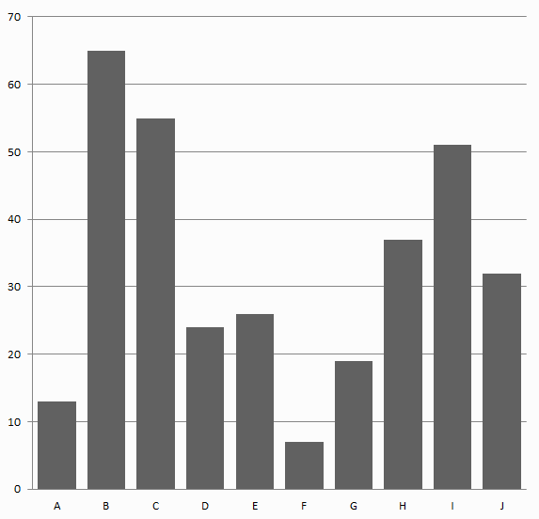
Lesson 3.6: Graphing
Obj. 3.6: Create a clear, accurate, and compelling graph to depict data.
Module 3: Drugs & Addiction
Notes:
This lesson will provide students with some basic skills and practice on graphing data. Students will begin by pointing out problems with a sample set of graphs to identify what they already know about what makes a strong graph. Then they will read a brief overview of graphs and charts published by the CDC. Next they will focus on the idea that graphs “tell a story” by trying to identify the purpose and main conclusions (essentially the story) in a sample of graphs. Finally, they will practice determining the most appropriate type of graph for a data set and actually create their own graphs in the context of the issue of drinking and driving.

Slide 2
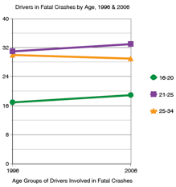
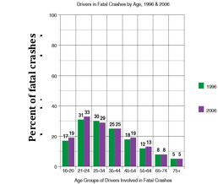
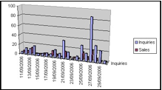
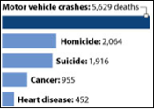
Do Now
Errors?
Missing components?
Confusing?
Weaknesses?
4.
3.
1.
2.

Slide 3
Discuss
Discuss the problems you found with each of the graphs.
4.
3.
1.
2.
Notes:
Some sample answers (many possibilities, so answers will vary): 1) 3D effect makes data hard to read, dates along x-axis are difficult to read quickly, no y-label scale, no title; 2) No title, confusing—what do numbers represent (deaths among whom and when?); 3) No y-axis label, a line graph is perhaps not the most logical for a data set that only contains two x-axis points (years in this case); 4) Strongest graph among all these, however the y-axis scale makes seeing the data and the relative differences between bars quite difficult.

Slide 4
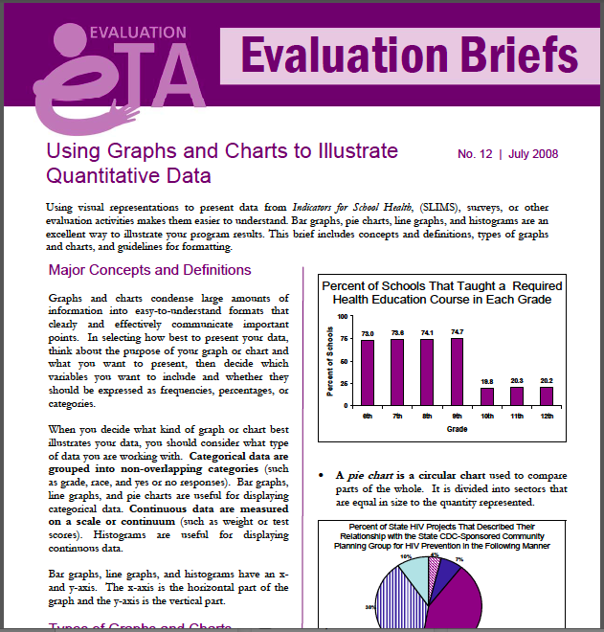
Data tells a story!
Read the CDC handout “Using Graphs and Charts to Illustrate Quantitative Data.
Notes:
This handout will be a basic review, unless students have not yet learned basic graphing skills. Scaffold by supplementing or increasing rigor as needed. For advanced students, focus on pushing them toward a very high level of rigor as they determine the story of the graphs used as examples in this handout.

Slide 5
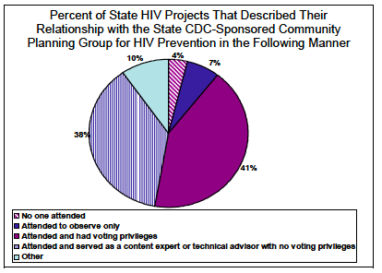
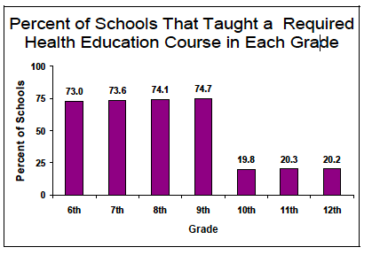
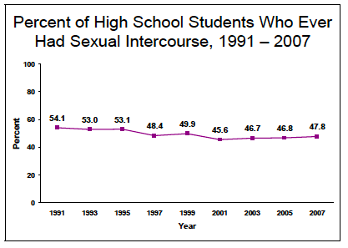
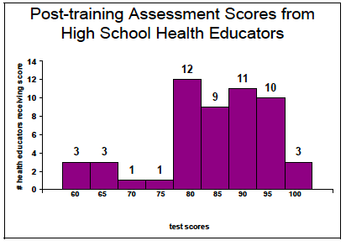
Tell the story. Focus on the purpose and the big conclusion.

Slide 6
Clear, Accurate, & Compelling
If your graph is not CLEAR, you lose your credibility!
1) Choose the relevant data to graph
2) Choose the best type of graph to show data (line, bar, pie, double bar, scatter plot)

Slide 7
Clear, Accurate, & Compelling
If your graph is not ACCURATE, everyone is lost!
3) Create a TITLE that explains the data
4) Add label (with units) on the X-AXIS
5) Add label (with units) on the Y-AXIS

Slide 8
Clear, Accurate, & Compelling
If your graph is not COMPELLING, nobody cares!
6) Choose a strategic scale to use most of the graphing space, but do not stretch or shrink your scale so that it misrepresents your data.
7) Graph the data, using signals (ex: colors, patterns) to show differences in the data

Slide 9
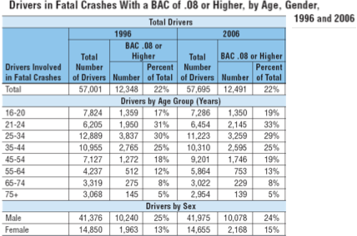
Time to Graph!
Create a graph showing differences in percent of total drivers involved in fatal crashes with BAC .08 or higher for different Age Groups for the year 1996 & 2006.
Source: CDC
Notes:
Teach students the skill of marking up a graph (or encourage them to use this if they have already learned). By circling the variables that must be graphed, students will be able to tame the wild data set down to a manageable number of data points. In doing this, they will also begin to visualize how the data would be best graphed. This is a difficult cognitive process for many, so be patient and encourage students to try different methods (even use trial and error) to help get the “feel” for graphing data.

Slide 10
Time to Graph!
Create a graph showing differences in percent of total drivers involved in fatal crashes with BAC .08 or higher for different Age Groups for the year 1996 & 2006.
Notes:
The best method to graph the data required is a: DOUBLE BAR GRAPH.
Some students may not arrive at this method. That is okay! Part of the process of learning to manipulate data is practicing and trial/error. Have extra graph paper on hand, as many students may realize they need or want to re-start after they get started. It can be annoying to have to erase pencil marks!

Slide 11
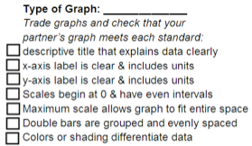
Assess:
Trade with another student
Assess graphs based on the checklist:
Notes:
Encourage students to provide one positive and one constructive comment to their partner,

Slide 12
Homework:
Find another set of data that interests you
It must only exists in table form.
Graph the data
You may choose to graph all of it or just smaller subset.
Notes:
The purpose of this assignment is to provide students with another opportunity to practice the skill of graphing, in a context that is both interesting and “real-world” to them.

