Slide 1
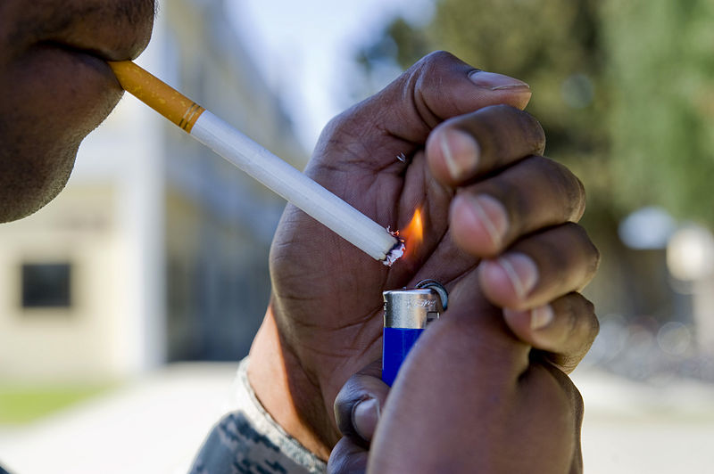
Lesson 3.4: TOBacco
Obj. 3.4: Analyze how public health policies and government regulations have influenced smoking
Module 3: Drugs & Addiction
Notes:
This lesson will provide an opportunity for students to examine the current and past problem with tobacco facing our population. They will examine data, facts, and a timeline to connect factors that influence addiction to tobacco, including the physiological effects of nicotine and the effects of governmental regulations and laws. Students will begin by analyzing a graph showing smoking trends over time. They will then read about statistics on tobacco and the basics of the drug. After that they will go online to an informational site sponsored by the HHS to answer more questions and review a timeline of governmental laws and regulations regarding tobacco.
Image source: Wikimedia Commons: http://commons.wikimedia.org/wiki/File:Lighting_a_cigarette.jpg

Slide 2
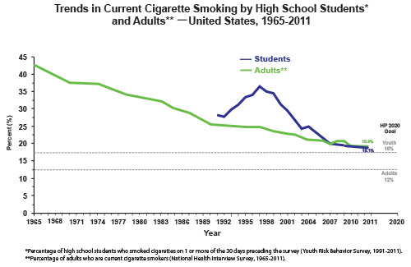
Do Now
Source: http://www.cdc.gov/tobacco/data_statistics/tables/trends/cig_smoking/index.htm
Notes:
Ask students why the blue line only begins in the year 1991? (They can use logic or the footnote below). Ask students why the dotted gray lines correspond to. Ask students if they are surprised by any of the values or trends on this table. Point out that in 1965, when this data was first collected, nearly half of all American adults smoked!

Slide 3
Do Now
1. Describe the trend in cigarette smoking by adults over time.
2. Describe the trend in cigarette smoking by high school students over time.
3. What factors do you think are responsible for these trends?
Source: http://www.cdc.gov/tobacco/data_statistics/tables/trends/cig_smoking/index.htm
Notes:
Answers:
Over time, adult smoking has decreased significantly from approx. 43% in 1965 to approx. 19% in 2011.
Over time (from 1991-2011), student smoking sharply increased (until approx ‘96-97) then sharply decreased.
Responsible factors are numerous, but may include: governmental regulation, anti-smoking campaigns, public health information available, media, access to tobacco products, peer pressure and social norms, policies in the workplace and other environments, changing roles in society, cost, health education improvement, etc.

Slide 4
Discuss
With a partner, share your ideas about factors that have influenced smoking rates over time.

Slide 5
Stats on Tobacco Use:
Each day, more than 3,600 people under 18 smoke their first cigarette, and more than 900 begin smoking on a daily basis.
In 2011, an estimated 19 percent of U.S. adults were cigarette smokers.
Approximately 18% of high school students smoke cigarettes.
In 2011, nearly 18% of high school boys were current cigar users.
From 2005 to 2011, the proportion of adult smokers declined from 20.9% to 19.0%.
Source: http://betobaccofree.hhs.gov/about-tobacco/facts-figures/index.html
Notes:
Consult other websites for additional facts. One source for youth-specific information is the CDC’s site fact sheets for youth and tobacco use, found here: http://www.cdc.gov/tobacco/data_statistics/fact_sheets/youth_data/tobacco_use/index.htm

Slide 6
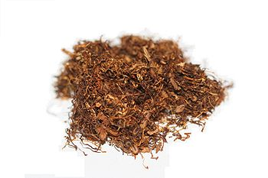
What is Tobacco?
Tobacco is a leafy plant grown around the world.
Dried tobacco leaves can be:
Shredded and smoked in cigarettes, cigars, and pipes
Ground into snuff, which is sniffed through the nose
Cured and made into chewing tobacco
Moistened, ground or shredded into dip, which is placed in the mouth between the lip and gum
Tobacco is an addictive substance because it contains the chemical nicotine.
Source: http://betobaccofree.hhs.gov/about-tobacco/facts-figures/index.html
Notes:
For more information on a brief history of tobacco, check out the CNN site here: http://edition.cnn.com/US/9705/tobacco/history/
Image source: Wikimedia Commons

Slide 7
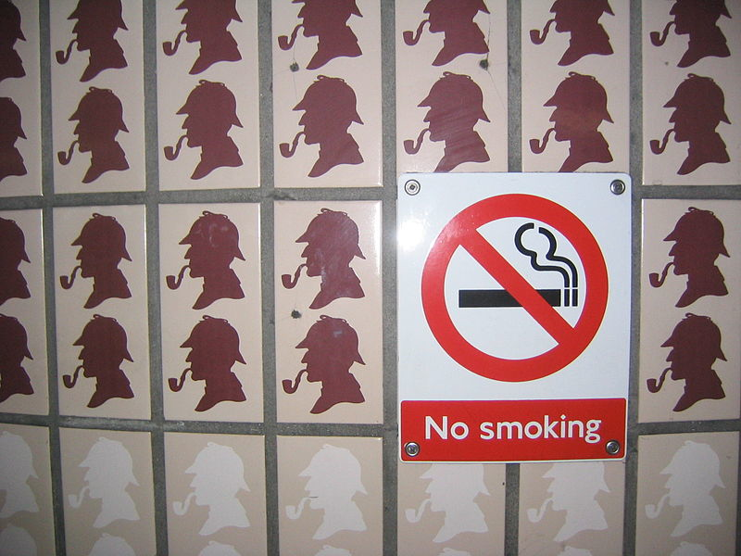
Research:
Go to the website:
betobaccofree.hhs.gov
Review the information on the website
Navigate to the pages listed in each question cluster
Notes:
Students can work in partners or small groups, or at individual computers or tablets.
Image source: Wikimedia commons: http://commons.wikimedia.org/wiki/File:Sherlock_Holmes,_No_Smoking.jpg

Slide 8
Reading Guide Questions:
Why is nicotine addictive?
How does smoking affect the heart and blood vessels?
How does smoking affect the lungs and breathing?
Do cigarettes cause cancer?
Why is tobacco control important?
In what year was the Federal Cigarette Labeling and Advertising Act passed and what did it require?
In what year was the Family Smoking Prevention & Tobacco Control Act passed? Summarize the law.
Notes:
Group work will help prevent copying answers word-for-word from the screen, but may promote all students writing the same words (from one student). Encourage students to discuss each question with pencils DOWN, then be SILENT while writing their own short summarized answers. This habit is important to push students towards, but is often not their default approach so it needs to be modeled and monitored.

Slide 9
Assess:
1. What causes people to become addicted to cigarettes and other tobacco products?
2. What are some factors that have influence the rates of smoking?

Slide 10
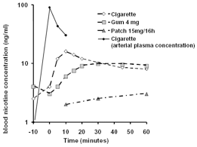
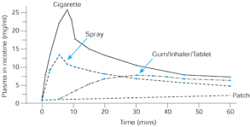
Homework:
Use the experimental data passage on blood nicotine concentration to answer the questions.
Figure 2:
Figure 1:
Notes:
Answers:
1. What was the purpose of these experiments? To determine the blood nicotine level of different nicotine-containing substances at various times
2. Figure 1 shows that as time goes on, the blood nicotine concentration for the patch: increase slightly; Figure 2: increase slightly
3. Figure 1 shows that as time goes on, the blood nicotine concentration for the gum: Increase sharply, then level out; Figure 2: Stay constant briefly, then rise gradually, level out and slightly drop in the end
4. According to Figure 1, at what time(s) do the gum and cigarettes produce the same level of blood nicotine concentration? Approx. 60 minutes after the start of use
5. According to Figure 2, at what time(s) do the gum/inhaler/tablet and spray produce the same level of blood nicotine concentration? Approx. 25 minutes after start of use? not accurately monitoring the blood nicotine levels
6. Does the data in each experiment show the same relationship between time and blood nicotine concentration for each substance? Why or why not? Yes, generally the same relationship.

