Slide 1
Lesson 3.2: Barriers to Change
Obj. 3.2: Identify barriers to behavior change
Module 3: Drugs & Addiction
Notes:
This lesson will introduce students to three basic barriers to change within the INDIVIDUAL domain: denial, disbelief, and refusal. Students will begin by drawing upon their own experience (or that of family/friends) with a habit or addiction. Then students will discuss why some addictions and habits are so difficult to break. Students will then read a short excerpt from the NIDA website (used in Lesson 3.1). They will learn about the three barriers to behavior change and practice applying them in scenarios.

Slide 2
Do Now
List one behavior you/a family member/a friend does that you/he/she would like to change?
Have you/he/she ever tried to stop these behaviors? Why or why not?
How do you think you/he/she could successfully stop these behaviors?
What things might stand in the way of behavior change?
Notes:
This may bring difficult issues to the surface for some students. Before students begin, remind them that they should choose to focus on potentially sensitive issues at their own discretion.

Slide 3
Discuss
With a partner, discuss the following questions:
1. How do addictions form?
2. Why is it so difficult for people to stop using a drug they are addicted to? (List all the reasons you can think of!)
Notes:
This should touch upon the research/reading students conducted for homework, on how the brain responds to drugs and what happens when addiction sets in.
Brainstorming the many reasons why people may have trouble pulling out of an addiction will help students see that it’s not just the individual’s “fault” that they may struggle to quit (denial, disbelief, and refusal all lay “blame” with the individual herself). There are may other factors potentially at play: For example, fear, lack of knowledge, lack of resources, lack of support system, etc. can all influence likelihood to get treatment or recover from an addiction.

Slide 4
Read
How do drugs work in the brain to produce pleasure?
Is drug abuse a voluntary behavior?
Can addiction be treated successfully?
Notes:
Before reading the answers to these questions, pose them to students to get a pulse on their preconceptions and previous understanding.
Source: http://www.drugabuse.gov/publications/media-guide/science-drug-abuse-addiction

Slide 5
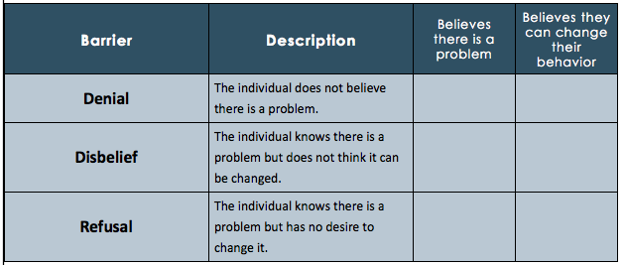
New Info
Notes:
Denial=OO Disbelief=XO Refusal=XX

Slide 6
Scenario 1:
Ashley has been making small cuts on her inner arms and thighs for the past 6 months. She does not feel like she can stop this behavior, though she knows she has fallen into an unhealthy behavioral pattern. She doesn’t believe she can change the way she was born, wanting to cut herself.
Does Ashley have an addiction?
What is Ashley’s barrier to behavior change?
Notes:
Answer: Yes, Disbelief

Slide 7
Scenario 2:
Jackson loves video games and is currently working on beating Batman: Arkham City. He plays for hours, breaking only when he absolutely has to. He sometimes goes without showering for days and has not seen his friends to hang out in ages. He occasionally misses school to stay home and play. Jackson doesn’t see anything wrong with his behavior; in fact, he feels a sense of achievement with each game he beats.
Does Jackson have an addiction?
What is Jackson’s barrier to behavior change?
Notes:
Answer: Yes, Denial

Slide 8
Scenario 3:
Monica tried cigarettes in fifth grade and has smoked ever since. Her awesome health teachers teach her all the facts about tobacco, so she knows her habit is unhealthy and she should change, but she thinks smoking looks so glam so she doesn’t want to.
Does Monica have an addiction?
What is Monica’s barrier to behavior change?
Notes:
Answer: Yes, Refusal

Slide 9
Homework:
Write a scenario for each barrier (3 scenarios total).
Choose who your character will be
Choose the behavior he/she is trying to change
Your scenario should allow someone else to guess the barrier that is assigned to the case.
Notes:
This assignment serves as both the assessment and the homework. The purpose of this assignment is to check students
‘ understanding of how the three barriers to change play out in an individual’s life in a more authentic way.

