Slide 1
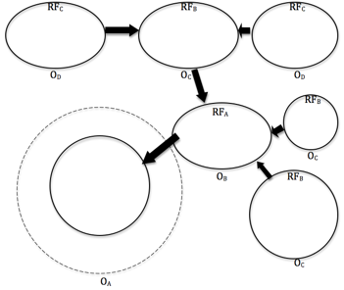
Lesson 3.11: Factor Outcome Webs
Obj. 3.11: Create a factor-outcome web to visually diagram a problem
Module 3: Drugs & Addiction
Notes:
This lesson will provide students with a new method in their toolkit, that of the factor-outcome web. Students will begin by brainstorming factors influencing drinking and driving. They will then practice selecting factor-outcome pairs. After that students will see a factor-outcome web modeled and then try one on their own.

Slide 2
Do Now
What influences teens to drink alcohol?
What influences them to drink and drive?
Notes:
When students are investigating problems and gathering their own data, it will often be most interesting, effective, and realistic to focus on accessible variables like knowledge, attitude, access to a resource, behaviors, etc. This Do Now exercise is designed to get them focusing on many of these types of variables.

Slide 3
RF/PF & Outcome
How is having one or more friends who engage in binge drinking associated with the likelihood for teens to binge drink?
How is education on drinking and driving in high school associated with the teenagers’ attitudes towards drinking and driving?
How is lack of parental supervision associated with the likelihood for teens to attend parties where alcohol is served?
How is _____ (RF/PF) associated with the ______ (O)?
How is _____ (RF/PF) associated with the ______ (O)?
Notes:
The key idea here is that you can study any two variables that are linked (associated) somehow and the labels of risk/protective factor and outcome are less important. But they do help to get students to understand the directionality of the hypothesized causative factors. A later lesson on causation vs. correlation will explore this issue in greater depth.

Slide 4
Factor-Outcome Web
Factor-Outcome Web: A tool used to show the relationship between risk or protective factors and associated outcomes, made by connecting variables with bubbles and arrows, pointed in the direction of hypothesized influence.
Examples:
Notes:
The factor-outcome web is a derivative of a variety of other maps. It is not a tool that students will find specific health practitioners or researchers using, most likely. Rather it is a way of visually mapping the thinking. By taking time to deliberately create the visual web, students will be more mindful of their thinking and have an opportunity to slow down the pace of thinking in order to aid in metacognition.

Slide 5
Think:
An antecedent can be defined as, “something that came before something else and may have influenced or caused it.” How many antecedent factors (risk or protective) can you think of that would influence someone’s decision on whether to join a gym?
Notes:
This is another exercise to get students brains humming around these factors. Examples might include: attitude toward exercise, having friends/peers who engage in exercise, physical activity habits of family, PE education in school, access to transportation, proximity to fitness center, cost of gym membership, income/financial situation, time limitations, time management skills, willpower, likelihood to make resolutions, past exercise patterns, diet, BMI/weight, gender, medical status, etc.

Slide 6
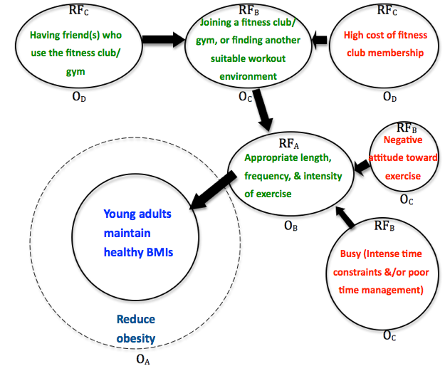
Factor-Outcome Web:
Notes:
This is just a small segment of what could be a much larger web. Students may benefit by seeing more modeling on the board or projector.

Slide 7
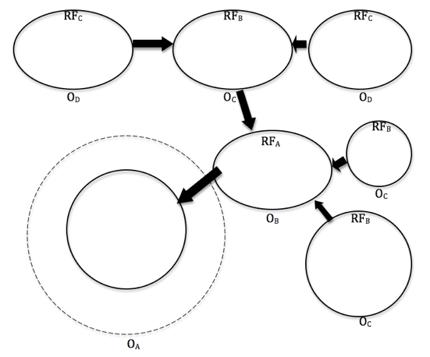
Practice:
Notes:
Alternatively, the instructor can provide a pre-selected list of options for students to choose and they can work in teams or individually.

Slide 8
Assess:
1. What is a Factor-Outcome Web? (Describe in your own words.)
2. In the space below, create a simple Factor-Outcome web that includes the following five bubbles:
Asthma attack
Intense exercise
Access to inhaler
Knowledge of personal triggers
Quality asthma education during physician visits

Slide 9
Homework:
Write a paragraph explaining the benefits and drawbacks to creating a Factor-Outcome Web when researching a health issue.
Notes:
The purpose of this homework assignment is for students to practice thinking about methods and tools with a critical eye. There are infinite ways to go about solving a problem, and the tools and methods that are used in class are just one example. However, learning how others might approach a problem and testing those methods can provide great insight and new ideas. Encourage students to be inventors and entrepreneurs. If they have a slight deviation they want to make in the method or a new and better idea, provide them with feedback and give them the opportunity to approach the issues differently.

