Slide 1
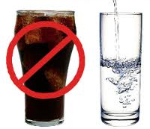
Lesson 2.6: What’s in a Drink?
Unit 2: Nutrition & Fitness
Notes:
This lesson exposes students to the major role that beverage choices play in our physical health and the obesity epidemic. First students will review a graph depicting amounts of sugar in various beverages, answering questions to help increase their agility with graphical information. Then students will read and discuss two sections from a report by the Harvard School of Public Health on the association between sugary beverages and weight problems and the benefits of drinking water. They will discuss and think individually with questions sets that follow each excerpt. To assess their understanding, students will devise a “top 5” list of benefits of drinking water (over sugary drinks).
Image source: http://www.paulsiodadds.com/news/10-fun-dental-facts/attachment/fridgepedia-water-vs-soda-01/

Slide 2
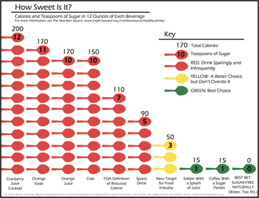
Do Now
Notes:
Which drink in this graph do you consume most often? _____________ Least often? ____________ (answers will vary)
2. The sweetest beverage listed in the graph is ______________________, which has ____ teaspoons of sugar and ______ calories in each 12 ounce serving. (cranberry juice cocktail; 12 tsp; 200 calories)
3. The researchers who devised this study of sugar in beverages believe that the food industry should meet a target of ____ teaspoons of sugar and ______ calories in each 12 ounce serving. (3 tsp; 50 calories – or less!)
4. Besides water, what are some other options for beverages that are considered the “best choice” with the least sugar and calories? (tea, coffee, seltzer water)
5. A father of three children is trying to provide his kids with a healthy breakfast each day. He tries to avoid sugary cereals and pours them each a glass of orange juice. What recommendations would you make for this father regarding the beverage he is providing for his kids each morning? Explain using evidence. (He should provide water for his children at breakfast –along with milk so they can get their dairy!—and provide actual oranges or other fruits. Orange juice has 10 tsp of sugar and 170 calories per 12 ounce serving, so it is not a healthy option since it provides empty calories. If he is determined to continue serving orange juice he should choose options with added calcium and vitamin D. Some studies have also shown that pulp varieties also will provide flavonoids and antioxidants, but the jury is still out on how much better, if at all, the pulp is compared to pulp free versions.

Slide 3
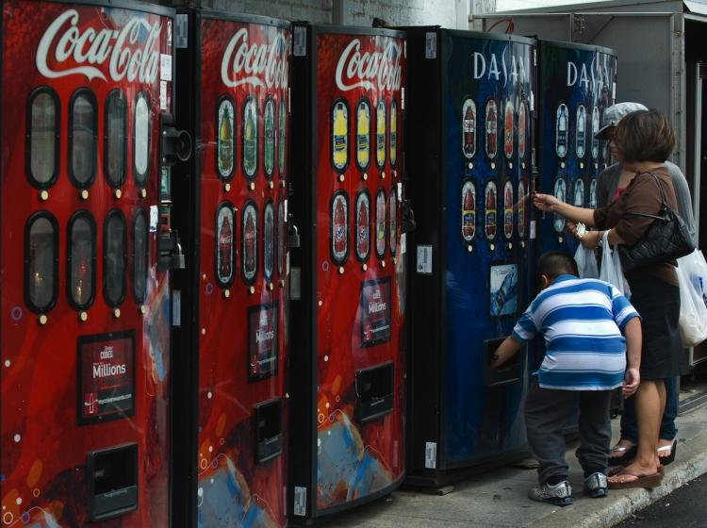
Drinking up the Pounds
Read: “Sugar-Sweetened Beverages and Weight” and “Fruit Juice and Weight”
Notes:
Many other excellent resources can be found at Harvard’s SPH website: http://www.hsph.harvard.edu/nutritionsource/sugary-drinks-fact-sheet/
In addition, there are many great articles surrounding controversial policies that have been proposed, or are already taking effect. Examples: 1) NYC attempted ban on large sugary beverages; 2) the recent USDA federal ban on sale of sugary beverages and junk food in school vending machines. These would be great to use to spark interest and debate if time permits.
Image source: http://www.theepochtimes.com/n2/united-states/soda-ban-in-effect-san-francisco-city-vending-machines-38713.html

Slide 4
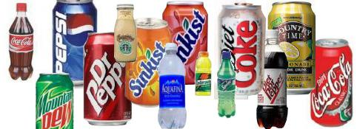
Discuss
1. Will this information impact your choices of beverages in the future? Why or why not?
2. What should be done about this problem? Consider the roles that different agencies play: the government, beverage companies, schools, health care providers, parents, media, etc.
3. Think about the warning labels on packs of cigarettes. Should sugary beverages carry a similar warning label informing people of their sugar content and the potential risks of obesity and other chronic diseases? Why/why not?
Notes:
If time permits, provide students with some context of the history of cigarette warning labels. The recent proposal for the “gruesome” warning label pictures may interest students as well. See: http://theweek.com/article/index/216534/the-fdas-gruesome-new-cigarette-warning-labels
Image source: http://orangepark.olx.com/vending-machine-route-business-franchise-opportunity-888-579-0892-soda-snack-energy-drinks-iid-120541497

Slide 5
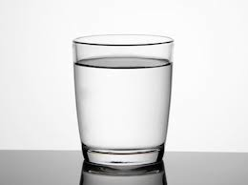
Why Water?
Read: “Water” and “Beverages to Limit”
Notes:
For more information and a nice list of 6 benefits of water, see: http://www.webmd.com/diet/features/6-reasons-to-drink-water
Image source: http://www.nydailynews.com/life-style/eats/diners-choosing-tap-water-beverages-report-people-choose-free-water-costlier-sodas-article-1.968166

Slide 6
Think:
1. What are some reasons people do choose other beverages instead of water?
2. What effect do you think the increase in bottled water consumption has had on the average level of water intake per person in the Unite States?
3. What are the health benefits of drinking water?

Slide 7
Assess:
You are a health reporter assigned to cover stories for the local news station. As part of an ongoing series on the obesity epidemic, you are devising a story on beverage choices. In the news segment, your producer wants to share with the public the top 5 reasons they should avoid soda and fruit juice and instead choose water. Using information from this lesson, write your top 5 reasons.
Notes:
If time permits, allow students to deliver their newscast top 5’s in small groups. Additionally, each group could vote on the best student to present to the entire class.

Slide 8
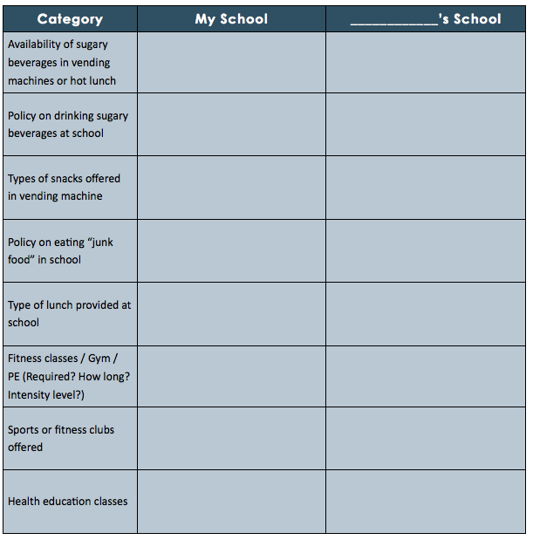
Homework:
Interview someone who attends a DIFFERENT school about their school’s health environment:
Friend
Sibling
Neighbor
Relative
Any grade level!
Notes:
The purpose of this homework assignment is for students to compare and contrast two school policies regarding physical health. Given the varying levels of control over the issue of sugary beverages (and the many other factors that are impacting the obesity epidemic), students can relate to the policies at the school level very easily. They may even be inspired to advocate for better policies.

