Slide 1
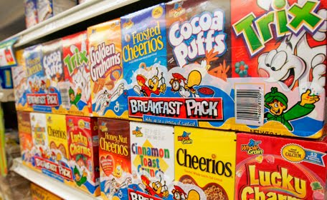
Lesson 2.5: Food Marketing
Unit 2: Nutrition & Fitness
Notes:
This lesson will focus on one aspect of the obesity epidemic: persuasive food marketing techniques. Students will begin by thinking about their own experiences with food advertising. Then they will read an article about unhealthy cereal marketing aimed at children and watch a short video on the problem. They will move into small teams to brainstorm solutions to the problem. Then students will learn about 10 persuasive techniques used in marketing and analyze 5 TV commercial clips, attempting to identify which technique(s) are used in each. Finally, students will team up to make a healthy commercial for one of the food groups in the MyPlate recommendation, using one of the persuasive techniques for a positive outcome.
Image source: http://12degreesoffreedom.blogspot.com/2010/11/food-ads-and-obesity.html

Slide 2
Do Now
Think about a TV commercial you saw lately that caught your attention.
What caught your attention or made the commercial memorable?
Besides TV commercials, what are all of the ways you can think of that foods and drinks are marketed and advertised.
Notes:
Encourage students to think broadly about how foods/drinks are marketed: print ads, billboards, radio spots, eye-catching packaging, in-store ads/displays, internet, etc.

Slide 3
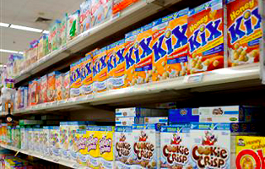
Cereal Marketing
READ: Kids Spoon-Fed Marketing and Advertising for Least Healthy Breakfast Cereals
Video: http://www.cerealfacts.org/ (1:12)
Notes:
Cerealfacts.org has a variety of information/resources. They also discuss some of the research studies, which are great models for students about how science is done in the real world. (example: http://cerealfacts.org/media/Sugar_Cereal_Study.pdf)

Slide 4
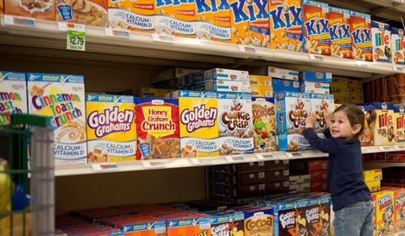
Discuss
As a small group, you are a “task force” assigned to focus on how cereal advertising impact the childhood obesity epidemic. What kind of solution would you devise to respond to this problem?
Brainstorm solutions!
Notes:
As students brainstorm solutions they will begin to think about all the factors and players influencing the problem and will likely run into some disagreement. For example, one student might suggest: “government should ban ads for sweet/unhealthy cereals.” Another student will likely disagree, but the debate is valuable. However, for the sake of time (and creativity!) encourage students to consider and write down all ideas. They do not have to solve the problem, they are just engaging in a brainstorming exercise.
Image Source: http://news.yale.edu/2012/06/22/cereal-facts-2012-spoonful-progress-bowl-full-unhealthy-marketing-kids

Slide 5
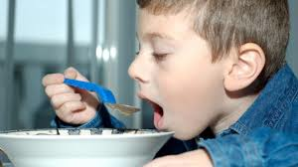
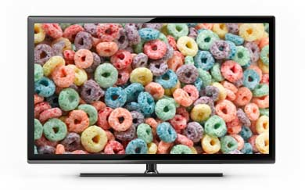
Persuasive Techniques:
1. Association.
2. Bandwagon.
3. Bribery.
4. Experts.
5. Explicit claims.
6. Humor.
7. Intensity.
8. Maybe.
9. Repetition.
10. Testimonials.
Notes:
This is not an exhaustive list of persuasive techniques, but a handful of the more “basic” ones. More can be found at the medialiteracyproject.org website and many other Internet sources. For students who need to be challenged, the list could be expanded.
Image Source: http://www.hsph.harvard.edu/obesity-prevention-source/obesity-causes/television-and-sedentary-behavior-and-obesity/
http://www.bakeryandsnacks.com/R-D/RTE-cereals-The-childhood-obesity-culprits

Slide 6
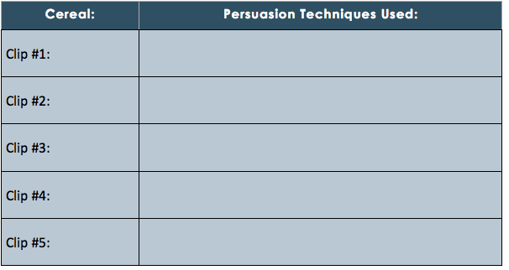
Which Persuasive Technique?
Notes:
CLIPS (Answer – Product: Youtube link) *note: many of these are old (“vintage”) and will be quite humorous & interesting for students to view. Encourage them to have fun with this activity!
Humor - Wackies: http://www.youtube.com/watch?v=U4UHHT0EuDg
Intensity and Repetition - Krinkles: http://www.youtube.com/watch?v=3094hyz-K9Y
Association (fun) - Weetabix: http://www.youtube.com/watch?v=RsLNNrjGrqk
Testimonial - Wheaties: http://www.youtube.com/watch?v=L5wbnqnwVPs
Bandwagon - Toddy: http://www.youtube.com/watch?v=n7vDuCa2zTc
Several 30-second cereal commercials can be found at:
http://www.youtube.com/watch?v=pA0di184Ntg

Slide 7
Challenge: Make a MyPlate Commercial
Your group is an Advertising Agency. The USDA has entered a contract with you to market the new MyPlate message. You need to create and perform a persuasive commercial for a one food group within the MyPlate recommendation. You must use one of the persuasive marketing techniques and your commercial must be 30-60 seconds.
Notes:
Students should just choose ONE strategy in order to facilitate quick planning and practicing. Students can perform their commercial skits for the class and classmates can guess which marketing strategy was used. If time is a limiting factor, groups can “exchange” skits with one other group rather than having all groups perform in front of the entire class.

Slide 8
Assess: ID the Persuasive Technique
1. “You have never tried CrazyPuffs cereal!? That is truly crazy! Everyone eats CrazyPuffs, so you should too!
2. “I have eaten Oaty O’s since I was in Little League. It makes me strong and energized. If I didn’t eat Oaty O’s I would not hit all those grand slams out of the park!”
3. “Star Bites are the greatest cereal in this galaxy. If you want to have the very best blast-off breakfast to start your day, choose Star Bites. Eat them for out-of-this-world energy!”
Notes:
Answers:
Bandwagon
2. Testimonial (celebrity)
3. Intensity

Slide 9
Homework:
Read facts about the fast food industry and answer the following questions:
1. Which of the above facts was most surprising to you? Least surprising to you?
2. What are some of the marketing strategies fast food companies have used to sell their product?
3. What would you do to reduce the consumption of fast food?
Notes:
The purpose of this homework is to give students another example (beyond breakfast cereals) of how an unhealthy food is marketed by a massive industry. All facts are from Fast Food Nation.
Image source: http://www.hsph.harvard.edu/obesity-prevention-source/obesity-causes/television-and-sedentary-behavior-and-obesity/

