Slide 1
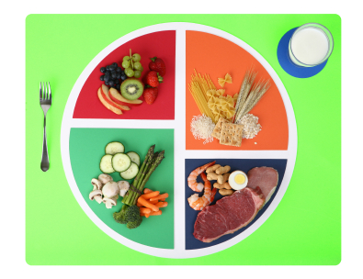
Lesson 2.4: Food Guidelines
Unit 2: Nutrition & Fitness
Notes:
This lesson focuses on food guidelines with an emphasis on the evolution of the governmental messaging. First students will take a step back to review the content of the first three lessons by making recommendations for the diet choices of people in various scenarios. Next, students will discuss what influences their diet choices and debate how much responsibility the government has. Then they will examine and compare/contrast the two older food guidelines: Food Pyramid (1992) and MyPyramid (2005). After discussing the drawbacks to the 2005 model and examining the rationale behind it, students will learn about the newest guideline: MyPlate (2011) and reflect upon its use.

Slide 2
Do Now
1. What could Robert do in order to build more muscle?
2. What information would you give Lydia about drinking pop?
3. How would you explain to Antoine that he is not eating a nutritious diet?
4. What might Sandra change about her diet that might help her digestion?
Notes:
Answers:
If his diet is lacking in protein (and only filled with protein-less carbs) he could introduce a balanced variety of lean protein in his diet. (Students should be able to name several sources).
Soda is an empty-calorie food. In addition to the high sugar content, it contributes calories without providing any nutrients. Instead, she should consume more water or 100% fruit juices.
His diet is high in simple sugars, but he is missing complex sugars, starches, and fiber. He is also very likely not getting the protein and nutrients he needs to stay healthy due to all these empty-calories.
She should increase the fiber in her diet. Prunes are a good quick fix fiber to help get her digestive system back on track. Beyond that, she should be consuming whole grains, vegetables, cereal, and other fiber sources daily.

Slide 3
Discuss
Who and what influence your dietary choices?
From what sources have you learned about eating?
What responsibility do you think the government has for educating citizens about healthy eating?
Notes:
Since the dietary guidelines are from the USDA, a governmental agency, students can get into a little debate (if time warrants) about the governments role in setting nutrition guidelines. (How far should the government go?—from doing nothing to more involved measures like compulsory education on nutrition guidelines. This debate may also bring up a number of other nutrition-related governmental laws and policies that are controversial—ex: trans fat ban, GMOs, requirements for school lunch programs, etc.

Slide 4
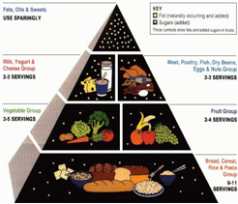
Food Pyramid (1992)
Notes:
For more information: http://www.hsph.harvard.edu/nutritionsource/mypyramid-problems/
FOOD PYRAMID: “With an overstuffed breadbasket as its base, the Food Guide Pyramid failed to show that whole wheat, brown rice, and other whole grains are healthier than refined grains. With fat relegated to the “use sparingly” tip, it ignored the health benefits of plant oils—and instead pointed Americans to the type of low-fat diet that can worsen blood cholesterol profiles and make it harder to keep weight in check. It grouped healthy proteins (fish, poultry, beans, and nuts) into the same category as unhealthy proteins (red meat and processed meat), and overemphasized the importance of dairy products.”

Slide 5
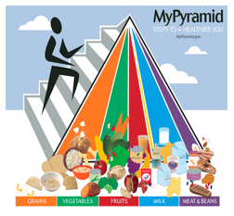
MyPyramid (2005)
Notes:
For more information: http://www.hsph.harvard.edu/nutritionsource/mypyramid-problems/
MYPYRAMID: “MyPyramid, unveiled in 2005, was essentially the Food Guide Pyramid turned on its side, without any explanatory text. Six swaths of color swept from the apex of MyPyramid to the base: orange for grains, green for vegetables, red for fruits, a teeny band of yellow for oils, blue for milk, and purple for meat and beans. The widths suggested how much food a person should choose from each group. A band of stairs running up the side of the Pyramid, with a little stick figure chugging up it, served as a reminder of the importance of physical activity.”

Slide 6
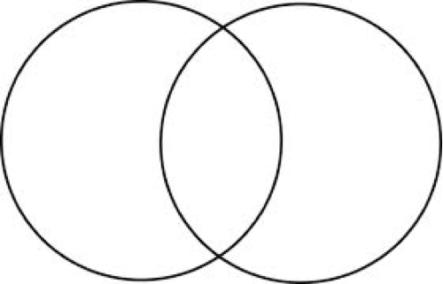
Compare & Contrast:
Food Pyramid (1992)
MyPyramid (2005)
Notes:
Possible answers:
Food Pyramid: has # of servings directly listed; emphasizes grains group heavily (big base of pyramid); Sets fats/oils/sweets equivalent to a food group (top of pyramid)
MyPyramid: More visually appealing, incorporation of exercise, more example foods, less text (no numbers/serving sizes), colors to represent groups, oils/fats/sweets not listed in text (though there is a narrow yellow band for them)
Both: Same food groups, similar emphasizing of importance of each group in diet

Slide 7
Think:
1. What are the biggest differences between the two models?
2. Do you notice any drawbacks to the newer recommendation (MyPyramid)? Explain.
Notes:
The main problem with the original Food Pyramid was that it released the wrong advice for dietary guidelines. The main problem with MyPyramid was that it confused people.

Slide 8
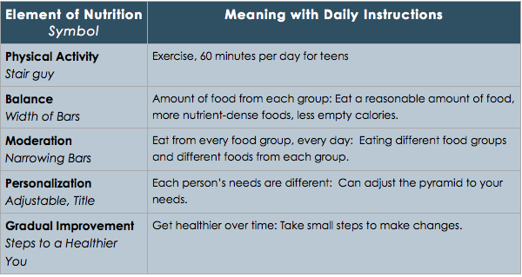
MyPyramid (2005): Incorporates 6 elements of fitness and nutrition
Notes:
These elements were not necessarily obvious to the viewer of MyPyramid. Ask students which of these elements are MISSING in the original Food Pyramid. After the new MyPlate is introduced, the same question can be posed.

Slide 9
Think:
1. Which of the 6 elements in the table above were clear to you when you first looked at MyPyramid (2005)?
2. What would you suggest changing to simplify the information for people?

Slide 10
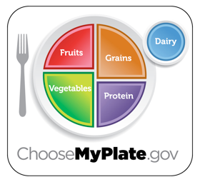
MyPlate (2011)
Fruits: Focus on Fruits
Vegetables: Vary your Vegetables.
Grains: Make at least half your grains whole.
Protein: Go lean with protein.
Dairy: Get your calcium-rich foods
Notes:
-Ask students WHY varying vegetables is important. They may not be aware that different veggies and color groups of veggies have different vitamins and nutrients.
-Ask students what it means to “Make at least half your grains whole.” Ask for examples of whole grains and refined grains (define this if they are stuck) to check for understanding.
-Ask for examples of lean protein sources vs. non-lean (fatty).
-Ask for examples of calcium-rich foods. Ask which type of milk is recommended for older children and adults.

Slide 11
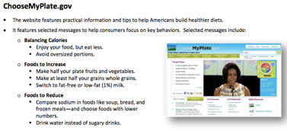
MyPlate (2011)
Notes:
These are screenshots from resources on the ChooseMyPlate.gov website. This would be a great time to project the actual website and spend a few moments navigating through the resources on the site to show students that it provides much more extensive info/recommendations than the simple plate diagram. Points to emphasize: MyPlate was designed to REMIND people; uses the familiar visual of the place setting (more practical than the pyramid), and the three messages the website focuses on: 1) balancing calories; 2) which foods to increase; 3) which foods to reduce

Slide 12
Discuss:
Do you and your family usually eat meals according to MyPlate? Why or why not?
How can you start to make small changes?

Slide 13
Assess:
1. In the MyPyramid plan, what do the different colored bars represent?
2. In the MyPyramid plan, what does the person running up the stairs represent?
3. In the MyPlate plan, what does it mean to ”make half your grains whole”?
4. In the MyPlate plan, what might qualify as a lean protein?
5. In the MyPlate plan, which of the following would you include in your diet if you wanted to “vary the vegetables”?
Notes:
Answers:
C - Variety – Eat from every food group every day.
B - Physical Activity – 60 minutes per day for teens.
D - At least half of the grains you eat should be whole grains, while the other half can be processed.
A - Baked chicken, no skin
B - Carrots, broccoli, red onions, and avocados.

Slide 14
Homework:
Create a meal plan for one full day that accounts for 2,000 calories and follows the recommendations of MyPlate.
Then write an explanation of how your meal plan accounts for the following elements:
Balance
Variety
Moderation
Plenty of nutrient-dense foods
Few (if any) “empty calories”
Notes:
The purpose of this homework activity is to give students practice implementing the modern MyPlate food guidelines. It will also help them draw together all of their accumulated knowledge so far in a practical and (hopefully) useful exercise. Encourage students to make food choices that are realistic for them and accessible. Remind them to think about cost, ingredients availability, and time needed to cook. And they should also consider taste, of course! Is their healthy plan something they would really commit to over time? Eating health does not have to taste bad!

