Slide 1
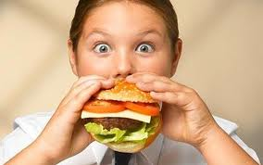
Lesson 2.2: Digestion
Unit 2: Nutrition & Fitness
Notes:
This lesson provides an overview of digestion. It does not go into great detail (for the sake of time), but gives a sense of each major organ and it’s function in the digestive process. Students will begin by examining their prior knowledge and tapping into their natural curiosity about the topic, by labeling the digestive organs and writing questions. They will then pair up to talk about what they think happens to a piece of food after it is eaten. Next, they’ll read about each component of the digestive system, answering a few comprehension questions that follow each section along the way. Finally, they will self-assess by writing the function of each component of the digestive system and trying to write the steps in order. Finally, their homework will be to trace the journey of a pretzel through the digestive system.
Image source: http://www.telegraph.co.uk/health/healthnews/6194284/Junk-food-makes-you-eat-more-research.html

Slide 2
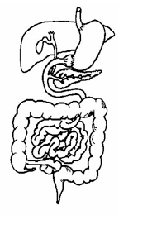
Do Now
Examine the digestive system organs below. Label any parts you already know (or think you know) in PENCIL.
Write any QUESTIONS you have about the digestive system in the box.
Notes:
Students will have varying levels of background knowledge on this process. Encourage them to make guesses if needed.

Slide 3
Discuss: The Pretzel’s Journey
You are a pretzel that has just been eaten.
What happens to you (from beginning to end)?
With a partner, discuss the journey the you take through the digestive system.
Notes:
If available, pass out one pretzel to each student and ask them to keep it on their desk (it’s unbelievable how difficult this might be for some of them!). When the lesson gets to the point where salivary amylase is discussed, ask them to eat the pretzel and describe what they taste. Some may detect the subtle change in taste (it gets slightly sweeter) as the starch is converted into sugar.

Slide 4
New Info
mouth:
saliva:
pharynx
esophagus:
stomach:
small intestine:
large intestine (colon):
gallbladder:
pancreas:
rectum:
anus:
Notes:
This list serves as a need-to-know vocabulary list.

Slide 5
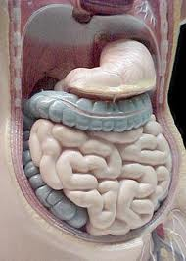
Read: What is Digestion?
1. How long do you think the digestive system would be if it were all stretched out? ______ feet
2. How much time does your food actually spend in the stomach? ______ minutes or more
3. How often do the stomach’s smooth muscles contract? Every ____ seconds
Notes:
Answers:
1. If stretched out, the system would measure about 30 feet, most of it the winding intestines [source: Kids Health: Digestive System]
2. Your liquefied sandwich, however, can be out of the stomach in a mere 20 minutes [source:Gastro.net].
3. The stomach's smooth muscles contract about every 20 seconds, stirring up the acid and enzymes and turning your sandwich into a liquefied blob (chyme). (howstuffworks)
Image source: http://www.saburchill.com/chapters/chap0016.html

Slide 6
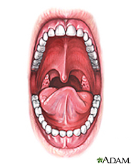
Stop 1: The Mouth
1. What class of nutrient begins its chemical digestion in the mouth?
2. What is the purpose of chewing?
Notes:
Answers:
1. carbohydrates, as salivary amylase begins breaking starches into simple sugars
2. Chewing causes food to be mechanically broken down into smaller and smaller pieces for easier digestion; it also mixes food with saliva so it can form a bolus for easy swallowing.
Image source: http://www.nlm.nih.gov/medlineplus/mouthdisorders.html

Slide 7
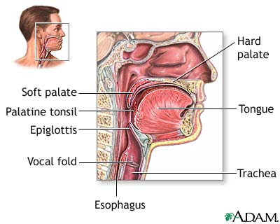
Stop 2: The Pharynx & Esophagus
3. What parts of the process of swallowing are voluntary? Which are involuntary?
4. What is going wrong if someone has heartburn? Which component of the system is not working correctly?
Notes:
Answers:
3. Voluntary swallowing includes using your tongue and soft palate to push the food into your pharynx. Involuntary include your glottis covering your trachea (windpipe), and your esophagus muscles performing paristalsis, and your lower esophageal sphincter opening and closing
4. In heartburn the lower esophageal sphincter is not closing properly or not staying closed, or both.
Image source: http://www.walgreens.com/adamHtml/bodyguides/reftext/html/dige_sys_fin.html

Slide 8
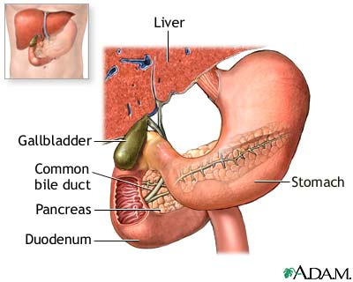
Stop 3: The Stomach & Small Intestine
5. What is the difference between digestion and absorption? Where does each occur in the digestive process?
6. Which segment of the small intestine does most of the final digestion, or breakdown, occur?
Notes:
Answers:
5. Digestion is the breaking down of food (physically and chemically). It occurs mainly in the stomach, but also the mouth and small intestine. Absorption is when nutrients are taken up into the bloodstream. It occurs almost exclusively in the small intestine.
6. The duodenum, the first section of small intestine
Image source: http://www.walgreens.com/marketing/library/contents.jsp?docid=100180&doctype=3&prn=t&langCd=0

Slide 9
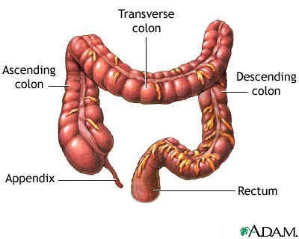
Stop 4: The Colon, Rectum, & Anus
7. What is primarily absorbed in the large intestine?
8. Name the segments of the large intestine in order from beginning to end.
9. What is the purpose of bacteria in our colon?
Notes:
Answers:
7. Water
8. Ascending colon, transverse colon, descending colon, sigmoid colon, rectum
9. Synthesizing vitamins, processing waste and food, and protecting against harmful bacteria

Slide 10
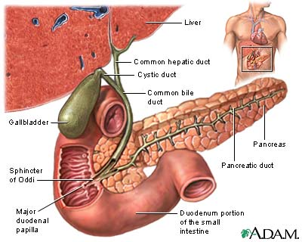
Accessory Digestive Organs: Gallbladder, Pancreas, & Liver
10. What is the purpose of bile?
11. How do the functions of the gallbladder and pancreas differ?
Notes:
Answers:
10. Bile is a substance that emulsifies fat. It’s produced in the liver and stored in the pancreas. It is released through the bile duct into the duodenum of the small intestine.
11. The gallbladder is merely a storage container for bile that is waiting to be released into the small intestine. The pancreas, on the other hand, produces several enzymes that help in the digestion of carbs, fats, and proteins.

Slide 11
Assess:
Go back to the list of digestive system components on page 2 and summarize the function of each in one sentence or less.
Then list all of the organs and components of the digestive system THAT FOOD PASSES THROUGH in order from beginning (at the mouth) to end (at the anus):
Notes:
Organs/components of digestive system in order: Mouth (saliva), pharynx, esophagus, stomach, small intestine (duodenum, jejunum, ileum), large intestine (ascending, transverse, descending, sigmoid colon), rectum, anus

Slide 12
Homework: Creative Writing
At the beginning of this lesson, you imagined the journey of a pretzel through the digestive system. Now that you are armed with facts and new knowledge, re-write the pretzel’s story from the moment it gets eaten to the very end of the journey. Your story should be approximately 2-3 paragraphs long. Be sure to use correct terminology and describe each stop accurately, yet creatively.
Notes:
The purpose of this homework is to help students review the process and make it “stick” by applying it to a situation creatively. Encourage students to be descriptive. For example: (speaking from the pretzels point of view, in first-person)… “then I fell into a giant cavernous pit called the stomach, where I began riding a wave of acidic fluid back and forth in a churning sea. Slowly I felt my insides break down even more until…”)

