Slide 1
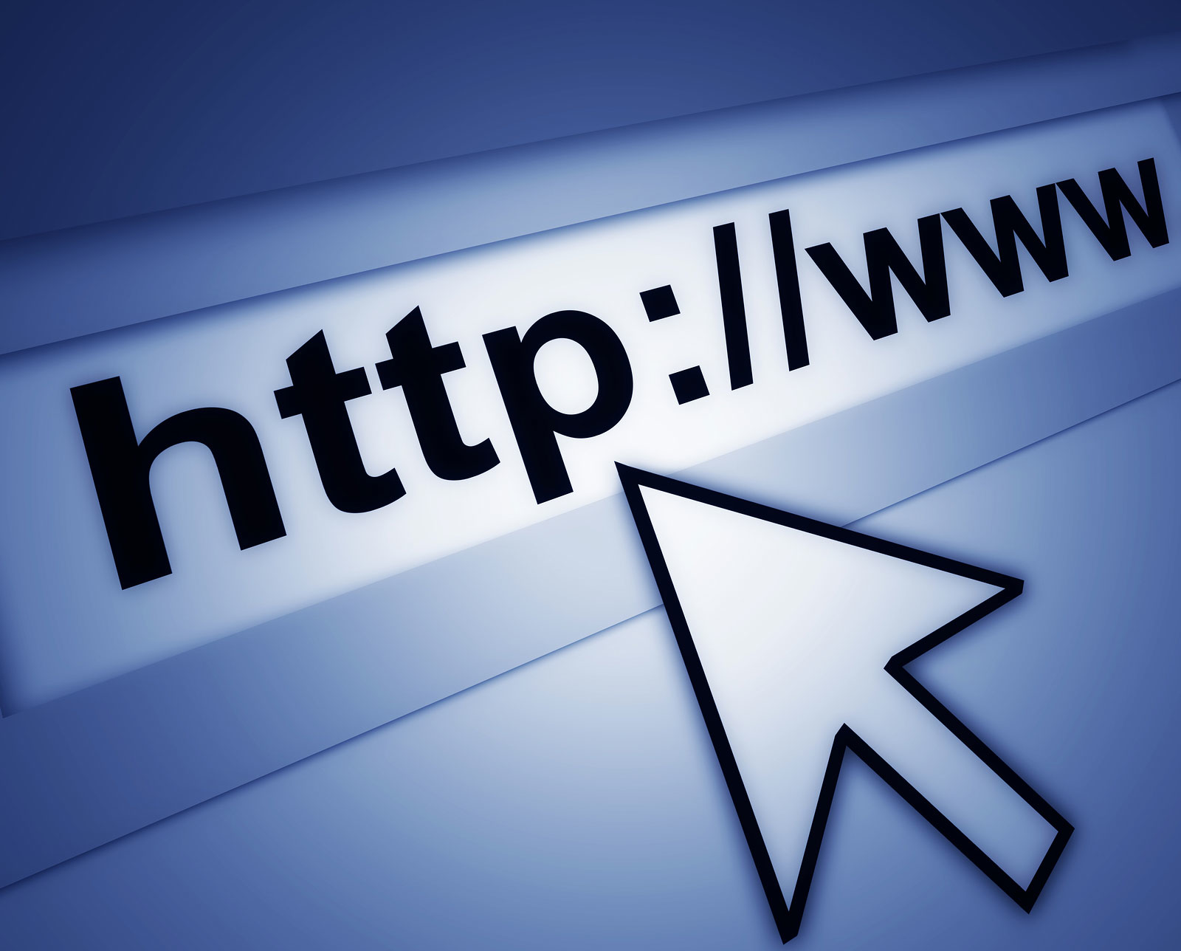
Lesson 2.11: Credible WEB SOURCES
Unit 2: Nutrition & Fitness
Notes:
This lesson will equip students with a basic primer on credible sources on the Internet. Students will begin by identifying how they know if a source on the internet can be trusted for reliable information. Then, with a partner, they will brainstorm two different types of websites they have used and identify the defining characteristics of information on that type of site. Next, students will be introduced to three elements of determining credibility: the URL, information on the perimeter of the site, and the sources referenced. To practice, students will perform a Google search to identify two sites and determine whether they are credible.
Image source: http://mises.ca/posts/articles/how-the-internet-saved-civilization/

Slide 2
Do Now
What clues would you look for to know whether or not you could trust the information you find on a website? List as many as you can!
Notes:
Students may list things like: author, doesn’t include personal opinion/bias, etc. If students seem like they are struggling, navigate on screen (if possible) to a site with untrustworthy information (ex: dieting websites and herbal supplement websites are plentiful) and scroll along to show students the page. Once they are looking at an actual webpage, more ideas may come to them. If students have access to their own personal computers in the classroom, direct them to an unreliable site so they can look through themselves.
Image source: http://www.insidearm.com/daily/debt-collection-news/debt-collection/cfpb-supervisory-report-on-mortgage-servicing-offers-clues-to-debt-collectors/

Slide 3
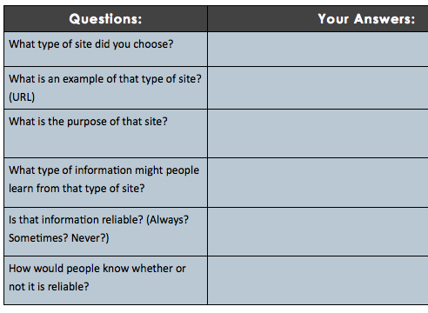
Discuss
Notes:
The purpose of this short activity is to open students minds to the many purposes of information on the internet and to help them orient themselves to the ways they approach Internet information. By examining a type of site like social media or blogs, students will be more aware of how the way they think about credibility changes (or should change!) when accessing different types of content online and looking for information for different purposes.

Slide 4
What is Credibility?
“the quality of being trusted and believed in”
Information that is:
Reliable
Accurate
Unbiased
Current
Notes:
Ask students: Can you think of other words to describe credibility?

Slide 5
Clues to determine credibility:
The URL
The Perimeter of the Page
The Sources Referenced
Notes:
For more information, a great source from Berkeley is: http://www.lib.berkeley.edu/TeachingLib/Guides/Internet/Evaluate.html
In addition, the Purdle OWL website provides excellent information at: https://owl.english.purdue.edu/owl/resource/553/01/

Slide 6
The URL
What to look for?
Sources from educational institutions (.edu), governmental organizations (.gov), and .nonprofits (.org) or commercial sites (.com) that are well-established and recognized in the field.
What to avoid?
Blogs and personal pages (often part of the person’s name is in the URL), Companies with advertising on their page or that are clearly trying to sell something (sometimes this can be difficult to recognize at first glance)
Notes:
This might be a good time to give students a short list of website URLs that have GREAT and CREDIBLE health information: These might include: cdc.gov, nih.gov, kidshealth.org, webmd.com, google.com/scholar, etc.

Slide 7
The Perimeter of the Page
What to look for?
Last updated date (usually at the very bottom), About page explaining the organization’s purpose, philosophy and structure, Author (with credentials and contact information), however often an agency or organization is responsible for the material so no author is listed
What to avoid?
Missing information about the source of content, missing date, author with no credentials
Notes:
Show students a few examples of actual webpages so they can see the various ways that this information can be laid out around the perimeter.

Slide 8
The Source Documentation
What to look for?
Footnotes or links should be provided to other reliable sources, permissions and copyright information
What to avoid?
Reproduced content that does not link back to sources
Notes:
Navigate to an topic page on wikipedia.org to show students how footnoting is used to link directly to sources. Then find a few other sites where this is done in various ways.

Slide 9
Practice:
Google: “building muscle”
Choose any 2 websites
Fill in the table to determine credibility:
Notes:
Example websites that could be used include: http://www.wikihow.com/Build-Muscle, http://www.askmen.com/sports/bodybuilding_150/193_fitness_tip.html, http://www.bodybuilding.com/store/musclegain.htm, http://www.webmd.com/fitness-exercise/features/build-muscle-better-health

Slide 10
Assess:
Name 3 things you would look for to determine whether a source is credible:
1)
2)
3)
Notes:
Answers: the URL, the perimeter, the sources (more information should be provided to explain)

Slide 11
Homework:
Find one credible and one non-credible website related to childhood obesity:
Credible site (URL):
Why?
Non-credible site (URL):
Why?
Notes:
The purpose of this assignment is to give students one more opportunity to practice, in a content area that will be relevant to the upcoming case study.

