Slide 1
Lesson 15.6: Career Planning
Obj. 15.6: Integrate and evaluate information about health science careers.
Module 15: Health Careers
Notes:
Overview: In this lesson, students will do investigation on health science careers and prep work that will get them ready for the following lessons in which they will complete a project on their chosen career. First, students will decide what factors are most important to them in choosing a career. Then they will consider these factors through discussion and debate about what factors are most important in making career choices. Next they will go online to access the BLS Occupational Outlook Handbook and select five careers they are interested in, taking notes on each. Then they will narrow it down to their top 3 and present to a small group. Finally, for homework they will narrow the field down to one.
Image source: Flickr (https://www.flickr.com/photos/mariettaga/6192647237/)

Slide 2
Do Now: What makes you tick?
In the circle below, list all of the things that might influence your career choice.
Notes:
Cold call students for a sampling of factors that students wrote down. Before you start, ask students not to repeat a factor someone else already stated.

Slide 3
Balancing Priorities
Which is more important: to earn a greater salary, or to do a job you love? Consider this question along with other possibly competing factors or priorities in career decision making (e.g., hours/flexibility, education required, etc.). Jot down your thoughts, then discuss with your partner.
Notes:
Make sure students take away two key messages: 1) we all might have different priorities in terms of what motivates us to be interested in certain careers; but 2) it is important to seek a career that fulfills you.

Slide 4
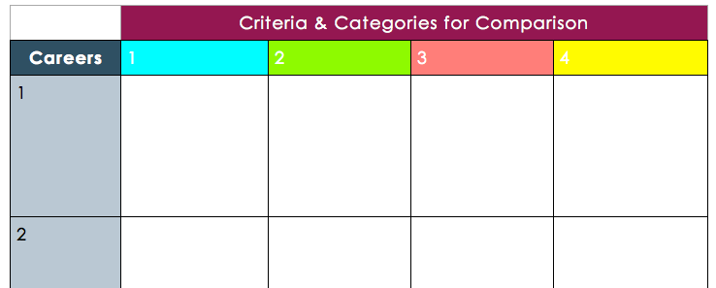
Occupational Outlook Handbook: Health Science Careers
Use the website for the BLS Occupational Outlook Handbook to select five careers that interest you. (Link: http://www.bls.gov/ooh/healthcare) Determine important criteria to record for each career, then fill in the table to compare and contrast them. When you are finished place a star by your top three that you are most interested in.
Notes:
Suggest that students start on the BLS site but they can certainly access any other credible sites for more information, especially if the career they are thinking about is very uncommon or they cannot find it in the Occupational Outlook Handbook.

Slide 5
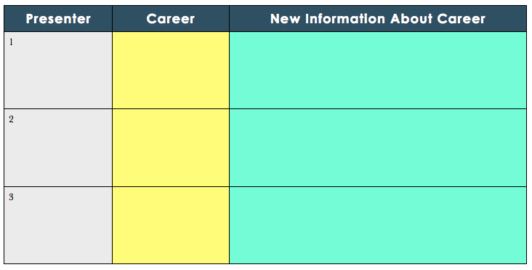
HS Careers Club
In a small group of 3-4 students, take turns presenting your top THREE health science career interests. Each presenter should spend one minute discussing each career, including the important facts about it, factors that were considered in comparing and contrasting it with other careers, and personal reasons why it was selected as a top 3 choice. After each presentation, the audience in each small group should ask questions and give feedback for 1-2 more minutes. In the table below, jot down one new career you learn about from each of your fellow presenters.
Notes:
Challenge students to be a sounding board and critic for one another. After each student presents, they should ask questions to learn more about the career to gauge the interest level and motivation to pursue that career of their fellow student

Slide 6
Homework: 5 to 3 to 1.
You started class with five health science careers you were interested in and narrowed it down to your top three. For homework, choose your ONE top health science career interest so you are prepared for the upcoming classes. You will use this top career choice in subsequent activities and projects, so choose carefully. As an additional way to prepare, continue to read about your career online, find credible and useful sources about it, take notes, and talk to anyone you know who is in the career or may have contacts who are in it.
Notes:
The purpose of this assignment is to prepare students to have a type of career in mind for the next lesson (5.7) on shadowing, and also to be ready to begin the larger Career Spotlight project (5.8).

