Slide 1
Lesson 15.4: THE INTERVIEW
Obj. 15.4: Maintain professionalism, composure, focus, and energy in an interview.
Module 15: Health Careers
Notes:
Overview: Students will engage in identifying and practicing essential skills for interviewing and expand their understanding of the types of questions they may be asked. First students will write interview questions for a hypothetical health care job. Then they will work with a partner to identify the most difficult of these questions. Next students will use online resources to identify and take notes on types of interview questions. Then they will watch and critique clip(s) of mock interviews. Finally they will work with a partner to conduct mock interviews of their own using the questions they wrote in the beginning of class.
Image source: http://en.wikipedia.org/wiki/Interview

Slide 2
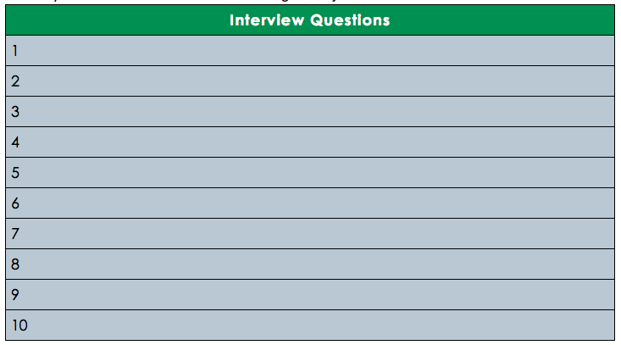
Do Now: Interview Questions
You are interviewing a candidate for a job entitled “Water Quality & Beach Safety Specialist” a position in your local community’s Department of Public Health. Make a list of ten questions you would ask the candidate interviewing for the job.
Notes:
Ask students to avoid questions that would require technical knowledge (for the purposes of class time), explaining that often jobs that do require technical knowledge do not focus on this aspect in the interview, instead focusing on the person’s characteristics, attitude, motivations, etc.

Slide 3
The Toughest Interview Questions
With a partner, share your lists. Then determine the top 3 most difficult questions. If you can come up with even more difficult questions, add them to the list! (Note: Avoid questions that are difficult because they require technical knowledge; instead, aim for questions that many people typically struggle with, e.g., “What are your weaknesses?”).
Most Difficult Questions:
1.
2.
3.
Notes:
Take a few of the most commonly cited difficult question types, e.g., “Tell me about yourself.” or “What are your greatest weaknesses?” and open them up for class discussion. Ask students for ideas on general strategies they could use to answer the toughest ones.
Additional resource: https://www.youtube.com/watch?v=GWBJDyB0YlQ

Slide 4
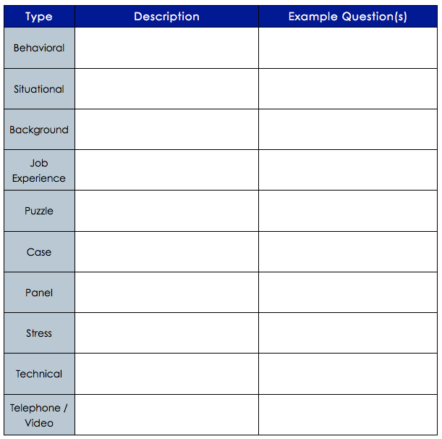
Types of Interview Questions
Visit Wikipedia’s overview of Job Interviews <http://en.wikipedia.org/wiki/Job_interview>
and use the information in the section “Types of Questions” to fill out the table.
Notes:
Challenge students to come up with a new example question for each category that is not already provided on the webpage.
Source link: http://en.wikipedia.org/wiki/Job_interview#Types_of_questions

Slide 5
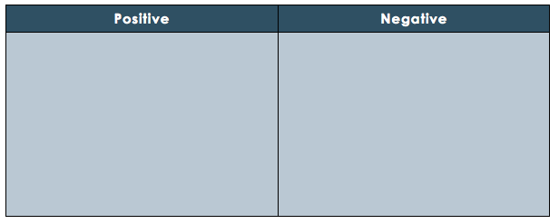
Interview Clip Critique
Watch the clips of the mock or real interviews. In the table below, jot down positive and negative behaviors, characteristics, ways of responding, or other factors pertaining to the person being interviewed.
Notes:
THINK:
Possible interview clips to use:
https://www.youtube.com/watch?v=qR-IhZJOq3U
https://www.youtube.com/watch?v=Gww2vrIhjeU
You may find more (or better) examples on youtube with a quick search!

Slide 6
Mock Interviews
With a new partner, conduct mock interviews for the “Water Quality & Beach Safety Specialist” position in your local community’s Department of Public Health. Follow the directions below:
1. Review the questions you wrote in the Do Now. Add any additional questions.
2. Consider responses you would offer if you were being asked your own questions. You will not know the actual questions you will be asked, as in real life, but preparation is still important.
2. Determine who will be the interviewer and interviewee first (you will switch roles so you each have a chance to do both).
3. Shake hands and begin the interview. Continue “in character” until your instructor calls time.
4. Before switching roles, take a few minutes to share positive and constructive feedback.
Notes:
THINK: Some tips...
--Ensure students partner with a different student than they partnered with earlier in the class.
--Have students being interviewed first stand up around the room and approach the “interviewer,” shake hands, etc. all at once.
--Warn students that the room volume will get very loud, very fast (spread them out first, as much as possible). Ask them to keep their voice as low as possible while still being heard.
--Use a timer (projected if possible, e.g., onlinestopwatch.com) to set a limit on each round. Suggestion: 4 minutes per interview.

Slide 7
Homework: Interview Resources Online
Find one or more resources providing helpful information about interviews online. Summarize the source and what you learned from it on a separate sheet of paper. Be sure to include the source citation (including website title, author, date, and URL)
Notes:
The purpose of this assignment is to give students some exposure to the vast amounts of resources available online for future use in job searches or interview preparation.

