Slide 1
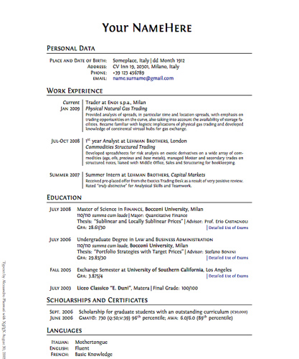
Lesson 15.3: The Resume
Obj. 15.3: Identify the components of a resume/
Module 15: Health Careers
Notes:
Overview:
Image source:

Slide 2
Do Now: All About You!
In the box below, list as many things about yourself as you can!
Here are some hints: Think about your educational history (what school do you attend, what is your average GPA?). Think about what activities, clubs, or sports are you involved in. Think about your hobbies, interests, and leisure activities. Think about any jobs you have had, even if they are informal (e.g. walking the dog, babysitting, mowing the lawn, etc.). Think about any skills or special talents you have. Think about places you have volunteered at or projects you have worked on. THE SKY IS THE LIMIT!

Slide 3
You Are Hiring!
You are opening a new medical center that aims to integrate health professionals of all kinds in a “one stop shop” for the community’s health care needs. You will hire public health workers (e.g., epidemiologists, health educators, etc.), healthcare practitioners (e.g., nurses, physician’s assistants, physicians, medical assistants, certified nurse assistants), physical therapists, nutritionists, dentists, psychologists, social workers, pharmacists, and even veterinarians. (WOW--that is a lot of healthcare professionals!) With a partner, discuss all of the factors you will consider when hiring. Then narrow your ideas down to the FIVE most important skills or other factors you will use when hiring.

Slide 4
What is a Résumé?
A résumé is a document used by persons to present their backgrounds and skills. Résumés can be used for a variety of reasons, but most often they are used to secure new employment. A typical résumé contains a summary of relevant job experience & education. The résumé is usually one of the first items, along with a cover letter and sometimes an application for employment which a potential employer sees regarding the job seeker and is typically used to screen applicants, often followed by an interview. In most contexts, a résumé is typically limited to one or two pages of size. highlighting only those experiences and qualifications that the author considers most relevant to the desired position. Many résumés contain key words or skills that potential employers are looking for, make heavy use of active verbs, and display content in a flattering manner.
Source: Wikipedia <http://en.wikipedia.org/wiki/resume>

Slide 5
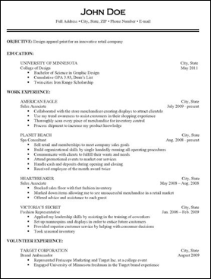
Résumé Components
For each of the components on the résumé pictured at right, write observations of the key things to include and/or remember about each section.
Source: Wikimedia Commons, Public Domain. User: Rkwriting

Slide 6
Résumé Critique
Go online and access the résumé following the directions listed below. Review its content, style, and format. Then write your comments, both positive and negative, in the table below.
1. Go to: http://www2.uwlax.edu/Career-Services/Resume-writing/
2. Click on “College of Science & Health”
3. Click on “Athletic Training - Senior”

Slide 7
Homework: Your Résumé
It’s your turn! Compose your own résumé in Microsoft Word. Use the Do Now exercise in which you brainstormed things about yourself to help you get started. You can be creative, since you may not yet have the job experience or other types of experience that typically fill a résumé. Use the box below to continue brainstorming before you start typing!

