Slide 1
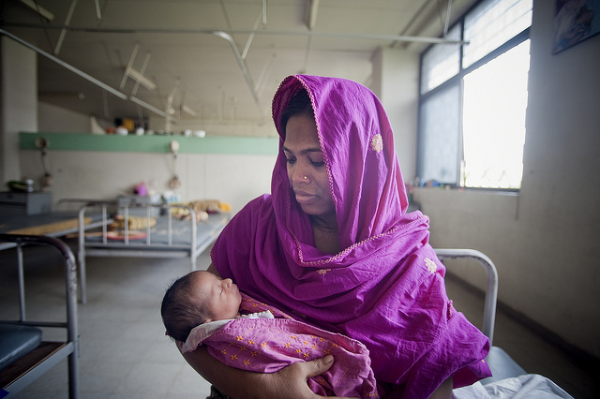
Lesson 13.7: Maternal/Child Health
Obj. 13.7: Explain the risk factors and causes for maternal and child health problems.
Module 13: Global Health
Notes:
Overview: Students will identify causes and risk factors for maternal/child health issues. First they will analyze data to better understand where the greatest global burden of maternal/child health issues lies. Then they will read about maternal and child health. Finally, students will read an article about an intervention in Senegal called Kangaroo care and answer questions to internalize the connections to their learning.
Image source: Flickr, https://www.flickr.com/photos/un_photo/5370298016/

Slide 2
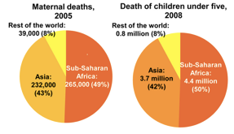
Do Now
Regional distribution of the global burden for maternal & child mortality
Source: Kinney et al (2010) Sub-Saharan Africa's Mothers, Newborns, and Children: Where and Why Do They Die? <http://www.plosmedicine.org>
The Burden of Maternal & Child Mortality
1. What region experiences the greatest proportion of maternal and child deaths?
2. Why do you think Sub-Saharan Africa and Asia, in particular, have the highest percentage of maternal and child deaths. List as many factors that might contribute to this problem as you can!
Notes:
1. Sub-Saharan Africa
2. These regions are the poorest and have possibly unstable governments and political systems. Students may give other good reasons as well. These are just a few.

Slide 3
What is Maternal Health?
Maternal health refers to the health of women during pregnancy, childbirth and the
postpartum period. While motherhood is often a positive and fulfilling experience, for too many women it is associated with suffering, ill-health and even death.
Source: http://www.who.int/topics/maternal_health/en/
Every day in 2013, about 800 women died due to complications of pregnancy and child birth. Almost all of these deaths occurred in low-resource settings, and most could have been prevented. The risk of a woman in a developing country dying from a maternal-related cause during her lifetime is about 23 times higher compared to a woman living in a developed country. Maternal mortality is a health indicator that shows very wide gaps between rich and poor, urban and rural areas, both between countries and within them. The major direct causes of maternal morbidity and mortality include hemorrhage (internal bleeding), infection, high blood pressure, unsafe abortion, and obstructed labor.
Source: http://www.who.int/gho/maternal_health/en/
Notes:
Students can read these sections independently. Encourage them to “mark up” the workbook text in order to help maintain active and focused reading.

Slide 4
What is Maternal Health?
Why do women not get the care they need? Poor women in remote areas are the least likely to receive adequate health care. This is especially true for regions with low numbers of skilled health workers, such as sub-Saharan Africa and South Asia.
Other factors that prevent women from receiving or seeking care during pregnancy and childbirth are:
poverty
distance
lack of information
inadequate services
cultural practices
Source: http://www.who.int/mediacentre/factsheets/fs348/en/

Slide 5
What is Infant & Child Health?
Poor infant and child health is a complex, multivariable problem. One major cause of infant morbidity (illness) and mortality (death) is hunger or nutritional deficiencies. The focus of this section will be on this particular aspect of infant and child health.
Key facts:
Every infant and child has the right to good nutrition according to the Convention on the Rights of the Child.
Undernutrition is associated with 45% of child deaths.
Globally in 2012, 162 million children under 5 were estimated to be stunted and 51 million have low weight-for-height, mostly as a consequence of poor feeding and repeated infections; 44 million were overweight or obese.
About 38% of infants 0 to 6 months old are exclusively breastfed.
Few children receive nutritionally adequate and safe complementary foods; in many countries only a third of breastfed infants 6–23 months of age meet the criteria of dietary diversity and feeding frequency that are appropriate for their age.
About 800 000 children's lives could be saved every year among children under 5, if all children 0–23 months were optimally breastfed.
Source: http://www.who.int/mediacentre/factsheets/fs342/en/

Slide 6
Kangaroo Care:
Read the handout article, “Senegal: A leap forward on infant survival.” Then answer the questions below.
1. What is kangaroo mother care?
2. Why is kangaroo mother care helpful in Senegal?
3. What outcomes have been observed with the use of kangaroo mother care?
4. What made this intervention successful?
Source: Senegal: WHO (2014). A leap forward on infant survival <http://www.who.int/features/2013/senegal-infant-survival/en/>
Notes:
READ:
1. Kangaroo mother care involves skin to skin contact between mom and baby. This allows the baby to benefit from maternal warmth and have easy access to on-demand breast-feeding.
2. It is helpful in Senegal because many babies are born low-birthweight and/or premature. These babies are often more vulnerable to hypothermia, infection, and other problems.
3. Improved outcomes have been observed for babies. They have reduced by half the number of babies that survive past the first month of life. Data is still being collected.
4. This intervention might be successful for a variety of reasons, some of which include: it is low-tech (really no tech) and thus it is free (not even just low cost). The only thing needed is a cloth for wrapping the babies, which is a supply the mothers are already likely to have. Thus it is sustainable, natural, easy for mothers to learn and understand, etc.

Slide 7
Homework: Low-Tech Interventions for Maternal/Child Health
Research another successful intervention (of any kind!) that has been used in low-resource settings for improving maternal and child health outcomes. After you research, answer these questions:
1. Describe the intervention clearly.
2. What problem does it address? Why is it effective?
3. What outcomes have been observed with its use? (Provide actual data if possible).
Notes:
The purpose of this homework is to help students realize how much potential there is in medical innovations. One example: The Odon Device <http://en.wikipedia.org/wiki/Od%C3%B3n_Device>

