Slide 1
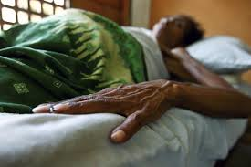
Lesson 13.6: HIV/AIDS, TB, & Malaria
Obj. 13.6: Use data to support a global health priority.
Module 13: Global Health
Notes:
Overview: This lesson will challenge students to gather information and data to make a case for a global health priority in the diseases HIV/AIDS, TB, & malaria. First, students will complete a K-W chart identifying background knowledge & questions on the diseases. Then they will discuss the challenges, limitations, & benefits of rich nations providing poor nation with foreign aid for health needs. Next, students will complete background research on the three diseases. Then they will be challenged to use gathered evidence and data to identify key priorities for health-related international efforts.
Image source: https://www.flickr.com/photos/un_photo/4636517289/

Slide 2
Do Now: K-W-L
This lesson will focus on THREE major global health threats; diseases that can be prevented but still affect millions worldwide. To begin, write what you already KNOW (facts, information) and what you WANT TO KNOW (questions) in the table below.
Notes:
Start a parking lot on a poster paper sheet or a white board where students can add their questions or “want to knows.” Encourage students to information share to address these questions during the research phase of the lesson.

Slide 3
Foreign Aid for Health
A recent headline in the Liberian Daily Observer (5/8/14) proclaimed, “Us$101M To Battle Hiv, Tb, Malaria.”
What are the challenges, limitations, & benefits of providing monetary aid to other nations in order to help fight these health issues?
Notes:
Foreign aid is a complex, nuanced issue. At face value it will seem good to many students. Shouldn’t rich countries give away some of their wealth to those who are in need? Yes, BUT... Ask students to share how foreign aid might have a negative side as well

Slide 4
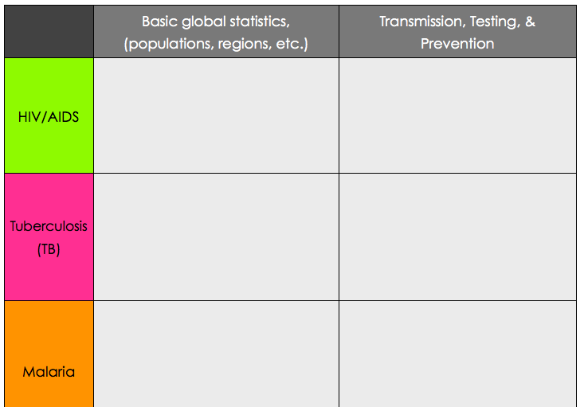
Background on HIV/AIDS, TB, & Malaria
Use credible medical information sites (CDC, WHO, NIH, WebMD, etc.) to gather comparative information about HIV/AIDS, TB, & malaria.
Notes:
Students can work in partners or teams to break up the research tasks. Alternately, six groups could be formed to do each component of the research and they could present their notes & information to the class

Slide 5
Limited Resources, Tough Decisions
Assume that the U.S. government decides to give $100 million more to the fight against these three global health threats. You are appointed the lead medical expert guiding a committee which will make recommendations about how that money should be allocated. On a separate sheet of paper, answer the following. Be sure you cite EVIDENCE to support each of your answers!
1. How should the money be allocated between the three diseases? Why?
2. What should the money be spent on? Which countries or regions should be targeted?
3. What role should the U.S. government play? What role should other stakeholders have?
Notes:
Select a few students at random present their answers to these questions. Encourage the class to push back and ask questions so that students are encouraged to think about different viewpoints and ways of using the evidence to defend their conclusions.

Slide 6
Health Education + Prevention
For each of the three diseases, write down ONE key understanding (health education) and ONE preventative tool that you think would be the most essential for citizens of a poor nation who are facing high levels of these diseases.
For example, if we wanted to prevent INFLUENZA, one key understanding might be: “Frequent handwashing (especially before and after eating) can prevent the spread of the flu germs.” And one preventative tool might be hand soap in places without access to this basic hygiene item.
be sure to describe the key understandings and preventative tools clearly and give rationale or evidence for why you chose them.

Slide 7
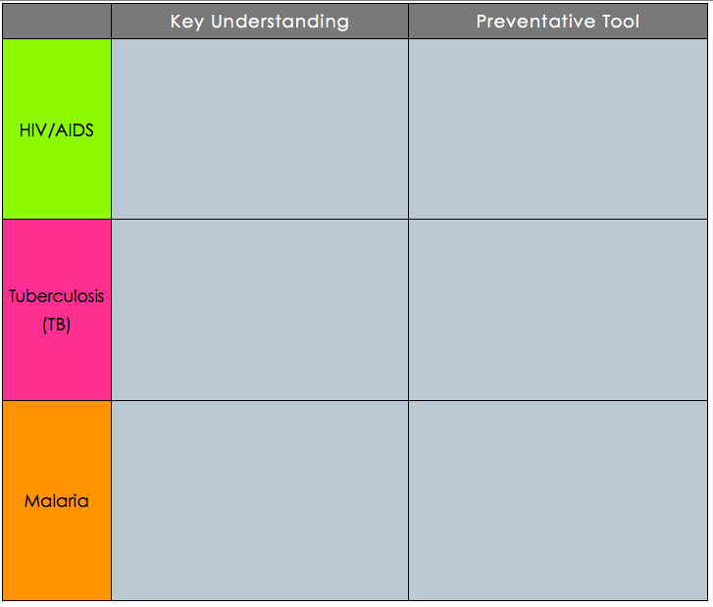
Health Education + Prevention
Notes:
The purpose of this homework assignment is to get students to think about how health education and prevention go hand in hand and can make great contributions to reducing the scourge of many major global health diseases. Obviously, there is more to it than just educating and providing prevention tools, but these are important starting points.

