Slide 1
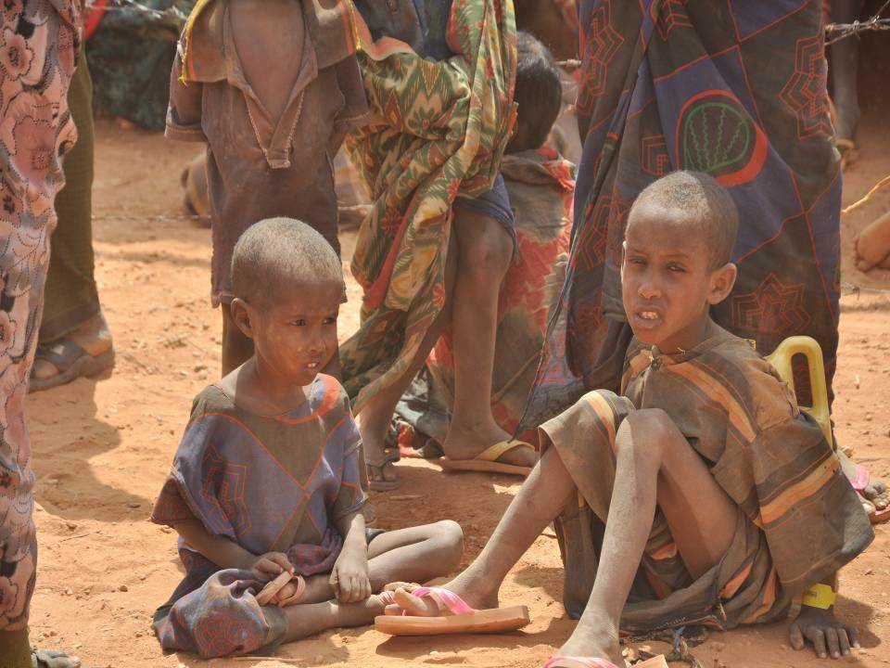
Lesson 13.4: Hunger & Malnutrition
Obj. 13.4: Identify risk factors and effects of hunger and malnutrition.
Module 13: Global Health
Notes:
Overview:
Image source: http://commons.wikimedia.org/wiki/File:Malnourished_children,_weakened_by_hunger.jpg

Slide 2
Do Now: Reflect on Hunger
Consider the questions below and spend 3 minutes in a free-write on the topic of this lesson.
What does it mean to be hungry? As an American, is our definition different than that of others in countries with lower standards of living? Within the U.S. does this issue vary widely? What experience, if any, have you had thinking about or dealing with this issue on a personal, community, national, or global level? What questions do you have?
Notes:
Ask students to describe hunger and malnutrition in the U.S. Ask them to describe it in other poor nations. Then ask where their preconceptions and ideas come from--experience, the media, news, research, reading?

Slide 3
Share your Reflections
With a partner, take turns sharing your reflections, thoughts, background knowledge, and questions about the topic of hunger and malnutrition.
Notes:
Have students partner up with a student they have not worked with before in the class if possible.

Slide 4
Hunger & Malnutrition
Visit the World Food Programme website (www.wfp.org/hunger) to find answers to each of the following questions. Summarize the information concisely rather than copying long passages.
What is hunger?
What is malnutrition?
Who are the hungry & malnourished?
What are the causes of hunger & malnutrition?
How can hunger & malnutrition be prevented?
Notes:
Encourage students to read the information completely, then write their own summary in their own words without looking back. This practice is useful in developing better reading comprehension skills.

Slide 5
Hunger & Thirst
How is the problem of hunger & malnutrition similar & different from the problem of safe and clean drinking water & sanitation?
Notes:
Possible answers: SIMILARITIES -- both affect basic needs for survival, both are simple problems that should be a guaranteed right for all humans but become complex when poverty and poor public works infrastructure exist in a country. DIFFERENCES -- water is often present but unclean so it causes disease to be spread; food is often absent or only one or a few staples are available so people miss out on important nutrients available when variety exists in the diet.

Slide 6
Homework: What can you do?
Propose one realistic intervention or action you could take to help reduce the problem of hunger & malnutrition. Describe your idea in the space below. You may write freeform or use any kind of organizational too (bullets, concept mapping, etc.)
Notes:
The purpose of this homework assignment is to help students feel more empowered by thinking of solutions. Any creative thinking should be valued, so encourage students to really think outside of the box and not worry if their ideas seem unrealistic or impossible.

