Slide 1
Lesson 12.8: Race & Racism
Obj. 12.8: Identify how race and racism are correlated with overall health outcomes.
Module 12: Health Disparities
Notes:
Overview: This lesson will delve into a difficult topic, that of race and racism and links to health outcomes. Students will begin by analyzing a very simple, but profound graph on life expectancy by race. Then students will complete an interactive activity online called, Accumulating Advantage, which will pair images with “realities” and descriptions of the health consequences of racism. Finally, students will finish with a comprehensive reading about the topic from the Unnatural Causes collection.
Image source: http://commons.wikimedia.org/wiki/File:Stamp_Out_Racism,_Belfast,_August_2010.JPG

Slide 2
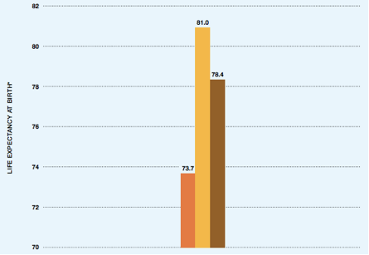
Do Now: Life Expectancy by Race
*Age-adjustedSource: Arias E. United States Life Tables, 2008. National Vital Statistics Reports; vol 61 no 3. Hyattsville, MD: Centers for Disease Control and Prevention, National Center for Health Statistics; 2012. <http://www.rwjf.org/content/dam/farm/reports/reports/2013/rwjf406474>
1. Which racial group has the shortest life expectancy at birth?
2. How many fewer years can a black baby expect to live, on average, compared to a white baby?
3. What are some possible factors that might explain these outcomes that differ by race?
Notes:
Answers:
1. Black (non-Hispanic) = shortest life expectancy at birth
2. A black baby can expect to live seven years less than a Hispanic baby and FIVE years less than a white baby
3. Factors may include: Socioeconomic disadvantages, racism (at all levels), chronic stress, etc.

Slide 3
Accumulating Advantage
1. Go to the Unnatural Causes website and click on Interactivities & “Accumulating Advantage.” http://www.unnaturalcauses.org/interactivities_08.php
2. Read, “How is health impacted by race and, consequently, class?
3. As you click on each image to explore how race and class impact health, take notes in the table.

Slide 4
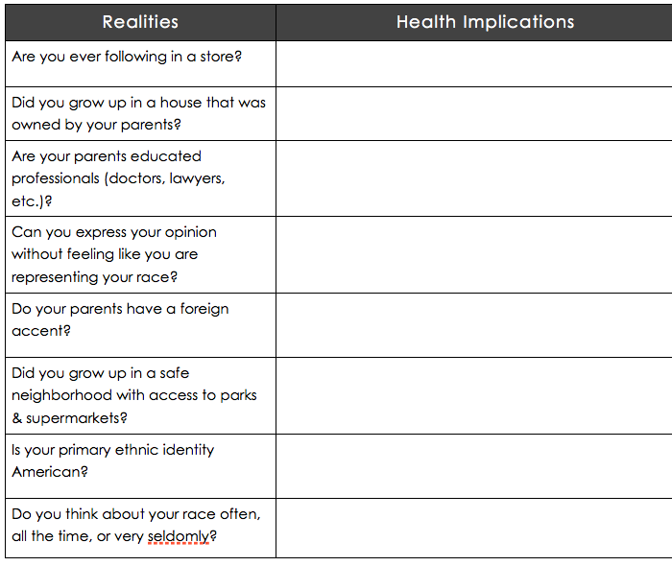
Accumulating Advantage
Notes:
Ask students to be self-aware about how they would answer each of the questions under “Realities.” If time permits, consider giving students some time & space to free-write or reflect individually (and then in partners if desired). This topic may understandably be a sensitive and difficult one for many students

Slide 5
Race, Racism, & Health Disparities
More than 100 studies now link racism to worse health. Many people of color experience a wide range of serious health issues at higher rates than do whites, including breast cancer, heart disease, stroke, diabetes, hypertension, respiratory illness and pain-related problems. On average, African Americans, Native Americans, Pacific Islanders and some Asian American groups live shorter lives and have poorer health outcomes than whites. But why?
Courtesy of UNNATURAL CAUSES: Is Inequality Making Us Sick? Produced by California Newsreel with Vital Pictures. Presented by the National Minority Consortia. www.unnaturalcauses.org; www.newsreel.org
Notes:
This reading continues from the series from Unnatural Causes. Source link: http://www.unnaturalcauses.org/resources.php?topic_id=8

Slide 6
Homework: Summarize
Summarize the reading on race, racism, and health disparities in 1-2 paragraphs.
Notes:
This homework will serve as a way for students to have some processing time and also to help reinforce the main concepts from the reading.

