Slide 1
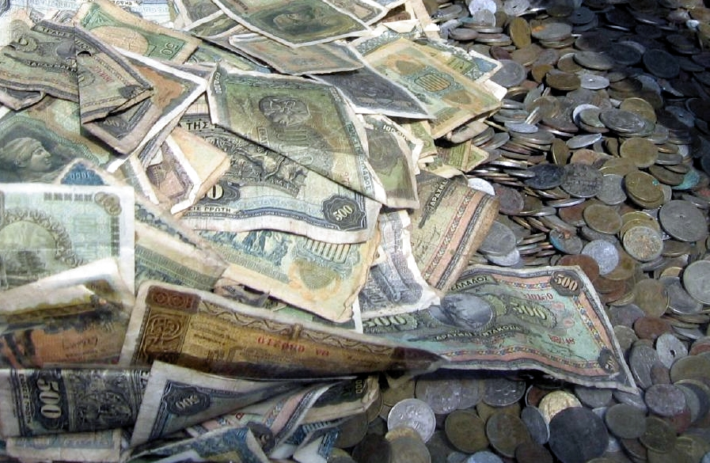
Lesson 12.7: Income & Health Disparities
Obj. 12.7: Identify how wealth and income are correlated with health outcomes.
Module 12: Health Disparities
Notes:
Overview: This lesson will encourage students to challenge their assumptions about income, wealth, and health. Students will begin by analyzing two graphs focused on income & health outcomes, making observations and conclusions. Then they will read an excerpt from the Unnatural Causes website on the link between income/wealth & health disparities
Image source: http://commons.wikimedia.org/wiki/File:Old_greek_money_1.jpg

Slide 2
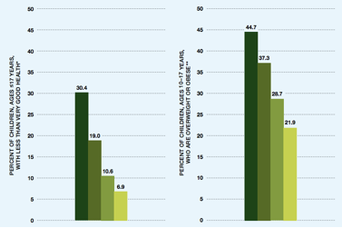
Do Now: Parental Income, Child Health Outcomes
Use the graph below to write the trend you notice for each graph. Then form a conclusion for the two data sets together.
Source: RWJH (National Survey of Children’s Health). http://www.rwjf.org/content/dam/farm/reports/reports/2013/rwjf406474
Notes:
Answers:
GRAPH 1: Compared with children in the highest-income families, children in poor families are more than four times as likely to be in less than “very good” health
GRAPH 2: Children in poor families are twice as likely to be overweight or obese as children in higher income families.
CONCLUSION: Higher parental income = healthier children!
Source: http://www.rwjf.org/content/dam/farm/reports/reports/2013/rwjf406474

Slide 3
Income, Wealth, & Health Disparities
“Perhaps the biggest predictor of one's health is one's wealth. It's not just the poor who are suffering; every step down the class pyramid corresponds to worse health. Study after study has shown that those at the top of the class pyramid live on average longer, healthier lives than the rest of us. The middle classes fare worse than those on the top, and the poor get sick more often and die sooner. ”
“The greater the inequality in a society, the steeper the gradient. Currently, the United States has the greatest inequality among rich countries - and the worst health inequities. People in the middle are twice as likely to die prematurely (before age 65) as those on top; people at the bottom are three times as likely.”
(Continues – see Workbook)
Notes:
Consider switching the method of reading this article from what has been done for other previous lessons. Try round-robin reading, partner reading, individual reading, or assigning the reading ahead of time (or for homework) and using class for discussion).
Source:
Courtesy of UNNATURAL CAUSES: Is Inequality Making Us Sick? Produced by California Newsreel with Vital Pictures. Presented by the National Minority Consortia. www.unnaturalcauses.org; www.newsreel.org
http://www.unnaturalcauses.org/resources.php?topic_id=7

Slide 4
Review
1. How is income/wealth inequality related to health?
2. Why is the impact of income/wealth on health greater for children?
3. What are the two ways to correct income & wealth inequality in order to improve health?
Notes:
ASSESS:
Possible answers:
1) Income and wealth are directly proportional (as a general rule of thumb) with positive health outcomes. The wealthiest are healthiest, and least wealthy are unhealthiest.
2) Children are more prone to experience negative health effects from income/poverty because of: lack of ability to negotiate barriers and environment, more time exposed to negative factors in poverty, lack of coping mechanisms, etc.
3) 1. reduce the overall income gap so that everyone has sufficient resources; 2. loosen connection between health and wealth by by making certain resources available to everyone.

Slide 5
Homework: A Story of Poverty & Poor Health
Choose a creative way to depict the life and health of a fictitious 30-year old who grew up (and is still living) in poverty. You may write a story, craft a comic strip/storyboard, draw a picture, write a poem, record a song/skit, or use any other method you prefer.
Be sure to include the following in your depiction:
1. At least one chronic health problem linked to poverty
2. At least two events or circumstances during childhood that negatively affected health
3. At least three income/wealth-related barriers that impact(ed) health.
Notes:
The purpose of this homework assignment is to help students congeal their understanding of the ways income/wealth (or lack thereof) impact health.

