Slide 1
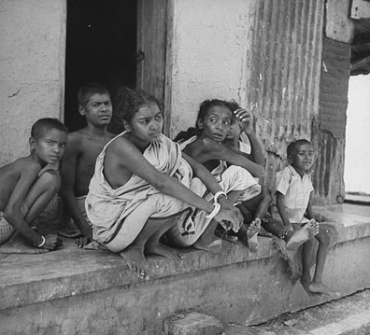
Lesson 12.6: Food Security
Obj. 12.6: Explain how access, time, cost, and marketing influence eating choices which lead to health disparities.
Module 12: Health Disparities
Notes:
Overview: This lesson helps build a deeper understanding of health disparities as it focuses on some of the major factors that shape food security and helps students connect these factors with populations who might be most affected. Students will begin by analyzing a graph depicting the changing cost of healthy eating. Next they will complete three short readings from Unnatural Causes--on food security, key factors, and consequences. Finally, students will interview a community member for homework, applying these factors to an analysis of their own community.
Image source: http://en.wikipedia.org/wiki/Food_security

Slide 2
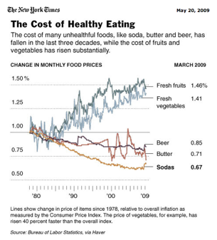
Do Now: The Cost of Healthy Eating
1. By what percentage have the cost of soda and fresh fruit, respectively, changed from 1978 to 1009?
2. What type of foods have become more costly over time?
3. What are some possible explanations for the cost of produce rising while the cost of foods like butter, beer, and soda have fallen?
Notes:
Ask students, “Which of the foods are processed?” (Butter, beer, soda) “How do you think the cost of processed food has changed in the past few decades? Why?”

Slide 3
Discuss
Think about your typical daily diet. With a partner, discuss the various influences that lead you to make healthy and/or unhealthy choices.
Notes:
Students should connect factors that influence their diet with the ones they will read about shortly (time, cost, access, marketing). Others may include: family or peers, education/knowledge, cultural influences, medical issues, etc.

Slide 4
What is Food Security?
We all know what it means to "eat right." So why do so many people, particularly the poor, turn to fast food outlets and "junk" food? Food security is a complex issue interconnected with place, economics, and social policies. Food security means having adequate access to nutritious things to eat. In the developing world, the issue typically is getting enough food; in the industrialized world, it's more often a matter of getting the right food. Ironically, high-calorie food is cheap and plentiful in poor urban communities (due to the low cost of corporate food production heavily subsidized by tax dollars), while low-calorie, nutrient-rich food is harder to come by. This leads to a counterintuitive situation in which poverty tends to foster obesity rather than starvation.
Source: Courtesy of UNNATURAL CAUSES: Is Inequality Making Us Sick? Produced by California Newsreel with Vital Pictures. Presented by the National Minority Consortia. www.unnaturalcauses.org; www.newsreel.org

Slide 5
What is Food Security?

Slide 6
Key Factors in Food Security
Rank the factors 1-4 based on the order in which you think most influences your family’s dietary habits. (1= most influential; 4 = least influential).
____ Access. Many low-income neighborhoods lack access to a full-service supermarket. These so-called "food deserts" are dominated by liquor, fast food, and convenience stores, where produce is not only scarce but comparatively expensive and poor quality. Residents of these areas are more likely to rely on public transportation, further compounding the problem of access.
____ Time. Many people today, particularly heads of households, work long hours, at multiple jobs or commute to make ends meet. Parents who spend long hours working and commuting have limited time and energy to shop and prepare nutritious meals for themselves and their families. Pre-made meals are fast, easy and affordable.
Source: Courtesy of UNNATURAL CAUSES: Is Inequality Making Us Sick? Produced by California Newsreel with Vital Pictures. Presented by the National Minority Consortia. www.unnaturalcauses.org; www.newsreel.org
Notes:
For the original source and more information and resources, see: http://www.unnaturalcauses.org/resources.php?topic_id=4
There are links to a variety of excellent websites summarizing, reporting on, and showing data on the problems of food security and health disparities.

Slide 7
Key Factors in Food Security
____ Marketing. Often, children and teens get their own dinners. Fast food is not only more readily available, the industry bombards youth with billions of dollars of advertising on television, in the neighborhood, and at school. It's no surprise, then, that many kids will make this choice when left to their own devices.
____ Cost. Simply put, "junk" food costs less than healthy food - for producers as well as consumers. The abundance of cheap additives like corn syrup (a product of government-subsidized corporate agribusiness) drives production and profit for manufacturers. For consumers, University of Washington researchers found that the cost to obtain 1,000 calories from nutrient-rich fruits and vegetables was $18.16, compared to only $1.76 to obtain the same number of calories from energy-rich, highly processed foods. Moreover, the same foods purchased by suburban residents in large supermarkets cost 3% to 37% more for urban dwellers. For people with a limited budget and limited access to better options, it's not a fair choice.
Source: Courtesy of UNNATURAL CAUSES: Is Inequality Making Us Sick? Produced by California Newsreel with Vital Pictures. Presented by the National Minority Consortia. www.unnaturalcauses.org; www.newsreel.org
Notes:
Have students share their rankings by doing a quick four corners activity. Label each corner of the room with the four key factors and ask students to quickly (but safely) proceed to the corner they ranked #1 (most influential). Then ask them to proceed to the corner they ranked #4 (least influential).

Slide 8
Consequences and Social Policies
Food insecurity not only impacts nutrition, it also affects learning, brain development, behavior, immune resistance and in turn, job prospects and life chances over the long term. A poor diet also leads to increased risk for obesity, diabetes, cardiovascular problems and even cancer.
Eating right isn't just a matter of making good choices and having self-discipline. Although it's important to educate people about nutrition and diet, our living conditions, socioeconomic status and other outside factors affect the options available to us and our ability to stay healthy.
Policies that would help improve food security include encouraging investment in poor communities; improving public transportation; developing community gardens, farmers' markets and partnerships between local, sustainable growers and low-income neighborhoods; limiting advertising and the availability of junk food in schools; guaranteeing a living wage; and eliminating sugar and corn subsidies to large manufacturers in favor of locally grown fruits and vegetables.
Source: Courtesy of UNNATURAL CAUSES: Is Inequality Making Us Sick? Produced by California Newsreel with Vital Pictures. Presented by the National Minority Consortia. www.unnaturalcauses.org; www.newsreel.org
Notes:
There is likely to be a lot of disagreement regarding the thinking question (easiest and hardest to change). Allow some discussion & encourage students to defend their views with evidence & logic, as much as possible.

Slide 9
Homework: Food Security in Your Neighborhood
Interview a neighbor or fellow resident of your community. Ask them how each of the four factors that contribute to food security are playing out in their home and community. Summarize their responses below.
Notes:
The purpose of this homework assignment is to engage students in an application of the key factors in food security in their own communities. If the instructor would like to make another option available (in addition to interviewing another person), students could fill out the table based on their own experiences, a family members, or research the key factors in another community that is facing health disparities.

