Slide 1
Lesson 12.2: Intro to Health Disparities (pt 2)
Obj. 12.2: Identify factors that impact health of individuals and populations facing disparities in health outcomes.
Module 12: Health Disparities
Notes:
Overview:
Image source: Flikr (Caleb) https://www.flickr.com/photos/27668445@N03/3191145019/

Slide 2
Do Now: Following Doc’s Orders Pt 1
A doctor recommends that a patient exercise 30 minutes per day. List reasons why this may be difficult for people (barriers or risk factors that prevent exercise) in the box below. Try to think of as many as you can!
Notes:
Examples: lack of time, work hours, lack of fitness facilities, unsafe outdoor environment, social stigma or lack of support for exercise, family obligations (i.e. small children that can’t be left alone), lack of education regarding importance and options for fitness, etc.

Slide 3
Discuss: Following Doc’s Orders Pt 2
Working with a small group, brainstorm a similar scenario. A doctor recommends that a patient stop smoking immediately. List reasons why this may be difficult for people (barriers to quitting smoking or risk factors that contribute to continued smoking) in the box below. Try to think of as many as you can!
Notes:
Examples: lack of support from family/peers, culture of smoking among peers, co-workers, family, etc., stress, lack of access to tobacco cessation products and programs (due to financial situation, lack of knowledge, etc.), etc.

Slide 4
A Tale of Two Smokers
With a partner, complete the following online interactivity where you will follow Jane and Joe as they try to lead healthier lives. Look for ways that their choices are limited by the conditions in which they live.. Then read the conclusion for policy ideas that can help all of us.
1. Go to “A Tale of Two Smokers” on the Unnatural Causes website at:
http://www.unnaturalcauses.org/interactivities_02.php
2. Fill in the table as you read.
Notes:
This “interactivity” can be found at:
http://www.unnaturalcauses.org/interactivities_02-6.php
Other interactivities can be found at:
http://www.unnaturalcauses.org/interactivities.php

Slide 5
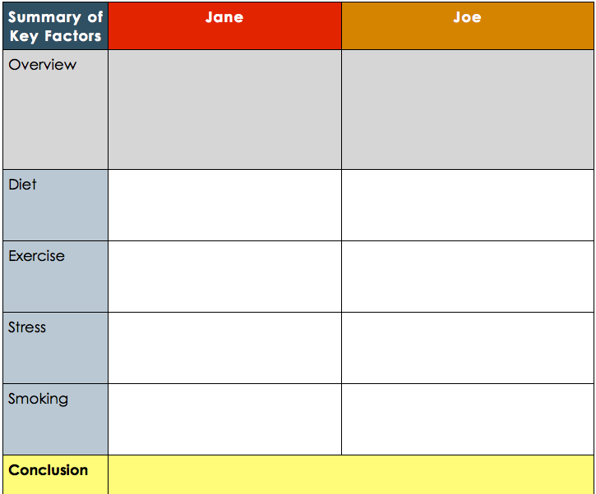
A Tale of Two Smokers

Slide 6
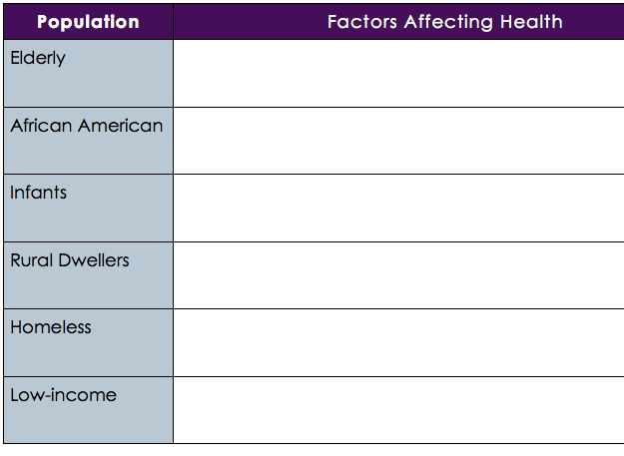
Assess: Factors Affecting Health Disparities
In the table below, list at least one factor that might contribute to health disparities among the populations listed in the left-hand column.
Notes:
Example answers:
Elderly: lack of social network
African American: racism
Infants: low income household
Rural Dwellers: lack of access to healthcare infrastructure (due to distance)
Homeless: lack of health insurance
Low-income: poor education options leading to health illiteracy

Slide 7
Homework: Health Disparity Narratives
Interview someone in your community. It may be a family member or friend. Ask them about health disparities that they have experienced, observed, or heard about. Construct a narrative story from their responses to your questions and write it out. Share the story with them and ask for feedback prior to turning it in.
Note: Be sure to ask the person you interview for their permission. Ask if they are comfortable discussing the topic before beginning your interview. Assure them that they do not have to answer any questions they feel uncomfortable with. Also, ask whether they would like to remain anonymous. If they do, be sure you do not include (or change) their name or any details about their story that may help others identify them.
Notes:
The purpose of this assignment is to challenges students to connect the factors that lead to health disparities to their own family, friends, neighbors, etc. By interviewing and writing about these disparities students will also practice articulating a discussion about the factors that shape our health.

