Slide 1
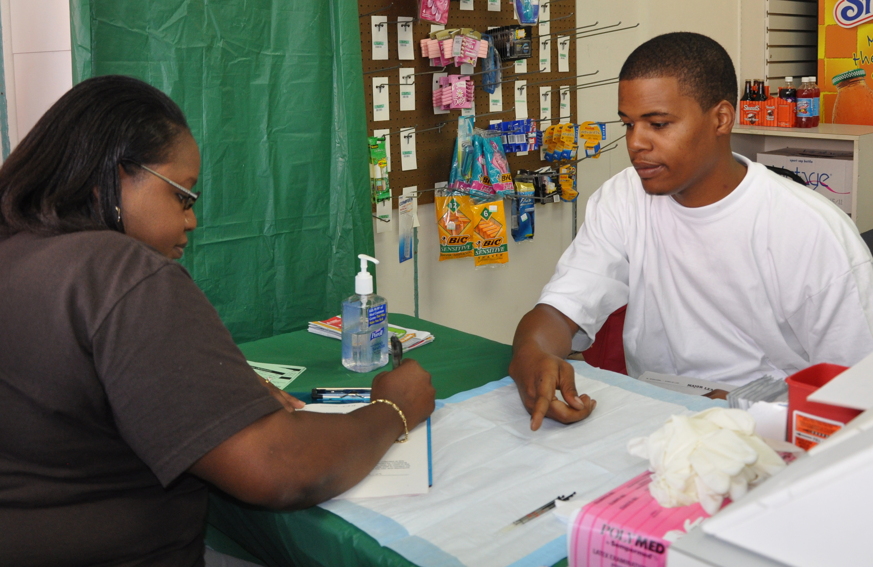
Lesson 12.1: Intro to Health Disparities
Obj. 12.1: Explain the problem of health disparities in the United States.
Module 12: Health Disparities
Notes:
Overview: In this lesson, students will be exposed to the major underlying facts about health disparities in our nation. Students will begin by identifying whether certain statements represent disparities. Then they will read a collection of 10 Things to Know About Health. Next they will reflect and apply the facts to scenarios. Finally they will watch part, or all of a documentary on health disparities called Unnatural Causes.
Image source: Flickr, User: Christiana Care (http://www.flickr.com/photos/christianacare/4008566935/)

Slide 2
Do Now: ID the Disparities
Which of the following do you think represent a health disparity?
There is a major pandemic of H1N1.
Diabetes is found more frequently in African Americans.
Patients tend to take their medications incorrectly.
Patients with low literacy tend to take their medications incorrectly.
Notes:
Ask students for their definition of health disparities. (Answers: 2 and 4 represent a clear health disparity) Ask students what differentiates these statements. This will help elucidate the definition of disparities.

Slide 3
Discuss
Which U.S. populations do you think live longer, healthier lives? Discuss reasons why you chose your answers.
Notes:
Look for answers that relate to underrepresented, marginalized, minority or disadvantaged populations. Factors that may be mentioned include income status, race, neighborhood, education, etc.

Slide 4
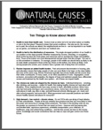
10 Things to Know About Health
Read the handout “Ten Things to Know about Health,” then complete the questions on the following page.
Courtesy of UNNATURAL CAUSES: Is Inequality Making Us Sick? Produced by California Newsreel with Vital Pictures. Presented by the National Minority Consortia. www.unnaturalcauses.org; www.newsreel.org
Notes:
The handout is included in lesson resources. It can also be found at:
http://www.unnaturalcauses.org/assets/uploads/file/10things.pdf

Slide 5
10 Things Reflection
1. Which of the 10 facts surprised you most? Why?
2. Which of the 10 facts were least surprising to you? Why?
3. Which of these facts relates most to your own life?
4. Which of these facts do you think is most within your control? The control of the leaders of our country?
Notes:
Have students who are comfortable and willing share their answers to #3 in a small group setting.

Slide 6
ID the Health Disparity Facts
Identify the health facts that are represented in each scenario and support your answer with facts from the scenario.
Scenario 1:
Janice is a 12-year-old Caucasian girl who lives with her parents, Aunt and Uncle, two cousins, and grandma in a three-bedroom house. The family lives in rural South Carolina where the nearest grocery store and pharmacy are over ten miles away. The family does not own a car and relies on neighbors for rides. Janice has Type 1 Diabetes and requires daily insulin injections. Neither of her parents have health insurance. Her condition is worsening, so her mom has to stay home almost every other day to care for her. Her mother’s boss is starting to get irritated because she works at a factory where she is needed.
Notes:
THINK: Answers may vary. Look for supporting reasoning/evidence. Possible answers include but are not limited to:
1. Health is more than healthcare; 2. Health is tied to the distribution of resources.
3. Racism imposes an added health burden. 5. High demand + low control = chronic stress; 6. Chronic stress can be toxic

Slide 7
ID the Health Disparity Facts
Scenario 2:
Albert is a 45-year old African American who lives in Deerfield, IL. He attended Northwestern University and earned his degree in finance. He now works for an extremely competitive, high paced Fortune 500 Company; the CEO and top businessmen are Caucasian. He often gets into work around 7 am and leaves around 9 pm. Recently, Albert visited the doctor because he was experiencing severe chest pain. His doctor told him that he had the early signs of hypertension (high blood pressure). Albert didn’t understand what the problem was. He told the doctor that he eats healthy and exercises on weekends.
Notes:
THINK: Answers may vary. Look for supporting reasoning/evidence. Possible answers include but are not limited to:
1. Health is more than healthcare; 2. Health is tied to the distribution of resources.
3. Racism imposes an added health burden. 5. High demand + low control = chronic stress; 6. Chronic stress can be toxic

Slide 8
WATCH: Unnatural Causes
Based on this video, how would you define health disparities? Give specific examples!
What statistics does the video give to demonstrate the problem of health disparities?
What does the video suggest are the causes of health disparities in the U.S.?
Notes:
The video is available at:
http://www.unnaturalcauses.org/
The entire documentary can be shown, or just a portion. Additionally, shorter segment clips can be shown if time or other reasons bar showing the entire thing.

Slide 9
Homework: Health Disparities in YOUR Community
Identify ONE health disparity in your community. Explain it and answer the questions below:
What evidence do you have that this is a disparity?
What population(s) is/are affected by this disparity?
Name 3 factors that contribute to the disparity.
Which of the 10 Things to Know About Health is most linked to the disparity you identified. Why?
Notes:
The purpose of this homework assignment is to help students apply the larger concepts of health disparities in our nation to their own communities and neighborhoods.

