Slide 1
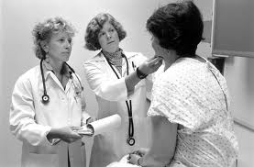
Lesson 11.8: Health care System Models
Obj. 11.8: Identify similarities and differences between major health care system models.
Module 11: Health Policy
Notes:
Overview: This lesson will expose students to a foundational understanding of health care systems used throughout the world, allowing them to better understand how the U.S. system acts as a hybrid of several systems. Students will begin by attempting to describe our health care system. Then they will discuss how our system stacks up with other countries based on cost, access, and quality. Finally, they will actively read about the four main systems.
Image source: http://en.wikipedia.org/wiki/Patient_participation

Slide 2
Do Now: Health Care System
Imagine you are speaking with a foreigner who is asking you to explain how the United States health care system works. Try to describe it in one paragraph.
Notes:
This will most likely be very challenging for students who may not have the background understanding or may lack the vocabulary to describe what they do know. Encourage students to just TRY! Once the finish, you can share a big takeaway with them: ONE possible reason that was so challenging is because our U.S. health care system is extremely complex, multi-faceted, and fragmented. Trying to explain it in one paragraph might even be impossible for an expert! :)

Slide 3
Cost, Access, Quality
Discuss with a partner: Based on what you have learned about the U.S. and other industrialized nations’ health care systems, do you think the U.S. has better OR worse health care than the rest of the industrialized world? In terms of...
COST?
ACCESS?
QUALITY?
Notes:
The preceding lesson (11.7) exposed students to an overview of the the U.S health care system outcomes compare with other industrialized nations. Have students review their notes from this lesson if they completed it. Generally, the answers are: U.S. system: a) COSTS more; b) has less overall ACCESS; and c) is higher QUALITY in extreme emergencies and complex procedures but lower QUALITY in overall preventative care and chronic disease care.

Slide 4
Health Care Systems: The Four Basic Models
Read the excerpt from PBS correspondent T.R. Reid’s book “The Healing of America: A Global Quest for Better, Cheaper, and Fairer Health Care (2009). After you read, go back and re-read it, taking notes in the table on the following page.
You can also find this excerpt at:
http://www.pbs.org/wgbh/pages/frontline/sickaroundtheworld/countries/models.html
Notes:
Main features & Countries using model:
BISMARK: It uses an insurance system -- the insurers are called "sickness funds" -- usually financed jointly by employers and employees through payroll deduction. Bismarck-type health insurance plans have to cover everybody, and they don't make a profit. Doctors and hospitals tend to be private in Bismarck countries. (Germany, of course, and France, Belgium, the Netherlands, Japan, Switzerland, and, to a degree, in Latin America.)
BEVERIDGE: Many, but not all, hospitals and clinics are owned by the government; some doctors are government employees, but there are also private doctors who collect their fees from the government. In Britain, you never get a doctor bill. These systems tend to have low costs per capita, because the government, as the sole payer, controls what doctors can do and what they can charge. (Great Britain, Spain, most of Scandinavia and New Zealand. Hong Kong, Cuba)
NATIONAL HEALTH INSURANCE: It uses private-sector providers, but payment comes from a government-run insurance program that every citizen pays into. Since there's no need for marketing, no financial motive to deny claims and no profit, these universal insurance programs tend to be cheaper and much simpler administratively than American-style for-profit insurance. National Health Insurance plans also control costs by limiting the medical services they will pay for, or by making patients wait to be treated. (Canada, Taiwan and South Korea)

Slide 5
New Info:
How is healthcare funded?
What are the main features of this model?
Parts of the world that use this model?
What part of the US system uses this model?
Strengths & Weaknesses

Slide 6
U.S. Healthcare System: A Hybrid
Explain why the U.S. is considered a hybrid model of healthcare. In your explanation be sure to include at least two examples of the health care system models that are present in the U.S. system.

Slide 7
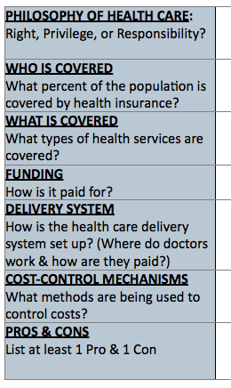
Homework: Create A Health System Model
Brainstorm a new health care system model. It can be entirely original, or it may incorporate parts of any of all of the other systems. Use the table below to plan the system, then write a 1 paragraph explanation/summary on a separate sheet of paper.
Notes:
The purpose of this homework assignment is to give students a chance to review the large amount of information they consumed and synthesize a new idea. Essentially, they should be asking themselves, “What has not been tried?”

