Slide 1
Lesson 11.7: Healthcare Models
Obj. 11.7: Identify strengths and weaknesses of the U.S. healthcare system
Module 11: Health Policy
Notes:
Overview: This lesson will provide data demonstrating how the U.S. health care system performs and compares to that of other industrialized nations. Students will begin with their own opinions. Then they will watch a documentary (Money Driven Medicine) and identify strengths and weaknesses in our system. Finally, they will work with a team to dissect and draw conclusions from a high-level comparison of 12 countries’ health cares systems.
Image source: http://www.flickr.com/photos/truthout/4402079474/

Slide 2
Do Now: Healthcare: Good or Bad?
Are you proud of our nation’s healthcare system? Or are you ashamed of it? Or does your feeling about it lie somewhere in the middle? Explain your feelings about the U.S. healthcare system in the box below. Use evidence and reasoning to support your opinion.
Notes:
This prompt uses the extremes (proud vs. ashamed) to incite an emotional connection to the topic among students. Ask students whether their own experiences or data from this module are more influential on their opinion.

Slide 3
Money-Driven Medicine
Discuss with a partner:
Do you think the expression “money-driven medicine” is an appropriate way to describe our health care system? Why or why not?

Slide 4
MDM: The Film
Watch the film, Money Driven Medicine, answering the questions below:
What is America good & not so good at when it comes to health care?
Explain the analogy: “Medicine in the US today is like…..”
What other analogy is used for insurance companies?
Should medicine work as a competitive market? Why could this be harmful? Beneficial?
How did the face of medicine change over the 20th century?
What is one reason, according to Dr. Berwick, for the outrageous expense of our healthcare today?
What is the conflict that doctors today face?
Notes:
Money Driven Medicine, a 2009 documentary (Run time: 86 minutes in entirety), can be found at: http://moneydrivenmedicine.org/
Recommendation: Do not purchase the film, but rather RENT it on Amazon.com for $1.99 for 7-days.
In case time is limited and the entire film cannot be watched (or instructor simply prefers not to show the entirety), there are a number of clips available on the site:
http://www.moneydrivenmedicine.org/video-gallery

Slide 5
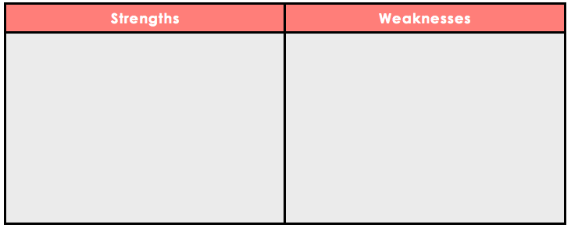
Strengths & Weaknesses
Summarize the strengths and weaknesses of the U.S. model of health care:

Slide 6
US Health System: 12-Country Comparison
1. Form a team of 4-6.
2. Review the article “The U.S. Health System in Perspective: A Comparison of Twelve Industrialized Nations,” a study sponsored by The Commonwealth Fund. Skim through to get a sense of the sections and types of data included in the report.
3. Split up the packet among group members. Each of you will read a different section and report back about your key findings.
4. Take notes in the table on the next page. Decide how to best organize your notes. Consider using a table or other graphic organizer tool.
5. After you have read your section, shared information, and taken notes, discuss the main conclusions with your team. Write your conclusion in the space below, following claim-evidence-warrant format:
Notes:
The PDF of this 14-page article is available in the resources. It can also be accessed at:
http://www.commonwealthfund.org/~/media/Files/Publications/Issue%20Brief/2011/Jul/1532_Squires_US_hlt_sys_comparison_12_nations_intl_brief_v2.pdf
Recommendation: Print one hard copy per group and have computers/tablets available for students to access online (if possible). Alternatively a class set could be made and re-used across periods.

Slide 7
US Health System: 12-Country Comparison
Notes:
Students benefit from being challenged to do their own organizing of the information, especially for a complex set of information such as this. However, for younger learners or those who may not have these higher order skills yet, one (or a few) possible organizing tool formats could be demonstrated or provided.

Slide 8
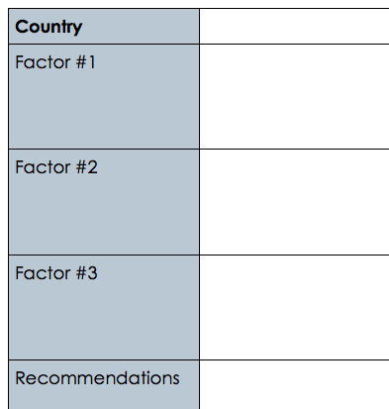
Homework: How to Improve the U.S. Health System
Based on what you have learned, select ONE nation that you feel the United States could learn the most from. For that nation’s health care system, choose three factors that make it work better than our healthcare in the U.S. Use those three factors to form a set of recommendations for the U.S. health care system.
Notes:
The purpose of this homework assignment is to have students take their learning to the next level of Bloom’s Taxonomy. They have already made a conclusion from the data with their team, but now they are being challenged to evaluate the information and make recommendations.

