Slide 1
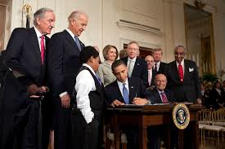
Lesson 11.5: Health Laws
Obj. 11.5: Identify evidence that supports or refutes laws that impose public health regulations
Module 11: Health Policy
Notes:
Overview: This lesson will provide students with a chance to debate laws that protect the public’s health. The lesson will primarily focus on the trans fat ban issue, by starting with background information that includes comprehension questions. Then students will complete a reading on the FDA’s trans fat decision and outline the evidence for and against the decision. Finally, they will take a final stand on the issue and then tackle some different case examples for homework.
Image source: http://en.wikipedia.org/wiki/Patient_Protection_and_Affordable_Care_Act

Slide 2
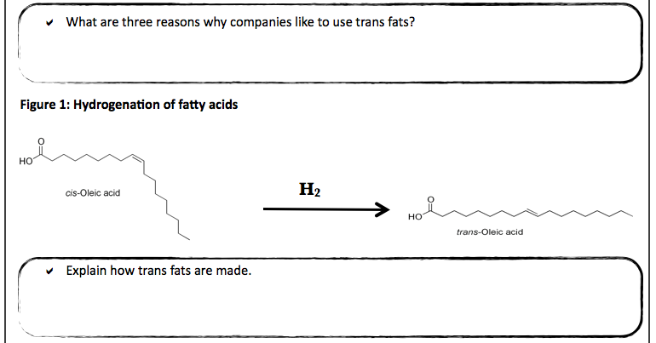
Do Now: Trans Fat
Passage 1: Trans fats (or trans fatty acids) are created in an industrial process that adds hydrogen to liquid vegetable oils to make them more solid as seen in Figure 1. Companies like using trans fats in their foods because they’re easy to use, inexpensive to produce and last a long time. Trans fats give foods a desirable taste and texture. Many restaurants and fast-food outlets use trans fats to deep-fry foods because oils with trans fats can be used many times in commercial fryers.
Source: American Heart Association <http://www.heart.org/HEARTORG/>
Notes:
Consider separating each sub-section into a “station” and having students rotate around in small groups. This is not essential to the learning, but provides students who get “antsy” sitting for long periods an opportunity to get their blood flowing!

Slide 3
Do Now: Trans Fat
A person’s diet can affect their cholesterol levels. When there is too much cholesterol in your blood, it builds up in the walls of your arteries, causing a process called atherosclerosis, a form of heart disease. The arteries become narrowed and blood flow to the heart muscle is slowed down or blocked. The blood carries oxygen to the heart, and if enough blood and oxygen cannot reach your heart, you may suffer chest pain. If the blood supply to a portion of the heart is completely cut off by a blockage, the result is a heart attack.

Slide 4
Do Now: Trans Fat
There are two forms of cholesterol: Low-Density Lipoproteins (LDL) and High-Density Lipoproteins (HDL). LDL molecules transport cholesterol through the water of a cell and through the bloodsteam. High-density lipoproteins (HDL) transport cholesterol from the cells of the arteries to the liver where it can be broken down. Studies have shown that higher levels of LDL particles increase the likelihood of atherosclerosis, while higher levels of HDL particles decrease the likelihood of this disease.

Slide 5
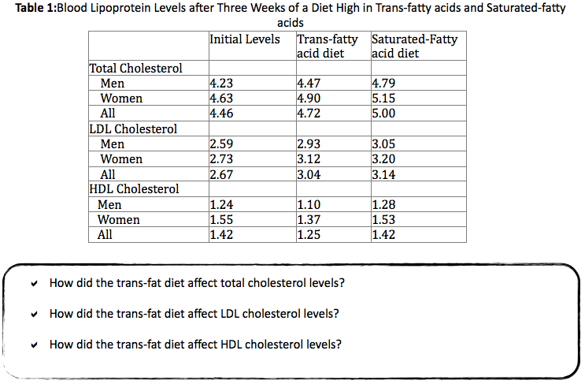
Do Now: Trans Fat

Slide 6
Discuss
1. Which of the following conclusions can be made from this study?
A high trans fat diet is more dangerous to Americans because it increases LDL and HDL levels in the blood.
A high saturated fat diet is most dangerous to Americans because it increases LDL and HDL levels in the blood.
A high trans fat diet is most dangerous to Americans because it increases LDL levels while decreasing HDL levels.
A high saturated fat diet is most dangerous to Americans because it increases LDL levels while decreasing HDL levels.

Slide 7
Regulation of Trans-Fats:
Access the article online. As you read search for evidence for and against the FDA’s actions.
Notes:
READ: Other resources:
Labeling of trans fats on nutrition label: http://www.fda.gov/Food/IngredientsPackagingLabeling/LabelingNutrition/ucm274590.htm
More background on trans fat: http://en.wikipedia.org/wiki/Trans_fat
CDC Trans Fat resources: http://www.cdc.gov/phlp/winnable/transfat.html

Slide 8
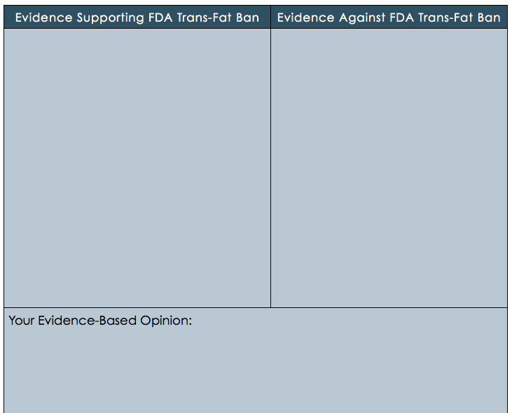
Regulation of Trans-Fats
Use the article and any other credible sources to fill in the table below.
Notes:
THINK: Have students debate. The following organizational structures could be used:
One-on-one pair debates; 2. Small group debates; 3. Whole class debates
*Make sure to set rules which requires students to participate, prevent dominance by single individuals, and encourage students to LISTEN to one another and respond & frame their comments in the scope of the discussion so that there is some flow.

Slide 9
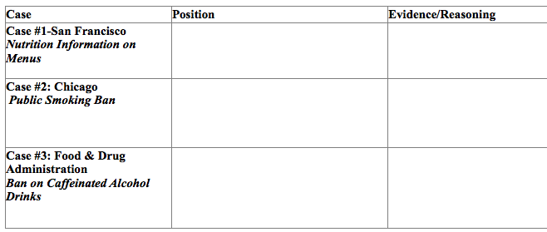
Homework: How much control over health policy should government have?
Case #1: San Francisco - Nutrition Information on Menus
Case #2: Chicago - Public Smoking Ban
Case #3: Food & Drug Administration – Ban on Caffeinated Alcohol Drinks
Notes:
This homework assignment will ensure students are exposed to other types of public health laws (since the lesson dove deeply into just one case--trans fat), while giving them an opportunity to practice taking an evidence-based stand in more contexts.

