Slide 1
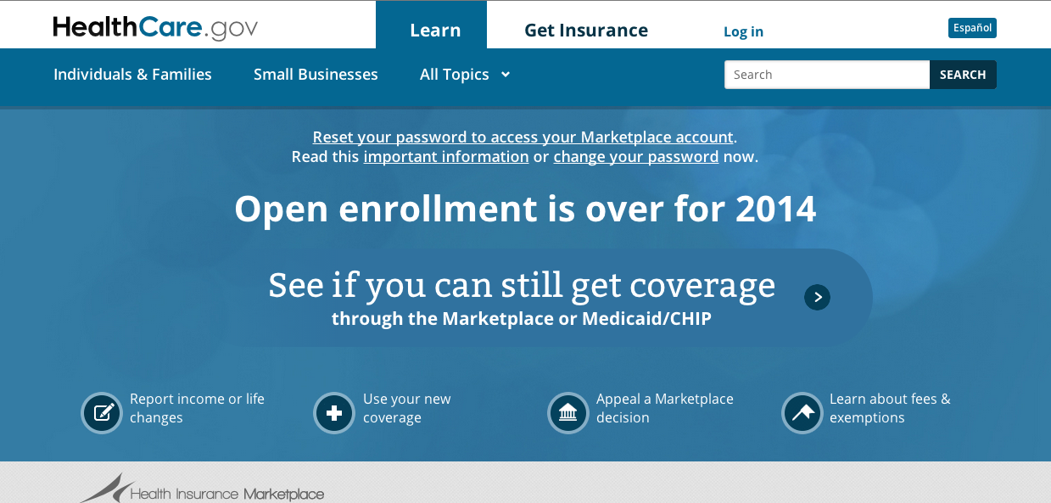
Lesson 11.4: Affordable care Act (ACA)
Obj. 11.4: Describe how the Affordable Care Act addresses concerns of health care in the United States
Module 11: Health Policy
Notes:
Overview: This lesson will carve out space for students to learn some of the basics of the Affordable Care Act. Students will begin by identifying what they already know or have heard about the ACA, both positive & negative. Then they will read about some of the central provisions that make up the ACA, visiting the website (healthcare.gov) for updates. Next they will have to identify whether the ACA would help characters in a set of scenarios.
Image source: healthcare.gov (screenshot)

Slide 2
Do Now: What do you know?
The ACA: What do you know?
Discuss with a partner what you know and/or have heard about the Affordable Care Act (ACA), also termed “Obamacare.” Include both positive and negative things you have heard in your discussion?
Notes:
Ask students what their sources of information on the ACA have been up to this point (ex: parents/relatives/friends opinions, news stories, blogs, etc.)

Slide 3
“Health Care that Works for Americans”
On March 23, 2010, President Obama signed the Affordable Care Act into law, putting in place comprehensive reforms that improve access to affordable health coverage for everyone and protect consumers from abusive insurance company practices.
Notes:
Inform students that the actual written ACA law is 906 pages long. Ask, “Why do you think it is this long? What are the consequences of the law being so long and complex?”

Slide 4
Consumer Rights and Protections
End to Pre-Existing Condition Discrimination: Insurance companies can no longer deny coverage to children because of a pre-existing condition like asthma and diabetes, providing peace of mind for parents of the more than 17.6 million children with pre-existing conditions. Starting in 2014, no American can be discriminated against due to a pre-existing condition.
End to Limits on Care: In the past, some people with cancer or other chronic illnesses ran out of insurance coverage because their health care expenses reached a dollar limit imposed by their insurance company. Under the health care law, insurers can no longer impose lifetime dollar limits on essential health benefits and annual limits are being phased out by 2014. More than 105 million Americans no longer have lifetime limits thanks to the new law.
End to Coverage Cancellations: Insurance companies can no longer drop your coverage when you get sick due to a mistake you made on your application.
Notes:
Navigate to www.healthcare.gov (on screen if possible) and show students where to find different types of information on the topics summarized in this reading.

Slide 5
More Affordable Coverage
Value for Your Premium Dollar: Thanks to the Affordable Care Act’s 80/20 rule, if insurance companies don’t spend at least 80 percent of your premium dollar on medical care and quality improvements rather than advertising, overhead and bonuses for executives, they will have to provide you a rebate. In 2012, 8.5 million people received half a billion dollars in refunds.
Stopping Unreasonable Rate Increases: In every State and for the first time ever, insurance companies are required to publicly justify their actions if they want to raise rates by 10 percent or more.
Small Business Tax Credits: Small businesses have long paid a premium price for health insurance – often 18 percent more than larger employers. The tax credit will benefit an estimated 2 million workers who get their insurance from an estimated 360,000 small employers who will receive the credit in 2011 alone.

Slide 6
Better Access to Care
Free Prevention Benefits: Insurers are now required to cover a number of recommended preventive services, such as cancer, diabetes and blood pressure screenings, without additional cost sharing such as copays or deductibles. Already, 54 million Americans with private health coverage have gotten better preventive services coverage as a result.
Coverage for Young Adults: Under the law, most young adults who can’t get coverage through their jobs can stay on their parents’ plans until age 26 – a change that has already allowed 3.1 million young adults to get health coverage and given their families peace of mind.
Coverage for Americans with Pre-Existing Conditions: Before the law, many Americans with pre-existing conditions were locked or priced out of the health insurance market. More than 50,000 Americans with pre-existing conditions have gained coverage through the new Pre-Existing Condition Insurance Plan. This temporary program makes health coverage available and more affordable for individuals who are uninsured and have been denied health insurance because of a pre-existing condition. In 2014, insurance discriminating against anyone with a pre-existing condition will be illegal.
Expansion of Medicaid: The Medicaid expansion to 138% of the federal poverty level ($15, 415 for an individual and $31, 809 for a family of four in 2012) for individuals under age 65
Affordable Insurance Exchanges: Affordable Insurance Exchanges are one-stop marketplaces where consumers can choose a private health insurance plan that fits their health needs. Starting in 2014, they will offer to the public the same kinds of insurance choices members of Congress will have. Exchanges will select health plans qualified to offer coverage; facilitate consumer assistance, shopping and enrollment; and coordinate eligibility for the Exchange and potential premium assistance. Already, 33 States and the District of Columbia are on their way to building Exchanges, having received at total of nearly $670 million in Exchange Establishment Grants.

Slide 7
Strengthening Medicare
Lower Cost Prescription Drugs: In the past, as many as one in four seniors went without a prescription every year because they couldn’t afford it. To help these seniors, the law provides relief for people in the donut hole – the ones with the highest prescription drug costs. As a first step, in 2010, nearly four million people in the donut hole received a $250 check to help with their costs. In 2011, 3.6 million people with Medicare received a 50 percent discount worth a total of $2.1 billion, or an average of $604 per person, on their brand name prescription drugs when they hit the donut hole. Seniors will see additional savings on covered brand-name and generic drugs while in the coverage gap until the gap is closed in 2020.
Free Preventive Services: Under the new law, seniors can receive recommended preventive services such as flu shots, diabetes screenings, as well as a new Annual Wellness Visit, free of charge. So far, more than 32.5 million seniors have already received one or more free preventive services, including the new Annual Wellness Visit.
Fighting Fraud: The health care law helps stop fraud with tougher screening procedures, stronger penalties, and new technology. Thanks in part to these efforts, we recovered $4.1 billion in taxpayer dollars in 2011, the second year recoveries hit this record-breaking level. Total recoveries over the last three years were $10.7 billion. Prosecutions are way up, too: the number of individuals charged with fraud increased from 821 in fiscal year 2008 to 1,430 in fiscal year 2011 – nearly a 75 percent increase.
Improving Care Coordination and Quality: Through the newly established Center for Medicare and Medicaid Innovation, this Administration is testing and supporting innovative new health care models that can reduce costs and strengthen the quality of health care. So far, it has introduced 16 initiatives involving over 50,000 health care providers that will touch the lives of Medicare and Medicaid beneficiaries in all 50 states.
Providing Choices while Lowering Costs: The number of seniors who joined Medicare Advantage plans increased by 17 percent between 2010 and 2012 while the premiums for such plans dropped by 16 percent – and seniors across the nation have a choice of health plans.

Slide 8
ACA Scenario #1
Scenario #1: Marcus is 23 years-old who has recently enrolled in college. After high school, he was dropped from his parents’ insurance plan because he was not a full time student, and the part-time job he was working did not offer any health insurance. How will Marcus benefit from the Affordable Care Act?
Notes:
The ACA will allow him to be covered on his parents’ plan until age 26.

Slide 9
ACA Scenario #2
Scenario #2: Bob has diabetes and spends a lot of money each month on his insulin and diabetic testing equipment. When he lost his job in 2000, he could not afford the monthly premiums of his health insurance plan without his employer’s assistance. After Bob was dropped from his health insurance, he could not find another plan that would cover him due to his diabetes. How will Bob benefit from the Affordable Care Act?
Notes:
Among other benefits, Bob will not be excluded from any plan or charged more because of his pre-existing condition.

Slide 10
ACA Scenario #3
Scenario #3: Sally is 60-years-old and she routinely does not get mammograms to check for breast cancer because she could not afford the cost of the test even with her insurance plan. How will Sally benefit from the Affordable Care Act?

Slide 11
ACA Scenario #4
Scenario #4: Maria works two part-time jobs. She makes a total salary of $14,232, which has been above 100% of the poverty line. Since she does not have any children, she has not qualified for Medicaid at this income level. How will Maria benefit from the Affordable Care Act?

Slide 12
Homework: Weighing Choices for Coverage
Scenario #5: Bob has high blood pressure and takes a preferred formulary prescription that he must refill each month. Without insurance his blood pressure mediation would be $356.
Scenario #6: Last year the only health expense the Anne had was the co-pay for her yearly physical (preventative) and her monthly birth control prescription which was a preferred generic prescription (birth control will be 100% covered, without co-payments in 2014).
Scenario #7: Sally is expecting a child in March. The cost of delivering a child (maternity coverage) is about $10,000.
Notes:
The purpose of this homework assignment is to give students a challenge that portrays real life. Making complex decisions and using data/evidence to do cost-benefit comparison is a skill that translates to life and almost any job.

