Slide 1
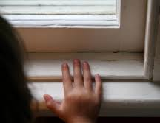
Lesson 10.6: Lead Poisoning
Obj. 10.6: Explain common sources and prevention methods for childhood lead poisoning.
Module 10: Environmental Health
Notes:
Overview: This lesson will equip students with a strong foundational understanding of the health hazards of lead--both where it originates and how to prevent it. Students will begin by analyzing trends in blood lead level testing and results since 1997. Then they will read the CDC website information on lead poisoning prevention and answer reading comprehension questions. Next they will discuss the role of lack of knowledge as a risk factor. Finally, students will read a tragic case study of a child who died from acute lead poisoning and debrief the details of the case.
Image source: http://www.besthomepro.com/blog/post/new-regulations-regarding-lead-paint-highlight-hazards-for-homeowners

Slide 2
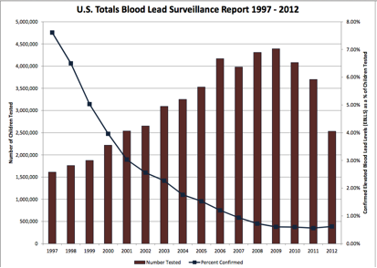
Do Now
1. How has testing for elevated blood lead levels changed over the 15 years represented in this graph?
2. How have the percentage of confirmed elevated blood lead levels changed over the 15 years represented in this graph?
3. During what 5-year period did percentage of elevated blood lead levels drop the most?
4. Name some factors that might be responsible for these trends.
Source: CDC <http://www.cdc.gov/nceh/lead/data/StateConfirmedByYear_1997_2012.pdf>
Notes:
Answers:
1. The number of children tested increased steadily between 1997 and 2009, then dropped between 2009 and 2012.
2. The percentages of confirmed elevated blood lead levels decreased significantly (from 7.5% to 2.5% from 1997 to 2003. Then it has continued to decrease, but more gradually from 2003 to 2012).
The biggest drop occurred from 1997 to 2002.
Increasing testing may have happened because of increasing awareness, public health education campaigns, or changing guidelines for schools and pediatricians in terms of what data they must gather from children. Decreases in elevated levels may be due to the decrease in homes with lead based paint (as more time passes, fewer homes will have the old lead-based paint present). It may also be due to increasing awareness and preventative measures taken by parents, schools, health care providers, and communities, as well as changing regulations for consumer products, especially those that target children.

Slide 3
Preventing Lead Exposure
According to the CDC, “Today at least 4 million households have children living in them that are being exposed to high levels of lead. There are approximately half a million U.S. children ages 1-5 with blood lead levels above 5 micrograms per deciliter (µg/dL), the reference level at which CDC recommends public health actions be initiated. Lead exposure can affect nearly every system in the body. Because lead exposure often occurs with no obvious symptoms, it frequently goes unrecognized.”
http://www.cdc.gov/nceh/lead/tips.htm
Notes:
IF laptops, computers, or tablets are not available for students to go online to read the full resource, copies of the PDF handout can be used.

Slide 4
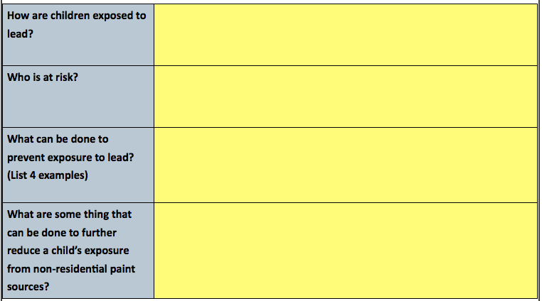
Preventing Lead Exposure
http://www.cdc.gov/nceh/lead/tips.htm
Notes:
See website for answers.

Slide 5
What Do Parents Know?
Do you think most parents are know the information you just read?
Which parts of the information might be more or less understood by the general public?
How do you think knowledge on this topic acquired by parents and guardians?
Should further efforts to educate parents and guardians take place? If so, how?
What other factors besides education may act as barriers for parents from making their home safe from lead hazards?
Notes:
Ask students to share answers to the last question. Barriers such as poverty, lack of accessibility to services to help inspect or adjust home to meet standards, etc. are a big factor!

Slide 6
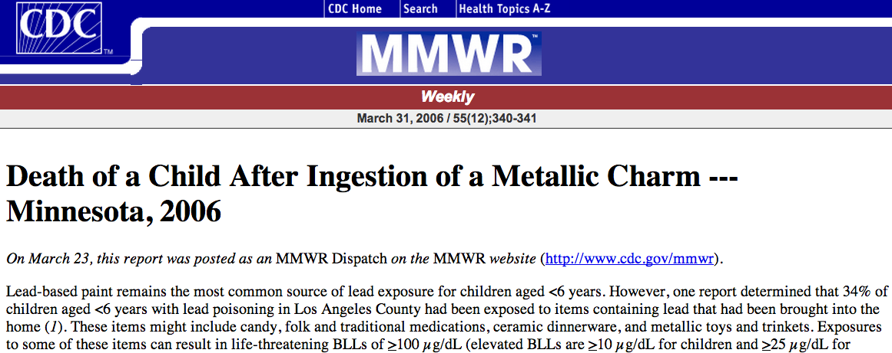
Case Study
Read the case study “Death of a Child After Ingestion of a Metallic Charm --- Minnesota, 2006” from the CDC MMWR report
Source: http://www.cdc.gov/mmwr/preview/mmwrhtml/mm5512a4.htm
Notes:
Since one big takeaway of the previous reading is that lead-based paint in older homes is the biggest contributing factor, this case study will help students understand that there are many other potential lead-based hazards children may come be exposed to.

Slide 7
Case Study Debrief
Answer the following questions based on the case study.
1. What blood lead levels (BLL) are considered elevated for children?
2. What are some possible sources of exposure to lead besides paint that were mentioned?
3. How did the child in the case study die?
4. What was the child’s BLL at death?
5. What were the results of the inspection of the boy’s home?
6. What did CDC scientists find when they purchased and tested charms like the one the boy ingested?
Notes:
ANSWERS:
10 ug/dl
Candy, folk & traditional meds, ceramic dinnerware, metallic toys and trinkets, jewelry
The child ingested a metal heart locket which had an exceptionally high level of lead
He had a BLL of 180 ug/dl
There were no lead-paint hazards in the home and only one slightly elevated lead-dust level on a windowsill
They found a great deal of variation in the lead contents of the various lockets.

Slide 8
Assess: Lead Poisoning
Fill in the table below with information about lead poisoning.

Slide 9
Assess Your Home
Gather information about possible lead hazards in your own home by talking with your parents and doing any further research. Make a list of the possible hazards and prevention strategies already being used in your home.

