Slide 1
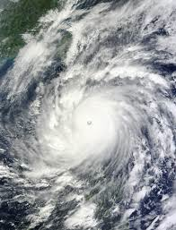
Lesson 10.5: Climate & Health
Obj. 10.5: Influence others to make positive choices with respect to climate and health.
Module 10: Environmental Health
Notes:
Overview: This lesson will give students space to consider, research, and make informed conclusions about climate change and its impact on health. Students will begin by identifying their own current knowledge and questions on the topic. Then they will work with a partner to brainstorm all the ways they think climate might affect health. Next students will read about the climate and health, answering guiding questions along the way. Finally students will diagram how the climate affects health and engage in a challenge to prioritize and market a particular aspect of climate change and health that will appeal to a target audience, be compelling, and have the potential to make a change in the health of our climate and/or ourselves, as a result.
Image source: NASA image by Jeff Schmaltz, MODIS Rapid Response Team, Goddard Space Flight Cente
(http://en.wikipedia.org/wiki/File:Megi_2010-10-18_0235Z.jpg)

Slide 2
Do Now: Climate K-W Chart
What do you KNOW and WANT TO KNOW about the relationship between climate and health?
Notes:
Encourage students to treat this as a free-write. Try to continuously write in the amount of time given, in order to keep their brains flowing and moving. There are no right or wrong answers!

Slide 3
Discuss
How does the climate affect our health?
With a partner, list as many ways as you can come up with in the box below:
Notes:
Some good background sources:
http://www.cdc.gov/climateandhealth/
http://www.cdc.gov/climateandhealth/effects/default.htm
http://ephtracking.cdc.gov/showClimateChangeLanding.action
http://ephtracking.cdc.gov/QueryPanel/EPHTNQuery/EPHTQuery.html?c=CC&i=-1&m=-1#

Slide 4
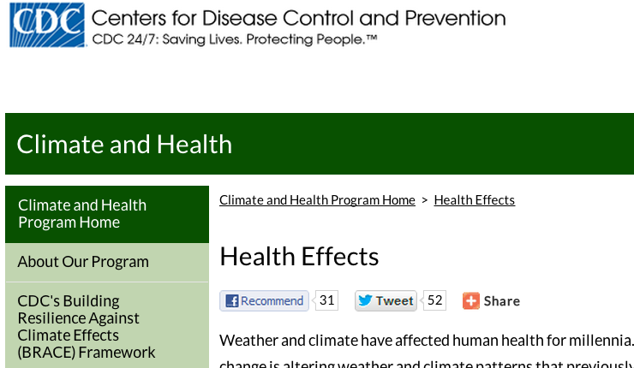
Climate & Health
A. Go to the CDC site:
http://www.cdc.gov/climateandhealth/effects/default.htm
B. Read about Climate & Health, answering the questions below as you read.
What is climate change?
What is happening to the world’s climate currently?
What potential health effects can be caused by the changing climate?
How might higher temperatures lead to increasing respiratory disease?
What types of extreme weather events can pose risks to humans?
Name two other indirect exposures and effects from climate change.
Notes:
Ask students, “Who is responsible for the climate?” Likely, answers will be that we all our, or a variety of entities are—citizens, government, businesses, organizations, etc. Push students to be clear about WHO is responsible for WHAT.

Slide 5
Potential Climate Change Health Effects
With a partner, select one possible climate change health effect and draw a diagram of how it can occur in relation to climate and health.
Heat-Related Morbidity and Mortality
Asthma, Respiratory Allergies, and Airway Diseases
Vectorborne and Zoonotic Diseases
Cardiovascular Disease and Stroke
Weather-Related Morbidity and Mortality
Foodborne Diseases and Nutrition
Waterborne Diseases
Human Developmental Effects
Mental Health and Stress-Related Disorders
Neurological Diseases and Disorders
Cancer
Notes:
Diagram will help students see better understand the connections and dig deeper in their research, if needed.

Slide 6
Climate & Health Advocacy
Challenge: You and your partner are consultants who work for an innovative marketing group. You are given a $1 million budget from a private donor who is interested in convincing the public to take action to reduce climate change, and thus improve health.
What manmade aspect of climate change will you target?
Who is your target audience?
What actions would you like them to change or start doing?
What information needs to be communicated?
How can that information be communicated in a compelling way to your audience?
What is unique or innovative about your idea for an intervention?
Notes:
One example: The push to reduce/eliminate unnecessary idling of cars/vehicles. http://idlefreevt.org/idling-facts.html

Slide 7
Homework: Gather Feedback!
Present your idea to a family member, friend, or any community member. Ask for their positive and constructive feedback and suggestions.
1. Positive Feedback:
2. Constructive Feedback:
3. Questions:
Notes:
The purpose of this homework assignment is to get students to take ownership of their work, learn from others’ positive/constructive feedback, and reflect critically upon their own ideas, evidence, and plans. If possible, have each team meet at the start of next class to share the feedback they received with fellow teammates, and even possibly with the entire class.

