Slide 1
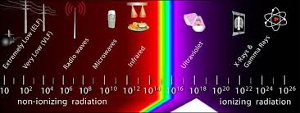
Lesson 10.4: Radiation
Obj. 10.4: Identify various sources of radiation exposure.
Module 10: Environmental Health
Notes:
Overview: This lesson will give students an introduction to radiation, a concept that many students misunderstand. First, students will attempt to identify which of a series of objects might be sources of radiation. Then they will discuss where they’ve seen representations of radiation in the media. Next, students will gather basic background information about the types of radiation. Following this, they will break into teams posing as scientists and public health planners, specialize in one type of radiation emergency, and prepare and present a summary and strategic emergency preparedness plan to their peers.
Image source: http://commons.wikimedia.org/wiki/File:OSHA_radiation_spectrum.jpg

Slide 2
Do Now: Radiation Sources
Circle any of the following items that can expose humans to radiation
Water
Airport security scanners
Sunlight
Food
Medical procedures
Air
Nuclear weapons test fallout
Computers
Cell phones
Rocks and soil
Notes:
Answer: All of these are sources of radiation. Explain to students that some of these give off very small doses of radiation, while others give off much higher doses. Ensure that students don’t walk away from this discussion afraid of rocks, soil, food, and air! ☺

Slide 3
Radiation in the Media
Discuss with a partner the various representations of radiation and its impact on health that you have seen in the media (think about movies, television shows, video games, the news, etc.)
Notes:
Examples: News—Fukushima; Movies--The China Syndrome (1998); Video games—Fallout 3, etc.
Students may get stuck and not be able to think of anything; in this case, encourage them to think about where their knowledge (even as limited as it may be) about radiation has come from (perhaps the only source they can trace back to is a basic science class in school. That’s ok!)

Slide 4
Types of Radiation
There are two types of radiation: ionizing and nonionizing. What is the difference?
Non-ionizing radiation has less energy than ionizing radiation. We use it for common tasks like microwave radiation to heat food, infrared radiation lamps at restaurants to keep food warm, and broadcasting via radio waves.
The most energetic form of radiation is ionizing radiation. Higher frequency ultraviolet radiation begins to have enough energy to break chemical bonds. It has enough energy to strip off electrons or, in the case of very high-energy radiation, break up the nucleus of atoms. Ionizing radiation is used to generate electric power, treat cancer, take x-rays and disinfect medical instruments.
Notes:
For more information, see: http://www.epa.gov/rpdweb00/understand/ionize_nonionize.html, http://en.wikipedia.org/wiki/Non-ionizing_radiation, https://www.osha.gov/SLTC/radiation_nonionizing/, http://science.howstuffworks.com/radiation2.htm

Slide 5
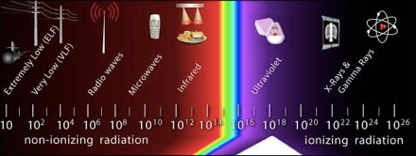
Types of Radiation
Examine the picture in order to see the relative strength of each type of radiation.
Notes:
Image source: http://commons.wikimedia.org/wiki/File:OSHA_radiation_spectrum.jpg

Slide 6
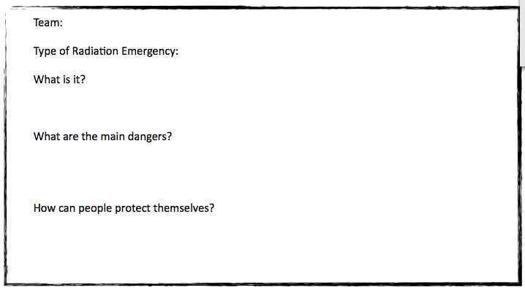
Radiation Emergencies
Challenge: You are a team of radiation experts working for the government. You must present a strategic plan to prevent and respond to a radiation emergency. You must include clear information about what the radiation emergency is, what the main dangers are, and how people can protect themselves, at the very minimum.
Go to: http://emergency.cdc.gov/radiation/typesofemergencies.asp
Read about your assigned radiation emergency on this site, then continue your research on any other credible websites you can find.
Notes:
Ask students, “Are these types of emergencies very common? If not, how uncommon? Do you think most people know what to do in the case of these emergencies? Do you think most governments, schools, organizations, hospitals, etc. prepared for these types of emergencies? Why or why not?”

Slide 7
Present & Learn:
Present your information in a roundtable conference with other experts in the field, taking notes in the table.
Notes:
Allow the audience to pose questions. Remind presenters that it is better to admit you don’t know the answer or did not find information about something, rather than to make something up.

Slide 8
Homework: Cell Phones & Cancer!?
Does Cell Phone Use Lead to Cancer?
Research this question and write a 1-3 paragraph response based on the evidence you find.
Notes:
Remind students to be sure to use only CREDIBLE, established sources. Show examples! Examples: Credible sources = http://www.cdc.gov/nceh/radiation/cell_phones._FAQ.html OR http://www.cancer.gov/cancertopics/factsheet/Risk/cellphones Possibly non-credible source: http://www.antenna-theory.com/tutorial/cancer/cellphone.php (who wrote it, what organization, what credentials, etc.)

