Slide 1
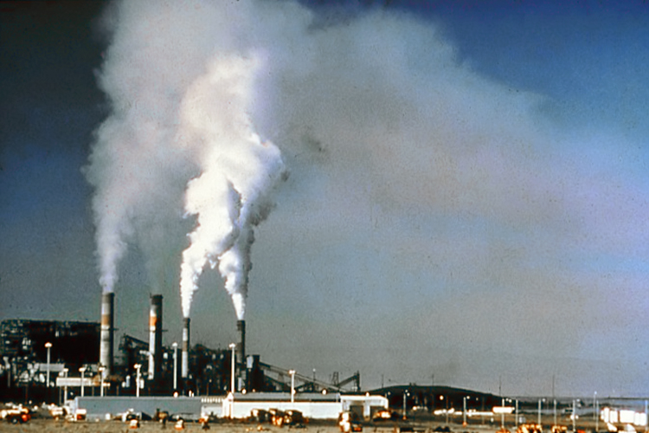
Lesson 10.3: AIR QUALITY
Obj. 10.3: Explain how air quality impacts our health
Module 10: Environmental Health
Notes:
Overview: This lesson will provide students with a more tangible understanding of how the air we breathe can be harmful to our health, by exploring the two key threats in our air: ozone & particle pollution. Students will begin by brainstorming what is in the air we breath. Then they will discuss some challenging questions with a partner. Next they will read about ozone and particle pollution on the State of our Air (American Lung Association website) and take notes, as well as the current year’s report. Finally, students will look up the air quality grades and statistics for their own zipcodes and examine possible ways the problem can be reduced through actions at the individual community, and national level.
Image source: Wikimedia Commons, http://en.wikipedia.org/wiki/File:Air_.pollution_1.jpg

Slide 2
Do Now: What’s in the Air We Breathe?
The average person takes in about 28,800 breaths per day! The quality of the air we breath affects our lung and respiratory health. When we breath in poor quality air over time, we can develop or worsen chronic disease. Brainstorm: What makes up the air we breath? What harmful gases or particles might be in the air we breath? Write your ideas in and/or around the cloud below.
Notes:
For more information on what actually is in the air we breath, visit: http://www.airlifeone.com/HEPA500air.html and read the section entitled, “So what is in the air we breath?”

Slide 3
Caretakers of the Air
With a partner, discuss the following questions. Record your ideas.
1. Who is responsible for the air we breathe? What roles do individuals, communities, organizations, the government, companies, etc. have?
2. If you found out that your home and/or school were located in areas with dangerous levels of air pollution, what would you do?
Notes:
Their answers to question #2 can be re-visited at the end of the lesson when they find out the actual air quality in their own zip code.

Slide 4
Ozone & Particle Pollution
Read the following introduction to air pollution from the American Lung Association’s website. Then navigate to the site at http://www.stateoftheair.org/2014/health-risks/ to complete the table below.
Two types of air pollution dominate in the U.S.: ozone and particle pollution¹ These two pollutants threaten the health and the lives of millions of Americans. Thanks to the Clean Air Act, the U.S. has far less of both pollutants now than in the past. Still, more than 147.6 million people live in counties where monitors show unhealthy levels of one or both—meaning the air a family breathes could shorten life or cause lung cancer.
So what are ozone and particle pollution? (Take notes from the website in the table below!)
Notes:
More excellent information on air quality can be found at: http://www.cdc.gov/air/default.htm

Slide 5
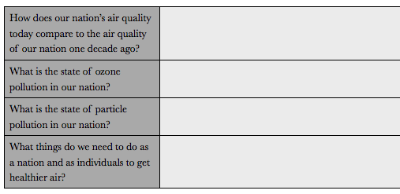
State of the Air
Read the “Key Findings” from the State of the Air report by the American Lung Association. Navigate to http://www.stateoftheair.org/2014/key-findings/ and click on the various subsections. Then answer the questions below:
Notes:
Consider searching for a recent news article about air quality and sharing with students. One example, from April 2014: http://www.usatoday.com/story/news/nation/2014/04/30/nations-air-quality-worsens/8466889/

Slide 6
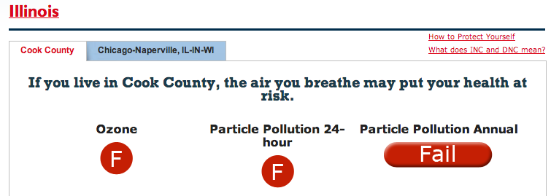
What is the State of Your Air?
1. Go to http://www.stateoftheair.org/
2. Type in your zipcode under “What is the State of Your Air?”
3. Answer the following:
What grade does your location get for Ozone? ______
What grade does your location get for 24-hr particle pollution? ______
What change in ozone and particle pollution has occurred in your area?
Notes:
Be sure students click on “How is my grade calculated?” to read an explanation of how to interpret the results and the data report to see graphs depicting more data.

Slide 7
Do You Know Your Types of Air Pollution?
1. Define particle pollution. Explain how it impacts health.
2. Define ozone. Explain how it impacts health.
Notes:
1. Ozone (O3) is a gas molecule composed of three oxygen atoms. Often called "smog," ozone is harmful to breathe. Ozone aggressively attacks lung tissue by reacting chemically with it.
2. Particle pollution refers to a mix of very tiny solid and liquid particles that are in the air we breathe. Particle pollution can be very dangerous to breathe. Breathing particle pollution may trigger illness, hospitalization and premature death, risks showing up in new studies that validate earlier research.

Slide 8
Homework: Reflect Upon the State of Your Air
How is the air quality in your zip code? Did the results surprise you?
Is it getting better or worse?
What can you do to help improve the air quality?
Share the results with a family member or friend. Explain what they can do to help. What was their reaction?
Notes:
The purpose of this homework assignment is to get students to reflect, share, and act upon the realities of air quality in their community.

