Slide 1
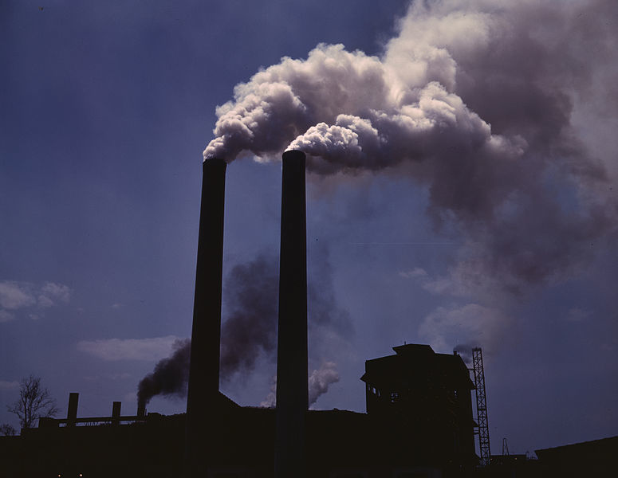
Lesson 10.1: Intro to Enviro Health
Obj. 10.1: Identify various non-infectious environmental factors that may be a danger to our health.
Module 10: Environmental Health
Notes:
Overview: This lesson will launch students into the realm of environmental health issues. Students will begin with a brainstorming exercise to tap into their own knowledge base and background. Then they will compare with other students and think critically about the role of humans in the environmental factors that affect our health. Next students will read an excerpt from the NCEH website describing the scale of environmental health and the role their organization plays. Finally, as a way to internalize the many facets of environmental health, students will come up with icons for each program within the NCEH as they read an overview of that aspect of the NCEH’s work.
Image source:

Slide 2
Environmental Health Brainstorm
How does the environment around you (both natural and man-made) influence your health? List all the ways you can think of in the tree below.
Notes:
Example answers: food availability, pesticides on food, pesticides in homes/buildings/outdoors, jobs available, condition of homes, schools, & workplaces (mold, asbestos, lead paint, etc.), hazards (chemicals, fire, biological, etc.), natural disasters & weather conditions, air quality & pollution, water quality, etc.

Slide 3
Discuss
1. Compare your list with a small group. Circle any issues on your list that at least one other person in the group also came up with.
2. Which type of environmental factors came up more commonly on your lists--natural ones or man-made ones?
3. What role do you think humans have in the state of our environmental health?
Notes:
Answers will vary.

Slide 4
What is Environmental Health & Who is the NCEH?
“The environment is everything around us - the air we breathe, the water we drink and use, and the food we consume. It's also the chemicals, radiation, microbes, and physical forces with which we come into contact. Our interactions with the environment are complex and are not always healthy. We at the National Center for Environmental Health, also known as NCEH, are working to prevent illness, disability, and death from interactions between people and the environment. We are especially committed to safeguarding the health of populations that are particularly vulnerable to certain environmental hazards - children, the elderly, and people with disabilities…
The scope of our work is worldwide, from protecting health during emergencies both in the United States and abroad to protecting the health of the public visiting U.S. national parks and taking cruises on ships that dock in U.S. ports. Since environmental problems cross geographic boundaries, and since lessons learned in helping other countries can be used to understand and address U.S. public health problems, we have established a global health office to coordinate and expand our global activities.”
Source: NCEH Website <http://www.cdc.gov/nceh/information/about.htm>
Notes:
Ask students if they know what the EPA is. Go to the EPA’s website to give students a quick overview. Ask students how the NCEH and EPA have different roles. Ask students if the roles are complementary.

Slide 5
Work at the NCEH
Based on the reading above, come up with three different job titles that might represent work done at the NCEH.
1)
2)
3)
Notes:
Examples: 1) Air quality engineer (tests air quality and provides recommendations for businesses and development); 2) Researcher focusing on the epidemiology of exposure to lead among children in low-income areas; 3) Data analyst compiling and reporting on aggregate data from all state and local health departments

Slide 6
Environmental Health Focus Areas
Read through the main program areas at the NCEH. For each one, draw a simple picture that can serve as an icon representing it.
National Asthma Control Program
Built Environment & Health Initiative
Climate and Health Program
Environmental Health Laboratory
Core Environmental Health Services
Environmental Public Health Tracking Network
Healthy Homes/Lead Poisoning Prevention Program
Radiation
Safe Water Programs
Agency for Toxic Substances and Disease Registry
?
Notes:
As students come up with icons for each program within the NCEH (as they read an overview of that aspect of the NCEH’s work), they should be internalizing the many facets of environmental health.

Slide 7
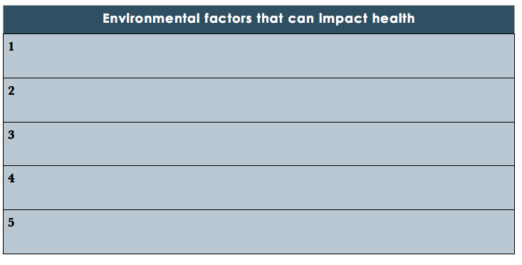
Environmental Health Factors
List 5 environmental factors (natural or man-made) that may impact our health.
Notes:
Answers will vary.

Slide 8
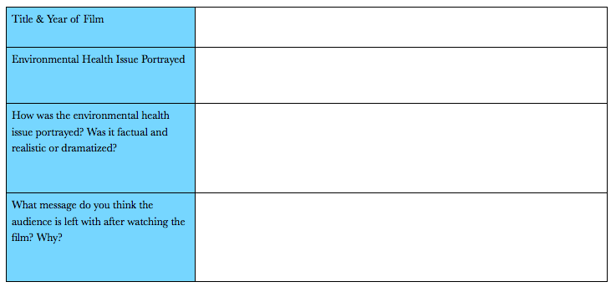
Homework: Environmental Health in Hollywood!
Search for a movie or documentary that features an environmental health issue. If possible, watch it. If unable to watch it, read a description online or watch a clip or trailer on youtube. Then answer the questions in the table below.
Notes:
The purpose of this homework is to get students engaged in how this health issue is portrayed by Hollywood. Ask students to briefly share at the start of the next class. Ask if they think the environmental health issues are misrepresented, or whether certain issues are “hot” while others are ignored.

