Slide 1
Lesson 1.8: The SOAP Note
Unit 1: Mental Health
Notes:
This lesson will introduce students to the SOAP note, the note-taking tool used by medical professionals. The note has four distinct parts—the Subjective, Objective, Assessment, and Plan sections. Students will not be expected to master the use of the SOAP note initially, but rather gain a familiarity with it’s parts. The first two patient case studies (PTSD and anorexia) will emphasize the Subjective and Assessment sections and future units will delve more deeply into each of the four sections to guide students toward proficiency with the tool. In this lesson, students will first answer SOAP-related questions for a scenario in which a baseball player breaks a leg. They will then read about the SOAP note and read descriptions of what each section means. After looking at an example SOAP note, students will be assessed and complete homework where they devise effective questions for parts of the Subjective section.
Image Source: http://www.ndtv.com/photos/health/doctor-s-day-the-doctor-patient-relationship-7669

Slide 2
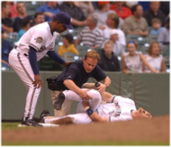
Do Now
Use this image to answer questions 1-4 on your worksheet:
1. Questions
2. Observations
3. Diagnosis
4. Treatment
Notes:
Possible Answers
Questions: How does it feel? How were you moving right before it happened? Have you ever injured anything before? Are you allergic to anything (in order to be able to quickly administer pain medication when paramedics arrive on scene)? Questions to establish that the patient has not had head injury: do you know where you are? What day it is? Who is the president? etc.)
Observations: Foot is bent at an abnormal angle, patient is holding leg on ground and writhing in pain, patient is yelling and screaming, any movement might be painful; when closer it can be established whether or not a bone is protruding (if not, can palpate to feel the fracture)
Diagnosis: Broken ankle and possibly torn Achilles tendon
Treatment: Immediate transportation to hospital, x-rays, casting and rest for several weeks/months,pain medications to manage pain, mental health counselor to ensure disruption to job and career is being worked through in a healthy way

Slide 3
Discuss
With a partner, share your responses. Then, imagine you are a doctor and the injured patient in the picture is only one of thirty patients you see in a day. Discuss the ways that you think medical professionals handle large amounts of information and data.
Notes:
Ask students to share responses. They may bring up note-taking or record-keeping, electronic medical records, informal note-taking and mental note-taking, etc.…

Slide 4
What is the SOAP Method?
As you read, be ready to share a description of each section, in your own words:
Subjective:
Objective:
Assessment:
Plan:
Notes:
Stop after each section of the reading and review. Type short definitions in students own words, if possible, on the slide or write on the board. Use this opportunity to correct any misunderstandings or confusions. The trickiest part may be differentiating S & O. S = information from the patient; O = data and FACTS collected by the medical care team

Slide 5
Post-Reading Questions:
1. What are SOAP notes and why are they used?
2. What are the differences between the Subjective and Objective sections?
3. What are the main components of the Assessment section?
4. What do you think differentiates a successful and effective Plan from an unsuccessful or ineffective one?
Notes:
Review using the reading. For question 4, look ahead to the description in the Plan box to help students elaborate on their answers if they are stuck.

Slide 6
Post-Reading Check Answers:
1. Subjective
2. Objective
3. Assessment
4. Plan
Notes:
Students should accurately label all four sections. This is not intended to be an assessment, hence all four appear in order. If any students are still struggling, ensure that their misunderstandings are corrected.

Slide 7
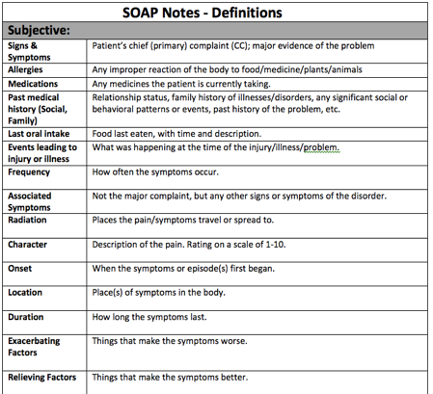
What’s in a SOAP Note? (SUBJECTIVE)
A SOAP note may be organized in many different ways. Let’s review the guided template we will begin using in our first case study.
Notes:
Note: The acronyms SAMPLE and FARCOLDER summarize the questions in the Subjective section. They are listed in this order, but it is important to remind students that real health care providers often do not follow this order. In addition, there will be times when certain questions do not apply. The FARCOLDER questions are designed to get a patient to elaborate on a symptom (usually pain somewhere in the body), but they can often be applied to different type of situations. Sometimes a question like, “Where does the pain/symptom move to?” (Radiation) just won’t make sense and can be skipped.

Slide 8
What’s in a SOAP Note? (OBJECTIVE)
A SOAP note may be organized in many different ways. Let’s review the guided template we will begin using in our first case study.
Notes:
Over time, students will be introduced to the different types of physical exam components and lab tests that medical professionals use. For now, they don’t need to have background information here but do give them an opportunity to share examples of different tests/exams/labs that they are familiar with. Once a few students get going, chances are all of them will get on a roll and be able to contribute an example.

Slide 9
What’s in a SOAP Note? (ASSESSMENT)
A SOAP note may be organized in many different ways. Let’s review the guided template we will begin using in our first case study.
Notes:
The assessment is designed to contain the evidence-based SOLUTION/ANSWER to the patient’s problem, but it is important for students to understand that medicine is an IMPERFECT science and that the body and disease process sometimes deviate from what is known or expected. Therefore, even in cases where it “seems” certain that a diagnosis is the only thing it could be, doctors are always asking, “What else MIGHT it be?” and doing tests to rule other things out. This is a VERY important big idea for students to internalize!

Slide 10
What’s in a SOAP Note? (PLAN)
A SOAP note may be organized in many different ways. Let’s review the guided template we will begin using in our first case study.
Notes:
For the Plan, a good rule of thumb is often, “the more detailed the better.” Obviously, the patient cannot be expected to comprehend or effectively enact a treatment plan that is TOO complicated. But in order to cover the bases of all aspects of health (mental, social, physical), it is best to encourage students to be very detailed and thorough in this section. LATER on in future modules, they will have a chance to delve into the problems of poor health literacy, impact of poverty on health, and poor adherence to treatment plans, but for now they should just be as comprehensive as they can be.

Slide 11
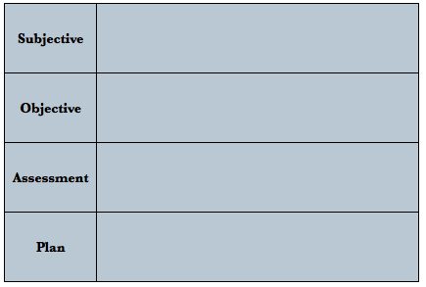
Any Questions?

Slide 12
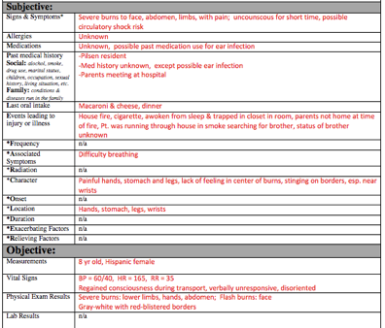
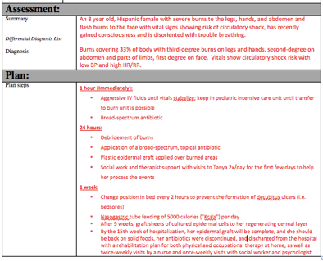
Example SOAP Note:
Notes:
This example is for a young girl who suffered severe burns following a house fire. Before students begin (or after), use the analogy of the SOAP note telling the patient’s story. The more we know, the better we understand her entire health picture and can treat her.

Slide 13
Any Questions?

Slide 14
S, O, A, or P?
1. WT = 210 lbs, HT = 60, BW = 115 lbs, Chol = 255, BP = 140/95
2. Obese at 183% BMI, hypercholesterolemia, hypertension.
3. Long Term Goal: Change lifestyle habits to lose at least 70 pounds over a 12 month period. Short Term Goal: Client to begin a 1500 Calorie diet with walking 20 minutes per day. Instructed Pt on lower fat food choices and smaller food portions. Client will keep a daily food and mood record to review next session. Follow-up in one week.
4. Pt. states that she has always been overweight. She is very frustrated with trying to diet. Her 20-year class reunion is next year and she would like to begin working toward a weight loss goal that is realistic.
Notes:
Answers:
Objective
Assessment
Plan
Subjective

Slide 15
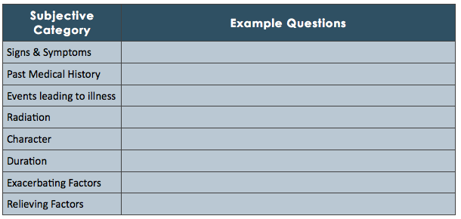
Homework:
Fill in the following chart with example questions that an excellent doctor would ask when obtaining a person’s Subjective information. The patient has come in because she is experiencing major headaches.
Notes:
The goal of this homework assignment is for students to begin practicing the skill of asking effective questions. Allow students to brainstorm (either before completing the homework or after) what makes an effective question from a physician. Questions should be open-ended (whenever possible), unbiased/fair, clear, simple, and not double-barreled (only asking one thing at a time).

