Slide 1
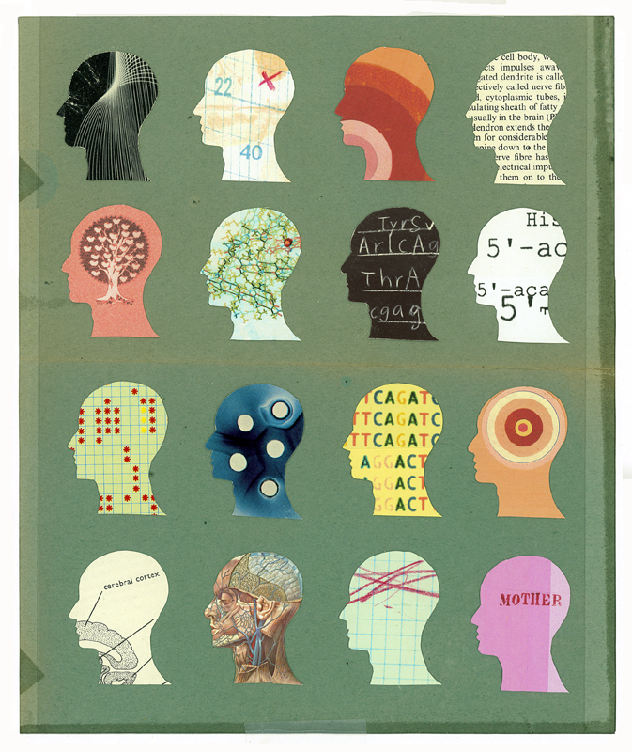
Lesson 1.7: Mental Illness
Unit 1: Mental Health
Notes:
In this lesson, students will learn that mental illnesses are diagnosed by their symptoms, through studying the way they are organized and examining some common mental illnesses. Students will begin with a data set showing the incidence of various mental illnesses before and after Hurricane Katrina. Then students will read two short passages about mental illnesses and how they are organized. Next, they will examine the symptoms for a handful of common mental illnesses. Throughout these presentations of information, students will periodically pause to discusses questions such as, “What makes mental illness often difficult to diagnose?” Finally, students will use this knowledge of common illnesses and symptoms to diagnose two patients in hypothetical scenarios.
Image source: http://thefeministwire.com/2012/03/forum-on-mental-health-and-illness/

Slide 2
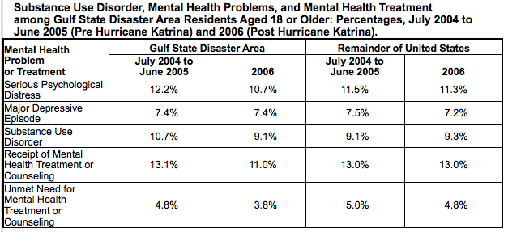
Do Now
Answer Questions 1-4 using this data set.
Notes:
This is a simple data presentation, but students who struggle with data analysis should: 1) be directed to the title and the row/column headers; 2) write or verbalize the purpose of the table…what trends might researchers have suspected they would see; 3) marking of the text/data, as needed
Questions:
1. What percentages of the population in the gulf state disaster area and in the remainder of the US had major depressive episode in 2006, respectively?
2. What percentages of the population in the gulf state disaster area had a substance use disorder in 2004-2005 and 2006, respectively?
3. Estimate, to the nearest whole number, the percentage of people who had serious psychological distress in 2006 in the entire United States.
4. After Hurricane Katrina, what happened to the percentage of people with the Gulf State Disaster Area with unmet needs for mental health treatment? What might be one reason for this trend?
Answers:
7.4% and 7.2%
10.7% and 9.1%
11%
The percentage of people with unmet needs for mental health treatment/counseling in the Gulf States decreased by 1% following Hurricane Katrina. A few possible reasons may be: 1) there was an increased level mental health care workers after the hurricane (due to people traveling in to help from other areas); 2) people recognized they needed help after the catastrophic event, leading to more people seeking mental health care; 3) doctors were trained to be more aware of mental health needs in their patients during regular visits or hospitalizations, etc. (many possible answers here!)

Slide 3
Read
A Deeper Understanding of Mental Illness
A mental illness can be defined as a health condition that changes a person’s thinking, feelings, or behavior (or all three) and that causes the person distress and difficulty in functioning.
How are Mental Illnesses Diagnosed?
The Diagnostic and Statistical Manual IV-TR (DSM) uses a five axes classification system to diagnose disorders and guide their treatment.
Notes:
Additional info students may find interesting, from wikipedia (on the DSM): “The initial impetus for developing a classification of mental disorders in the United States was the need to collect statistical information. The first official attempt was the 1840 census, which used a single category, "idiocy/insanity". Three years afterwards the American Statistical Association made an official protest to the U.S. House of Representatives stating that "the most glaring and remarkable errors are found in the statements respecting nosology, prevalence of insanity, blindness, deafness, and dumbness, among the people of this nation" and pointing out that in many towns African-Americans were all marked as insane, and the statistics were essentially useless.”

Slide 4
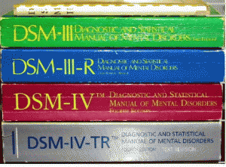
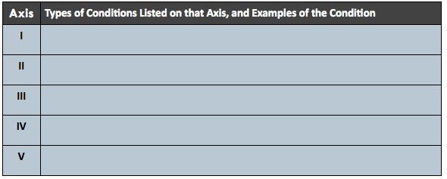
Summarize:
Notes:
Ask students, “What is the purpose of dividing the DMS in to these 5 axes? OR What might happen if there were no axes?”
Image source: http://bdkmsw.umwblogs.org/what-is-autism/autism-in-the-dsm/

Slide 5
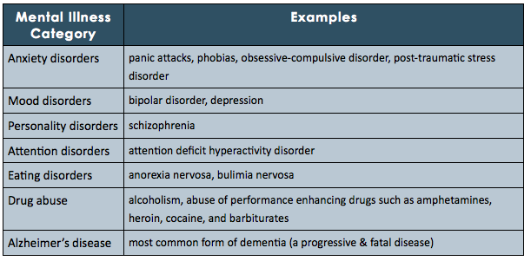
Mental Illness Categories
Notes:
Some major mental illnesses are listed here, but give students an opportunity to add to these lists? They may have to guess which category an illness will fall into, but that is okay because it will give them the opportunity to get comfortable with the categories.
Image source: http://writingcreativenonfiction.wordpress.com/2011/07/09/opinion-essay-mental-illness-is-rampant-in-our-society/

Slide 6
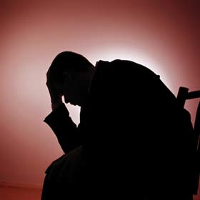
How well do we know mental illness?
Choose one mental illnesses & list symptoms you know (or guess!):
Mental Illness:
Symptoms:
Notes:
Students will most likely have limited lists of symptoms and may be surprised when they see long lists of possible symptoms. This is a great time to reinforce that illnesses (mental and physical) do not affect any two people the exact same way.
Image source: http://www.psych.org/mental-health/more-topics/warning-signs-of-mental-illness

Slide 7
The Difficulty of Diagnosing
With a partner, talk about the following questions:
Do you think your list of symptoms above was accurate?
Do you think everyone who has the mental illness exhibits these symptoms?
Do you think you could accurately diagnose someone with this mental illness given their symptoms?
What makes diagnosing mental illness difficult?
Notes:
For more great background information on this topic, see “Diagnostic Breakthrough for Mental Illness: A new method of MRI interpretation allows for objective diagnosis”
Published on December 8, 2012 by Kristian Marlow in The Superhuman Mind
http://www.psychologytoday.com/blog/the-superhuman-mind/201212/diagnostic-breakthrough-mental-illness

Slide 8
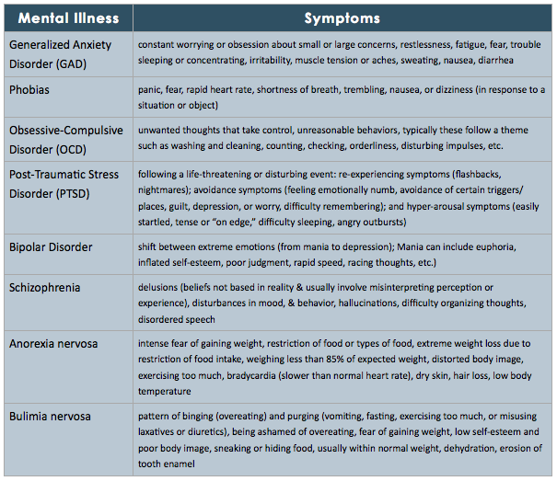
Mental Illness Symptoms
Notes:
If time permits, students can break into pairs to role-play scenarios where a patient has some of these symptoms. This will make learning the symptoms more engaging.
Image source: http://writingcreativenonfiction.wordpress.com/2011/07/09/opinion-essay-mental-illness-is-rampant-in-our-society/

Slide 9
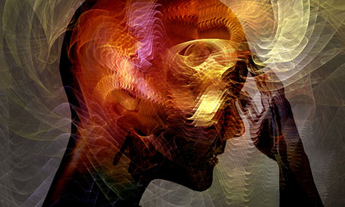
Difficulty of Diagnosis
With a partner, choose one of the mental illnesses above. Review its lists of symptoms, considering which symptoms are easily visible to others and which would be difficult or impossible for another person to detect without disclosure from the person who is mentally ill. Discuss how this impacts the recognition and diagnosis of this mental illness.
Notes:
The idea of mental illnesses being ”silent” or “invisible” is very related to the stigma surrounding mental illness that students learned about in the last lesson. Help them make this connection.
Image Source: http://www.theguardian.com/commentisfree/2012/feb/10/diagnostic-manual-mental-illness

Slide 10
Vignette #1:
A 19-year old female is brought in to the ER by her mother. The chief complaint is a change in behavior and mental state. She recently began college and has lived in a dorm for four months now, but during her visit home for winter break she was uncharacteristically argumentative, talkative, and in a “goofy” mood. She has been treated for depression for the last two years. When questioned, she admits to increased alcohol intake. She also admits that she hasn’t attended classes in a month and has been staying up extremely late blogging. When questioned, she has gotten very defensive and has accused her parents of trying to “overmedicate her” and “ruining her happiness.”
Which mental illness does this patient seem to have?
Notes:
Answer: bipolar disorder
Image source: http://blog.workhealthlife.com/2012/08/bipolar-disorder-an-introduction/

Slide 11
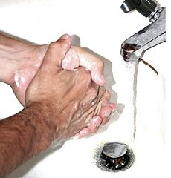
Vignette #2:
A 41-year old male admits to an intense fear of germs at his routine physical exam. He describes fear of touching doorknobs, bathrooms, toilet seats, and public spaces. He is a vigilant hand washer and has red, cracked hands. He recently got divorced because his wife could not understand his impulsive behavior. He estimates he spends several hours per day cleaning and re-cleaning his apartment in addition to constant bathing and washing. He does not admit that this thoughts and behaviors are irrational.
Which mental illness does this patient seem to have?
Notes:
Answer: Obsessive-Compulsive Disorder (OCD)
Image source: http://en.wikipedia.org/wiki/Obsessive%E2%80%93compulsive_disorder

Slide 12
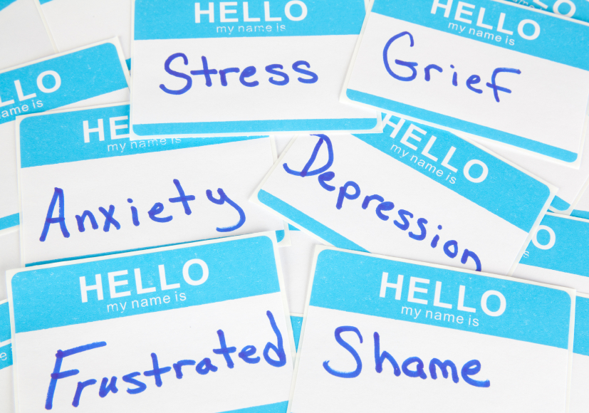
Homework:
Choose any mental illness.
Write a vignette (approx. 1-2 paragraphs) about a patient with that mental illness.
Include all important information and at least three symptoms consistent with that mental illness.
Notes:
The goal of this homework is to give students more practice identifying the symptoms of a mental illness.
Image source: http://msw.usc.edu/mswusc-blog/putting-theory-into-practice-the-heart-of-mental-health-field-work/

