Slide 1
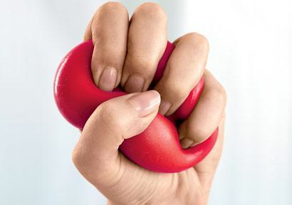
Lesson 1.3: sTRESS
Unit 1: Mental Health
Notes:
Overview: This lesson will introduce student to the causes and effects of stress. To engage and allow for reflection, students will begin by evaluating their own stress and that of their classmates in a way that will also help them solidify simple concepts like independent/dependent variables, taking an average, and looking for patterns or trends. Then students will read background information on what stress is and when it can be good and bad. After being introduced to a framework for thinking about the causes of stress (stressors) and effects or outcomes, students will have an opportunity to generate ideas for things that fit in each category. Finally, students will read scenarios and classify the details as stressors and outcomes.
Image Source: http://www.prevention.com/mind-body/emotional-health/silent-signals-youre-stressed

Slide 2
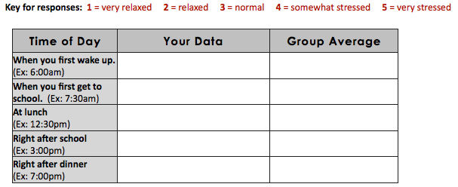
Do Now
How much stress do you feel throughout the day?
Notes:
When students have the opportunity to compile group data to get averages, they can work in small groups or as a whole class based on instructor preference.

Slide 3
Do Now
What are the independent & dependent variables?
What happens to your stress levels throughout the day?
What trend do you notice in the group’s averaged data?
What times of day did the “average” group member have the highest and lowest levels of stress, respectively?
Notes:
Students can answer these individually, with a partner, or in groups, at the instructor’s discretion.
Answers:
IV: time; DV: stress level
Answers will vary; look for students to describe how their stress level increases and/or decreases throughout the day; they also may determine that there is no predictable pattern
Answers will vary
Answers will vary

Slide 4
Discuss
What is YOUR definition of stress?
How does the way you experience stress differ from others?
Notes:
This questions are important for students to think about in order to begin to appreciate the challenges scientists face when measuring variables based on self-reported data and variables that are subjective. If time permits, engaging in a short discussion on how scientists can make a variable like stress as objective as possible will help students grasp this bigger idea. Asking students the pros/cons of measuring stress in two different ways (for example, by asking people how they feel vs. drawing blood and measuring cortisol levels)will help promote thinking about methodology.
Image source: http://mdhomehealth.com/tag/health-and-stress/

Slide 5
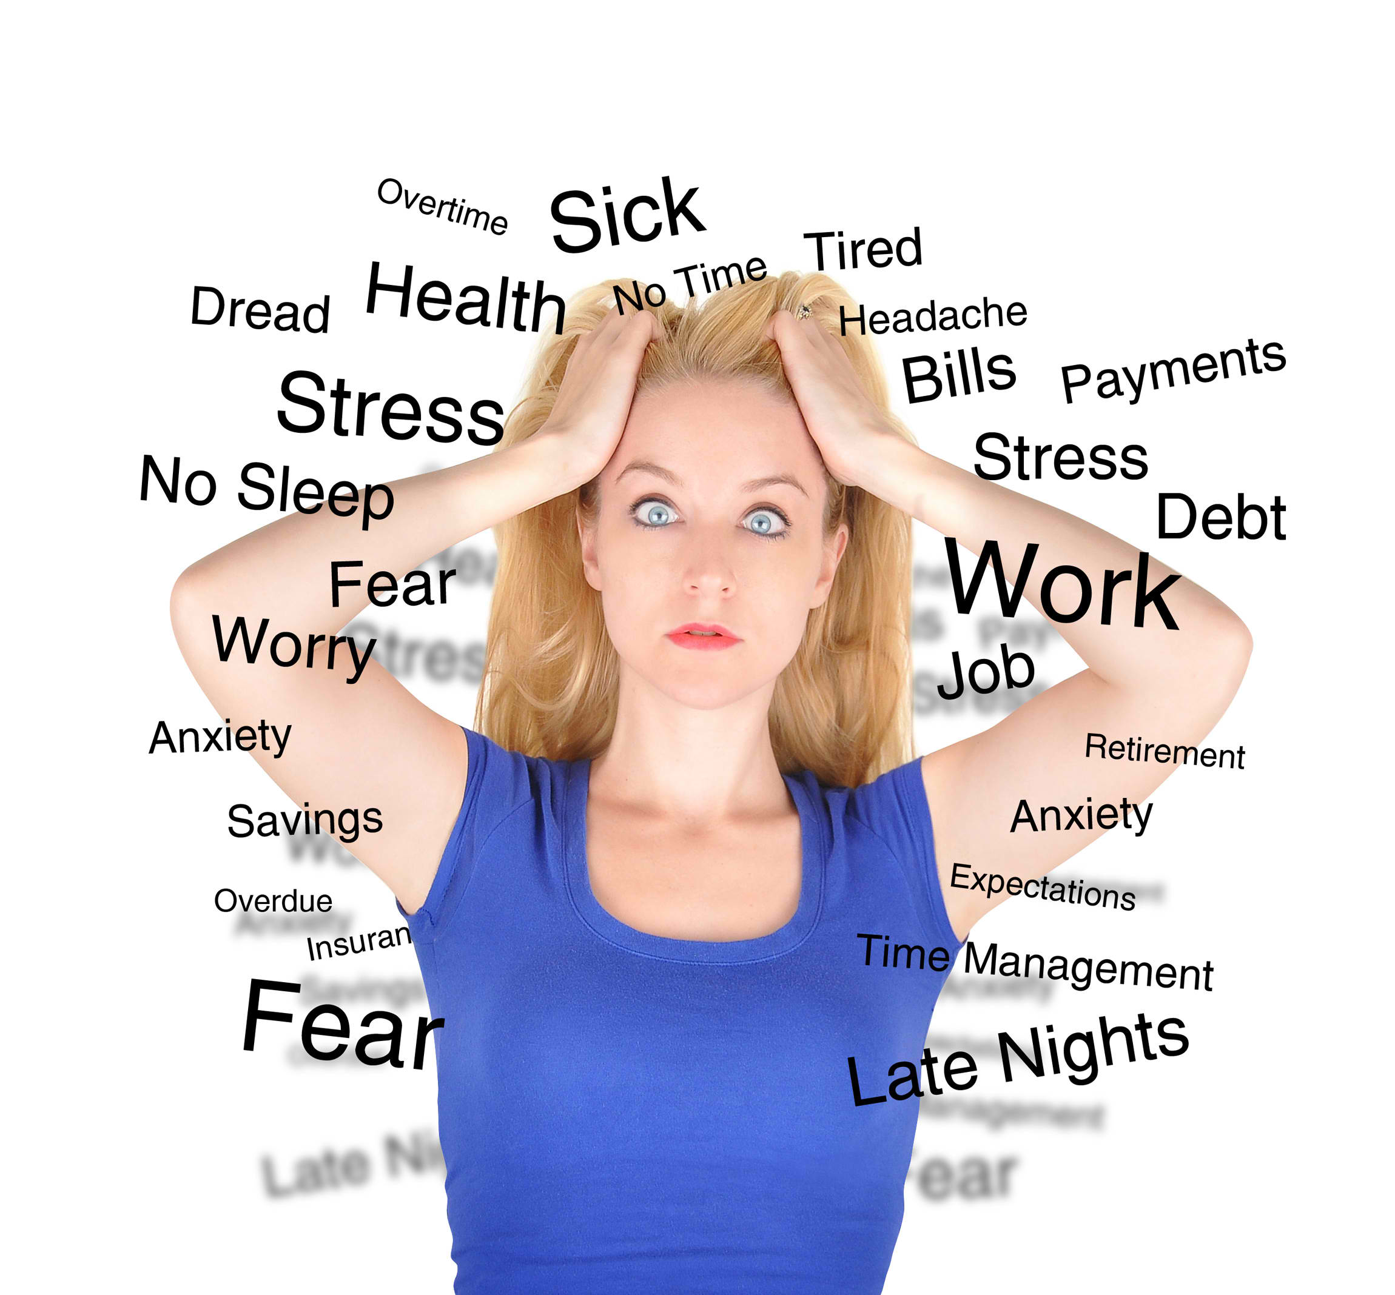
What is STRESS?
Read about stress in your student workbook.
What is stress?
What are the short and long-term effects of stress on the body?
When is stress a good thing? What is it a bad thing?
Notes:
Have students briefly pre-think about these questions before they begin reading. They can read independently, in partners, teams, or whole class, at instructor discretion. The source in the student workbook is basic, but to extend the learning or challenge more advanced students use the supplemental article, ‘Brain Is a Co-Conspirator in a Vicious Stress Loop’
Image Source: http://www.weladwbanat.net/2013/stress-management-dealing-with-the-stress/

Slide 6
What are stressors?
Major life changes | Catastrophes | Everyday problems | Environmental problems
Notes:
Provide 1-2 examples for each of the four stressors to give students a model, then ask students to volunteer responses. They should be able to explain rationale for why their examples fit in the suggested categories of stressors.
Examples:
Major life changes: new job/school/house/town, divorce, marriage, having a child, breaking up with significant other, starting a new relationship, beginning college, death of a loved one, etc.
Catastrophes: natural disasters, violence, domestic abuse, sexual assault, fire, accidents,,etc.
Everyday problems: being late, traffic, dealing with conflict at school/work, excessive workload (homework or on the job), lack of time/over-scheduling, disagreements and arguments, etc.
Environmental problems: unsafe streets, dangerous driving conditions, lack of access to resources (healthy food, healthcare, etc.), unsanitary or toxic surroundings, etc.

Slide 7
Possible outcomes of stress:
Behavioral changes | Changes in thinking | Physical changes | Emotional changes
Notes:
Provide 1-2 examples for each of the four categories of outcomes, in order to give students a model, then ask students to volunteer responses. They should be able to explain rationale for why their examples fit in the suggested categories of outcomes to stress.
Examples:
Behavioral changes: overeat/undereat, violence, rushing/hurrying, isolating oneself, lazy or antisocial behavior
Changes in thinking: self-critical, suspicious, worrying, suicidal thoughts, difficulty concentrating, self-esteem changes
Physical changes: headaches, stomachache, fatigue, heart rate changes, blood pressure changes
Emotional changes: crying, angry, frustrated, irritable, sad, annoyed

Slide 8
Identifying causes & effects of stress
Diane, age 17, is eight months pregnant. She did not plan to become pregnant and no longer has a relationship with the baby’s father. She is at her prenatal doctor appointment when her OB/GYN asks about her preparations for the baby. Immediately, Diane erupts in tears. She explains that she is trying to finish high school while working two jobs part-time to save money for the baby. She has been feeling exhausted, is getting very little sleep, and seems to have lost her appetite. She struggles to focus in classes because she is so tired and her mind cannot stop racing as she thinks about childbirth and becoming a mom. Before she was pregnant, she had dreams of going far away for college, but now she will have to live at home and attend the community college. She is worried about bringing her baby up in the neighborhood where she was raised because of all the violence and gang activity. On top of that, her parents are divorced and her mother is struggling with alcoholism, so she doesn’t even know if the home environment will be safe for her baby. Diane has a lot to think about, so her doctor sets her up with an appointment with a social worker.
Notes:
Have students read twice! The first time, have a student read aloud at a normal pace. The second time, encourage students to re-read it silently and slowly, underlining or marking up examples that they see along the way.

Slide 9
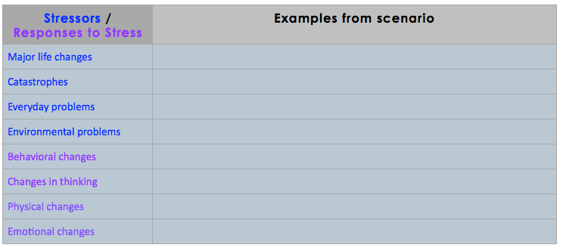
Identifying causes & effects of stress
Notes:
POSSIBLE ANSWERS: (make sure students can provide rationale)
Major life changes: pregnancy, dissolved relationship with boyfriend, parents divorced
Catastrophes: unplanned pregnancy,
Everyday problems: juggling school/jobs/pregnancy, mother struggles with alcoholism,
Environmental problems: lack of resources/money for baby, violence/gang activity in neighborhood
Behavioral changes: gets little sleep, lost appetite (eating less)
Changes in thinking: difficulty focusing in class, mind racing, worry (about childbirth/becoming a mom)
Physical changes: feels exhausted/tired
Emotional changes: crying, disappointment (not heading to college, staying home)

Slide 10
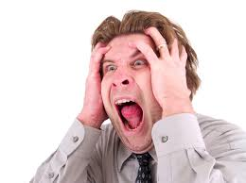
Scenario:
Tim, age 26, cannot seem to get out of bed today. He has a hard time focusing at work, and he hasn’t been eating enough lately. When he started getting mild headaches, he went to the doctor, but the doctor said he was healthy and that the headaches were probably due to stress. Tim started to think about the last few weeks-he just moved to a new city and started a new job. He hasn’t experienced any huge tragedies recently, but he just can’t figure out what’s going on.
Notes:
Use this as one additional practice opportunity AND/OR as a check for understanding (exit ticket).

Slide 11
Check your understanding:
Based on information from the passage, which of the following best describes the factor that contributes the most to Tim’s stress?
Environmental problem
Major life change
Catastrophe
Everyday problem
Notes:
Answer: B-major life change

Slide 12
Check your understanding:
Based on information from the passage, which of the following is an example of a change in thinking that Tim is experiencing as a result of his stress
Tim cannot seem to get out of bed today
Tim has a hard time focusing at work
Tim hasn’t been eating enough lately
Tim started getting mild headaches
Notes:
Answer: B-Tim has a hard time focusing at work

Slide 13
Homework:
Poll your family members (or neighbors, friends, etc.) to find out their average stress levels throughout the day, according to the table in the beginning of this lesson.
You add an extra column and record the new data in that table, or use an additional piece of paper.
When you have polled at least three people, take the average of their responses.
Create a line graph showing how YOUR stress level fluctuations throughout the day compare to the class group average and your family’s average.
Notes:
Optional: Assign each group in the class to poll a different subset of people. For example, one group could poll teachers, another can poll older students (outside the class) or college students, another polls family, and a final student polls younger children/students. Students can make predictions about the patterns/trends in levels of stress they will see with their sub-group. Then take a few minutes at the beginning of the next class to have students re-group to share data and report out any trends or major differences in average stress levels to the class.

