Slide 1
Lesson 1.2: self-concept
Unit 1: Mental Health
Notes:
Overview: This lesson will introduce student to the concepts underlying self-concept in mental health, including self-esteem, self-image, and self-efficacy. The lesson begins with an opportunity for students to reflect on their own self-concept to give them a concrete starting point of reference. After defining the terms, students will read a summary of a recent and relevant scholarly research study related to self-esteem and Facebook use. Finally, students will classify statements according to self-esteem, self-efficacy, or self-image.
Image Source: http://leadershiptherapist.com/2011/02/28/unshattering-the-mirror/

Slide 2
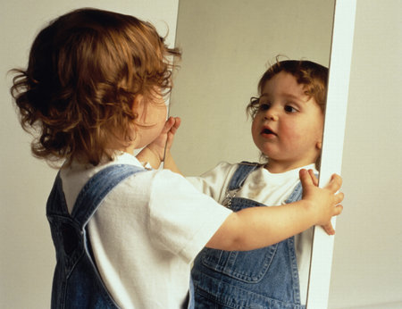
Do Now
Write down 5 words or phrases that describe you or represent who you are
Rank the 5 words or phrases you wrote above by placing the numbers 1 through 5 next to each one. (The number 1 represents the word or phrase that is most important to your identity, while 5 is the least important, relatively).
Did this quick exercise reveal anything interesting or surprising to you?
Notes:
Students may potentially write things that are personal or of sensitive nature, so it’s best to discuss this upfront. It might be best to suggest upfront that students to only write down things they are comfortable sharing.
Image source: http://missmollyl.blogspot.com/

Slide 3
Discuss
With a partner, share your responses.
How is the way you each approached this task similar or different?
Notes:
Since the Do Now prompt was intentionally left open-ended students will likely approach this from many different angles. Some may focus more on physical descriptions of themselves, while others focus on personality or skill such as athleticism or academic performance. Others may have tied in values or beliefs. Having student share responses will help illustrate the variety of concepts that can be a part of one’s self-identify.
One other interesting trend to have students reflect upon is the tendency to report favorable things about themselves. This aligns with the scientifically recognized “social desirability phenomenon.” While a few students may have included negative statements, the majority probably focused on positive or neutral statements.

Slide 4
Review: What is Mental Health?
Mental health (MH): The WHO defines this as “a state of well-being in which an individual realizes his or her own abilities, can cope with the normal stresses of life, can work productively and is able to make a contribution to his or her community.”
Notes:
Review from lesson 1.1 on physical, mental, and social health. If students struggled in the previous lesson, it will be useful to clarify things here.
Image Source: http://oreoj12.tripod.com/id14.html

Slide 5
What is self-concept?
Self-concept = Self-identity
A collection of beliefs about oneself.
Answer to “Who am I?”
Includes:
physical, mental, social, and emotional self
academic performance, gender roles and sexuality, and racial identity, etc.
past, present, and future selves
hopes, goals, standards, fears, and threats
Notes:
Self-concept is the broad umbrella under which self-esteem, self-image, and self-efficacy will be organized. While self-concept does not exclusively deal with these three terms, for the sake of simplifying and clarifying the concepts, the information will be presented hierarchically.
Wikipedia is a helpful resource for more information on all four new terms.

Slide 6
Self-esteem, -image, & -efficacy
Self-esteem
general feelings of one’s worth or value
How do you feel about yourself?
Self-image
Mental picture of oneself
What do you think people think about you?
Self-efficacy
belief in one’s capacity to succeed at tasks
How do you think you will do?
Notes:
For an English-language learner or a struggling reader the differences in these three definitions (or the questions that lead to them) may be subtle. It will be important to distinguish them precisely when they are asked to categorize statements into these labels. By starting with the examples in this section of notes in the student workbook and expanding to have students share other examples, the differences may be understood sooner.

Slide 7
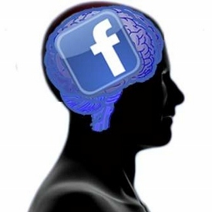
“Facebook Profiles Raise Users' Self-Esteem…”
Read about this recent study on self-esteem:
“A Facebook profile is an ideal version of self, full of photos and posts curated for the eyes of family, friends and acquaintances. A new study shows that this version of self can provide beneficial psychological effects and influence behavior.”
University of Wisconsin-Madison. "Facebook profiles raise users' self-esteem and affect behavior." ScienceDaily, 31 May 2013.
Notes:
Although a full page in length, the entire summary article is included in the student workbook. If needed, the article can be understood by reading excerpts, but that will be left to teacher discretion.
Image source: http://www.pcmag.com/article2/0,2817,2399819,00.asp

Slide 8
After You Read:
How does spending time looking at one’s own Facebook profile impact self-esteem, according to this study?
Do you use social media? If so, how do you feel while spending time on Facebook or other social media websites?
Do you think spending time on Facebook might influence one’s self-image and self-efficacy? Why or why not?
Notes:
The first question is a check for understanding. The second asks them to apply It to their own lives. The third asks them to predict results of a new study given their understanding of both the study and the new vocabulary/concepts.

Slide 9
Self-esteem, Self-image, Self-efficacy, or None?
1. I’ll probably end up repeating freshmen year.
2. I have such a great sense of humor.
3. I can’t stand my hair. It looks so frizzy.
4. I never gossip because I know it makes me a better friend.
5. I am able to make lots of friends this year.
6. My score on the science test was 82%.
7. I love wearing my favorite new tee-shirt—people think I look really great.
8. People are always staring at my pointy nose, I can’t stand it!
9. I won’t make the basketball team, I’m just not that skilled.
10. I have four brothers and two sisters.
Notes:
Answer Key:
1. –efficacy; 2. –esteem; 3. –image; 4. –esteem; 5. –efficacy; 6. –none of the above; 7. –image; 8. –image; 9. –efficacy; 10. –none of the above.

Slide 10
More Practice:
Review your responses from the Do Now.
Categorize each statement you wrote down as Self-esteem, -image, -efficacy, or none of these.
Add a few more statements so you have at least one that represents each term.
Take turns reading your statements to a partner one-by-one.
Have your partner answer with the term (Self-esteem, -image, -efficacy, or none) they believe to be most fitting.
Notes:
Have students partner with a different person than they did earlier (during the Do Now), so they get to know a new person and hear a variety of different statements.

Slide 11
Self-esteem, Self-image, Self-efficacy, or None?
1. I sound great to others when I sing in Music.
2. I’m a great musician with a beautiful voice.
3. I will get an A in music because I work hard.
4. I don’t have any previous music experience.
Notes:
Answer Key:
1. –image; 2. –esteem; 3. –efficacy; 4. –none of the above

Slide 12
Homework:
Write 3-5 statements about yourself that fit each concept below.
SELF-ESTEEM
SELF-IMAGE
SELF-EFFICACY
Write a paragraph reflection analyzing how this went for you. What was easy? What was difficult? What did you learn about yourself?

