Slide 1
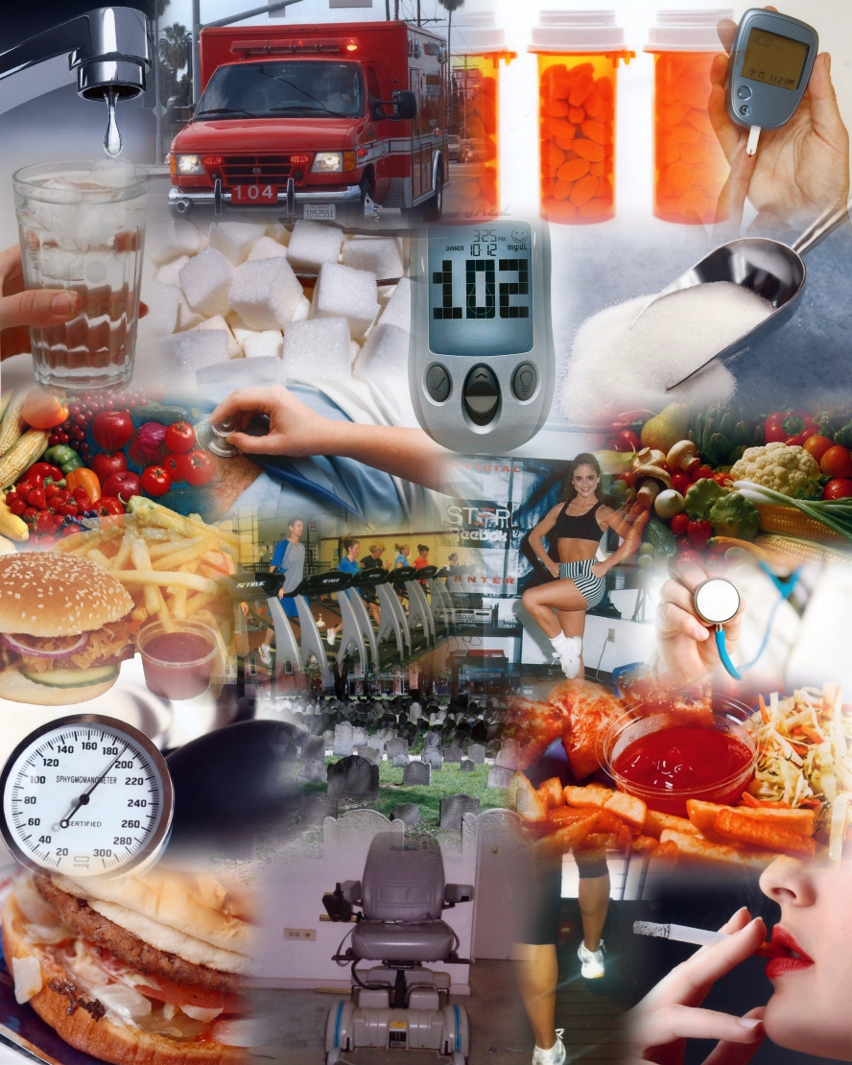
Lesson 1.1: What is Health?
Unit 1: Mental Health
Notes:
Teacher Notes: The first lesson could take 30-45 minutes. It could be paired with other introductory activities such as anticipation guides,
Overview: Students will begin by reflecting on examples of health from their own lives. They will then create a personal definition of health and learn the WHO definition and the 3 components of health. By reading a summary of research on the connection between stress and heart disease, they will begin to appreciate the interconnectedness of the 3 components. Next they will work to identify the three components manifested in the lives of four fictitious characters. Finally, they will return to a reflective state for the homework assignment of creating a recipe for themselves, including the ingredients and directions that contribute to their mental, social, and physical health.
Image Source: http://michelledemersfitnessexpert.blogspot.com/

Slide 2
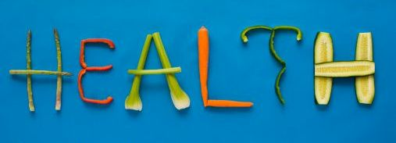
Do Now
Think about the last 24 hours of your life. At what point did you feel most healthy? Why?
In the last 24 hours, when did you feel least healthy? Why?
Jot down your personal definition of the word “health.”
Notes:
Students will likely come up with a variety of different definitions of health and rationale for answers. A common answer for when they felt “most healthy” may be a sports practice, PE class, or some form of exercise. A common “least healthy” time may be when they were playing videogames, watching television, or doing something sedentary. This fits with the physical nature of health that we often think of first. Keep an eye out for students who write answers (they “why” or rationale) related more to mental or social health and have them share with the class to expand the thinking.
Picture source: http://yourchiropracticwellness.com/the-meaning-of-the-word-health-has-been-corrupted/

Slide 3
Discuss
With a partner, share your responses. Then, discuss what the word healthy means to each of you.

Slide 4
Definition of Health
The word health originates from the word hale (Old English) which means “wholeness, being whole, sound or well.”
The World Health Organization (WHO) defines “health” as: “a state of complete physical, mental, and social well-being and not merely the absence of disease or infirmity”
Notes:
When students compare their own definitions of health to the WHO definition, ask them which part (mental, social, or physical) they failed to include. Prompt them to think about why they did not include that component.
Image Source: http://oreoj12.tripod.com/id14.html

Slide 5
Components of Health
Physical health (PH): well-being of the body; absence of illness, injury, or pain. Includes diet, exercise, sleep, safety precautions, etc.
Mental health (MH): having a positive mental outlook that allows one to realize abilities, cope with stress, work productively, & contribute to community
Social health (SH): deals with relationships & interactions
Notes:
A simplified way to think about the three components is:
Physical = body
Mental = mind
Social = relationships

Slide 6
“Mental Stress May Lead to Heart Disease”
Jan. 11, 2006 — Most people believe that stress plays a role in heart disease. A study published in the latest issue of Psychophysiology finds that large rises in blood pressure during mental stress are associated with higher levels of activity in the regions of the brain associated with experiencing negative emotions and generating physiological responses in the rest of the body. The research suggests that exaggerated activity in the cingulate cortex during mental stress may generate excessive rises in blood pressure that may place some individuals at a greater risk for heart disease. Most of what is known about the brain and its links to stress and heart disease has been taken from research on animals. This study on humans used functional magnetic resonance imaging (fMRI ), a non-invasive technique for imaging brain activity. While they were inside an MRI scanner, twenty healthy men and women performed a computer task to create mental stress that, consequently, increased their blood pressure. This allowed the researchers to correlate simultaneous changes in blood pressure and brain activity during stress.
Notes:
Blackwell Publishing Ltd. “Mental Stress May Lead To Heart Disease." ScienceDaily, 11 Jan. 2006. Web. 21 Sep. 2013.

Slide 7
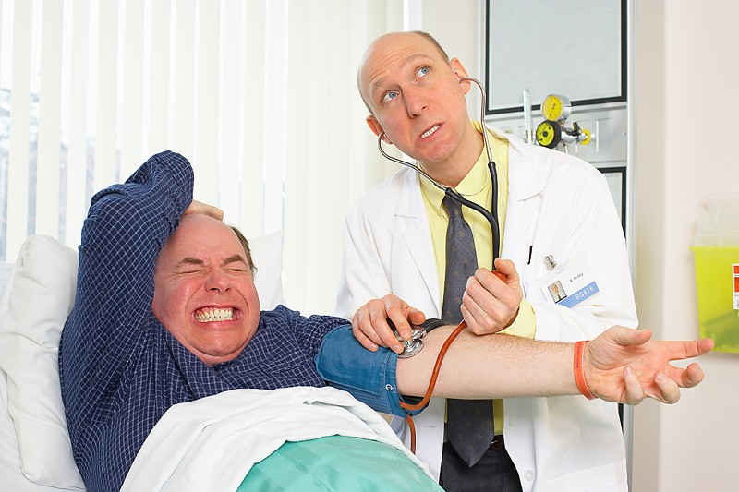
After You Read:
1) What variables of a person’s mental, social, and physical health were involved in this research study?
2) What is the relationship between these variables
3) Besides raising blood pressure, what other effects do you think stress has on our body?
Notes:
Answers:
blood pressure changes, risk for heart disease, stress level, activity in cingulate cortex
As stress level increases, blood pressure rises. Stress level seems to also be associated with more activity in the cingulate cortex. And although not directly studied in this relationship, scientists have already established strong correlations between high blood pressure and increased risk for heart disease.
Stress has many effects. The release of adrenaline (activation of sympathetic nervous system or the “fight or flight” response) can include increased heart and respiration rate, sweating, slowing of digestion and excretion, dilation of pupils, headache or dizziness, etc. Prompting students to think about a time when they were very stressed or nervous (i.e. before a big game or class presentation) might help elicit these responses if they are struggling. Students might also list effects of longer-term (chronic) stress, including impaired immune system, fatigue, stomach/digestive problems, sleep issues, anxiety, depression, etc.
Image source: http://www.businessknowledgesource.com/health/stress_and_high_blood_pressure_029018.html

Slide 8
Scenario 1:
Lorenzo is a fifteen-year-old skateboarder. He has a few very close female friends, but has never had a girlfriend and hopes to develop a romantic relationship soon. He was very close to his grandfather, who recently died after a long battle with cancer. Lorenzo has earned average grades in school this year, but he gets stressed out easily. He talks to the school social worker every few weeks who gives him strategies for managing his stress. Lorenzo also frequently struggles to maintain focus in class. His mother took him for his annual physical a few weeks ago and mentioned this to his physician. He is scheduled to have a full evaluation for Attention Deficit Hyperactivity Disorder in a few days. When Lorenzo was in junior high he experienced a big fluctuation with his weight. He had been overweight since he was 9 years old, but lost a significant amount of weight in his eighth grade year. He attributes his weight loss to a huge growth spurt and positive changes in his eating and exercise habits. Lately, a few of Lorenzo’s skateboarding friends have been starting to smoke marijuana. He hasn’t tried it before, but is starting to feel some peer pressure to give it a try.
Notes:
MH: loss of relative (grief); stressed out; talks to social worker; struggles to focus; evaluation for ADHD
SH: close female friends; no girlfriend; close to deceased grandfather; peer pressure to use marijuana
PH: skateboarding; past weight change; positive changes in eating/exercise
Image Source: http://community.allhiphop.com/discussion/485160/why-are-sports-like-skatebording-surfing-skiing-ice-hockey-swimming-dominated-by-whites

Slide 9
Scenario 2:
Ever since Tyler’s older brother was locked up, he has been forced to step up in the family. He helps out at the family restaurant and takes care of his younger brothers and sisters after school. He is stressed out because all of his friends seem to get most of their work done at school, but he feels like he has hours of homework. He has played basketball his whole life, but doesn’t know if he will have time to play on the school team this year because of these added pressures.
Notes:
MH: older brother in jail (stress); stress due to homework; lack of time SH: step up in family; caretaker for siblings PH: basketball
Image Source: http://www.asianmalerevolutions.com/index.php?/reinvent/v-raising-the-next-generation/

Slide 10
Scenario 3:
In an effort to lose weight, Regina decided to join the school softball team, but she is starting to realize that she is still not getting enough physical activity in her daily life. She is stressed out because everyone else in her family is fit, but she struggles with her weight. Her siblings eat whatever they want and don't seem to put on any weight. Even when she watches what she eats, she can't seem to take off any weight. Lately, she has been spending more and more time in her bedroom and cutting herself off from family and friends. She wonders if she is suffering from depression.
Notes:
MH: stress (over weight); spending time secluded in room; possible depression
SH: spending less time w/ family/friends
PH: softball; trying to lose weight; lack of physical activity; watches food intake
Image source: http://breakingmuscle.com/sports/resistance-training-builds-muscle-and-performance-female-softball-players

Slide 11
Scenario 4:
Katy enjoys walking around her neighborhood because she feels like she knows everyone and everyone knows her. She especially enjoys attending parties. Since she has taken dance classes for several years, she feels very confident dancing and gets many compliments from her friends about her moves. But lately, the parties have been including alcohol and her best friend has been getting out of control after drinking. She is starting to worry about her friend and wonders if she should say something. But she doesn’t want to be a hypocrite because she is thinking about experimenting with alcohol herself. Her friends just seem to be having so much fun with it.
Notes:
MH: confidence in dancing; worry/concern for friend
SH: realtionship w/ community; parties; peer pressure to drink alcohol
PH: walks; dance class
Image source: http://madamenoire.com/39287/are-you-living-or-just-existing/black-woman-dancing/

Slide 12
Homework:
Create a recipe for “YOU” using ingredients and directions that represent different parts of your life and who you are. Be sure to represent each component of your health.

